Slide 1
Domestic and Industrial Machines
Lesson 7

Slide 2
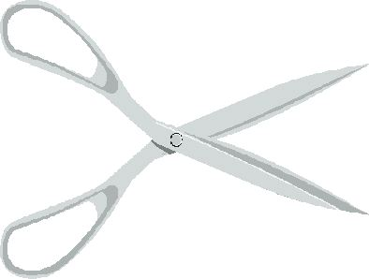
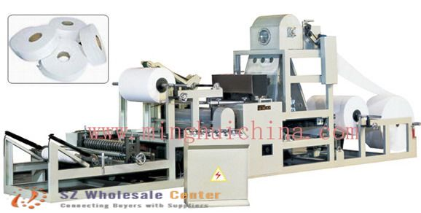
A compound machine is a machine made of two or more simple machines. The complexity can range from being very simple to very complex.

Slide 3
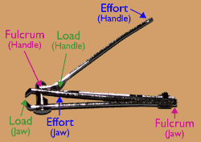
Domestic Machines
A common example of a domestic compound machine is nail clippers. A nail clipper contains two levers. A second class lever and a third class lever. The cutting blades themselves are also simple machines as they are inclined planes.

Slide 4
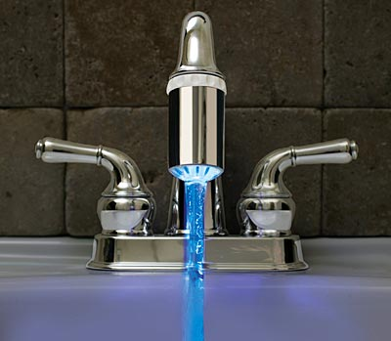
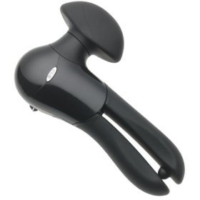
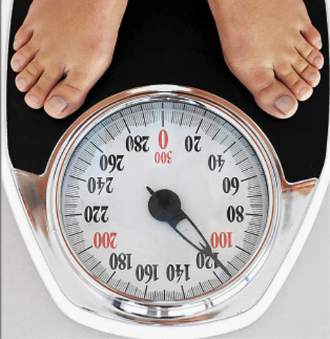
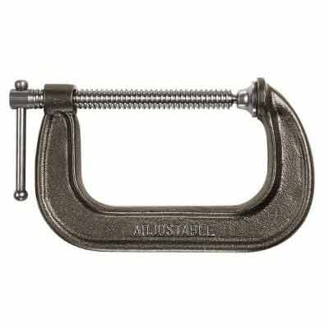
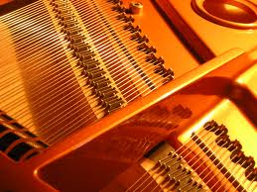
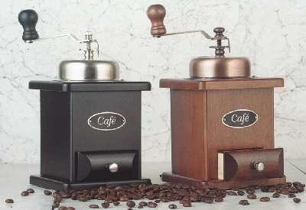
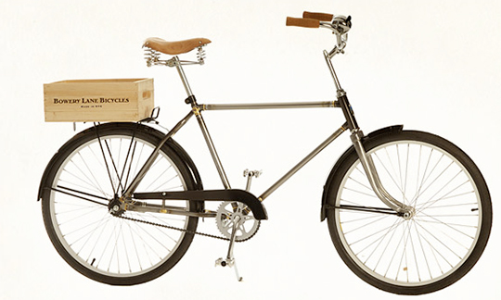
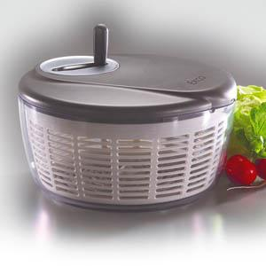
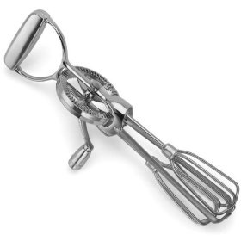
Other common examples found around the house are can openers, faucets, window shades, coffee grinders, pianos, bathroom scales clamps, bicycles, egg beaters and salad spinners.

Slide 5
An egg beater has a wheel and axel for the handle connected to a large gear which is connected to several small gears that cause a second set of axels to rotate the beaters. The beaters move several times faster than the handle and they rotate in a horizontal plane while the handle rotates in a vertical plane

Slide 6
Industrial Machines
Large, compounds machines are used in many industries. A common simple machine used is the pulley, in some cases the more than one pulley will be used to increase the force. Two common pulley designs are the block and tackle and the chain hoist.

Slide 7
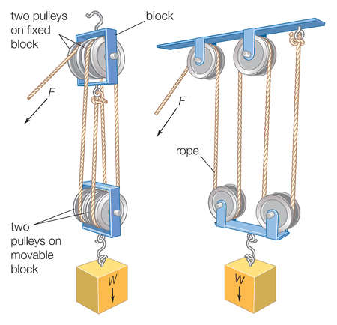
Block and tackle is found on cranes and other heavy machinery. The system has one cable wound around two separate sets of pulleys. The pulley of each set rotates freely on the same axis. The upper set is fixed to a support, and the slower set is attached to the load. Pulling the rope raises the lower set of pulleys, and thus raises the load. The IMA of the block and tackle is equal to the total number of support strands in the rope.

Slide 8
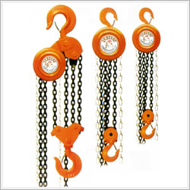
A chain hoist consists of an endless chain looped around three pulleys. The upper two pulleys have teeth and are joined together, while the lower pulley is free to move up and down with the load. The IMA of this machine is the ratio of the radius of the larger fixed pulley to the radius of the smaller fixed pulley. The IMA can also be determined by the number of teeth in the pulleys.

Slide 9
Other chain hoists use a separate pull chain and a triple gear reduction mechanism to maximise the ability to lift heavy loads.

Slide 10
Computer Assignment: Using the computer for research, you will find examples for all of the following questions.
Name at least one machine that applies the principles of :
The lever and the wheel and axel
The pulley and the lever
The pulley and gears
The wheel and the axel and gears
The wedge and wheel and axel
The screw and the wheel and axel

Slide 11
Name at least one industrial machine that applies the principles of:
The lever and the wheel and axel
The pulley and the lever
The pulley and gears
The wheel and the axel and gears.
Choose a compound machine in the kitchen, such as a coffee grinder, a pepper grinder, or a food processor, and describe the simple machines it uses. Draw a sketch to show how the device works.

