Slide 1
Uniform Acceleration
Lesson 6
January 26th, 2011

Slide 2
Acceleration (a)
The rate of change in speed is calculated by the ratio of change in speed (Δv) to the time interval (Δt) during which the change has occurred.

Slide 3
Acceleration Formula Rearranged
Acceleration from rest
Change in Time
Change in speed

Slide 4
If the ratio remains constant throughout the acceleration, than the acceleration is called constant or uniform acceleration.
Uniform Acceleration
The same change in speed (Δv) occurs in equal intervals of time (Δt)
When acceleration varies over a period of time, we generally describe the objects average acceleration.
(a_{av}) is the average rate of change in speed of an object.

Slide 5
Example 1: - Finding average acceleration
A motor cycle speeds up from rest ( 0.0 m/s) to 9.0 m/s in a time of two seconds. What is the acceleration?

Slide 7
Therefore, the average acceleration is 4.5 m/s/s. (read as 4.5 meters per second per second)
This means that you are increasing you speed by 4.5 m/s every second you move.
After one second you are moving at a rate of 4.5 m/s. After 2 sconds; 9.0 m/s and after 3 seconds 13.5 m/s.

Slide 8
To simplify the units from m/s/s we will use 4.5 m/s²
We read this as 4.5 meters per second squared.

Slide 9
Example 2: other units of acceleration can also be used.
A car accelerates from o to 100 km/h in 6.0 seconds. What is the car’s average acceleration?

Slide 11
Therefore, the cars average acceleration is 17 km/h/s. This means that every second the car is traveling 17 m/s faster than it was the previous second.

Slide 12
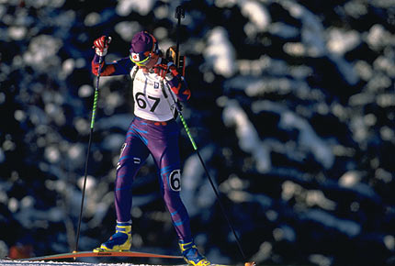
Example 3: Finding Velocity
Olympic skier, Myriam Bedard accelerates at an average of 2.5 m/s² for 1.5 s. What is her change in speed at the end of 1.5 s?

Slide 13
Rearrange

Slide 14
Therefore, Bedard’s change in speed is 3.8 m/s.

Slide 15
Example 4: Finding change in time
A skateboarder rolls down a hill and changes his speed from rest to 1.9 m/s. If the average acceleration down the hill is 0.40 m/s^{s}, for how long was the skateboarder on the hill?

Slide 18
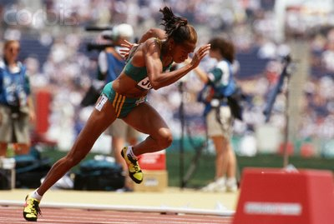
Finding final speed while moving
Another way to think about acceleration is to realize that your final speed is determined by your initial speed plus your change in speed. v₂ = v₁ + Δv
This change in speed Δv is the result of the acceleration and equals a_{av}Δt.
If we sub this into the equation above we can derive the formula.

Slide 19
Finding initial speed while moving
This same idea can then be used to find initial speed. v₁ = v₂ – Δv
This change in speed Δv is the result of the acceleration and equals a_{av}Δt.
If we sub this into the equation we can derive the formula.

Slide 20
Example: 5
A Bravo reaches a final speed of 22.5 m/s after accelerating at 1.2 m/s² for 17 s. What was the initial speed of the snow mobile?
v₂ = 22.5 m/s
a_{av} = 1.2m/s²
Δt = 17 s
v₁ = ?

Slide 21
v₁ = v₂ – a_{av}Δt

Slide 22
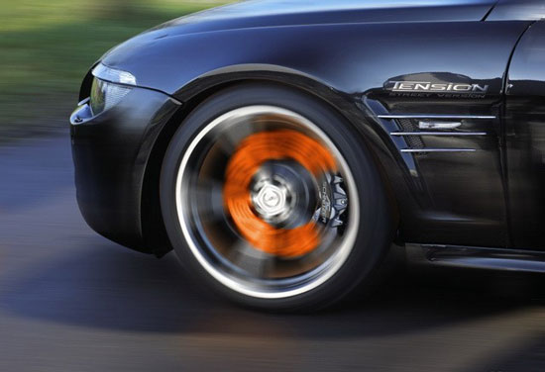
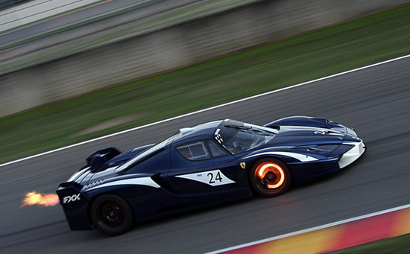
Therefore, the initial speed of the Bravo was 2.1 m/s
Note: If something is decelerating (slowing down), it will have a negative number, as v₁ will be greater than v₂.

Slide 23
Questions:
In uniform or constant speed, the speed is the same during each time interval. In constant acceleration, what is the same in each time interval? C(1)
You and your friend are on bicycles and accelerate from rest. If your average acceleration is double that of your friend, how will your change in speed compare with your friend’s after the same time interval. C (1)
A cyclist increases her speed by 5.0 m/s in a time of 4.5 s. What is her acceleration? T (2) C(1)
A roller coaster accelerates at 8.0 m/s² for 4.0 s. What is the change in speed of the rollercoaster? T (2) C(1)
A downhill skier moving at 2.5m/s accelerates to 20.0 m/s in a time of 3.8 s. T (2) C(2)
Calculate the average acceleration of the skier.
What does the acceleration mean?
You are coasting on your skateboard at 1.4 m/s and you decide to speed up. If you accelerate at 0.50 m/s² for 7.0 s, what is your final speed? T (2) C(1)
An octopus can accelerate rapidly by squirting a stream of water for propulsion. An octopus moving at 0.10 m/s accelerates at 5.5 m/s² to a final speed of 3.5 m/s. What is the elapsed time during the acceleration? T (2) C(1)

