Slide 1
Determining Average Speed Lab
Lesson 5
January

Slide 2
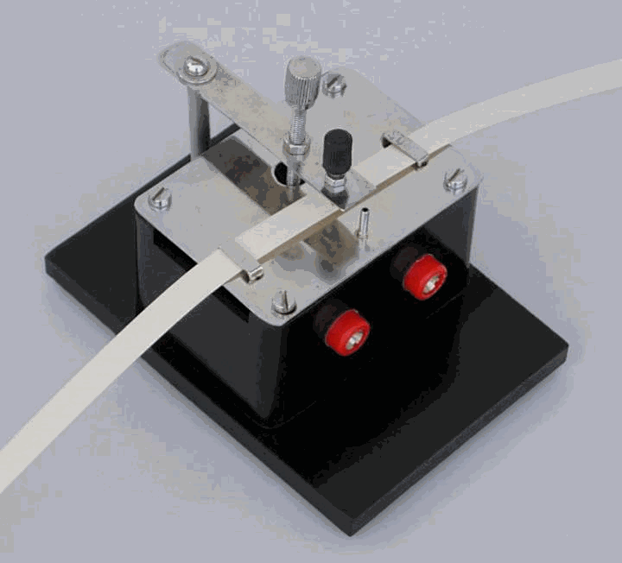
A ticker tape is the most commonly used technology for objects moving in a straight line. As the object attached to the end of the paper moves, it pulls the tape through the timer. As the tape moves through the timer, dots are recorded at consistent time intervals.

Slide 3
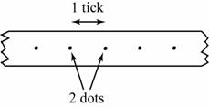
A ticker-timer consists of an electrical vibrator which vibrates 50 times per second.
This enables it to make 50 dots per second on a ticker-tape being pulled through it.
The time interval between two adjacent dots on the ticker-tape is called one tick.
One tick is equal to 1/50 s or 0.02 s.

Slide 4
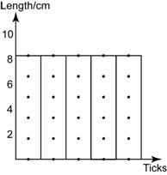
Uniform speed
The distance of the dots is equally distributed.
All lengths of tape in the chart are of equal length.
The object is moving at a uniform velocity.

Slide 5
Question:
What is the average speed of the object in motion?

Slide 6
Design
Attach a cart to the ticker tape and let it run down a smooth, slightly inclined ramp at a constant speed. Calculate the slope of the graph of distance versus time to determine the average speed of the cart.
Controlled variables : Cart, ramp
Independent variable: Time elapsed
Dependent variable: Total distance traveled

Slide 7
Prepare a table similar to that seen below.
Dot | Total Time (ms) | Total distance (mm)
1 | 0 | 0
2
3

Slide 8
Conduct the lab
Answer the questions and hand the lab in.

