Slide 1
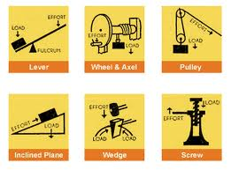
Simple Machines
Lesson 3
Unit 2

Slide 2
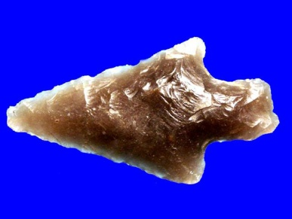
Simple Machines
Machines created thousands of years ago and even the machines used today are still based on basic machines. Tools such as arrows (wedges) and ramps (inclined plane) are examples of simple machines.

Slide 3
A Machine is a device that helps perform tasks. It is designed to achieve at least 1 of the 5 main functions:

Slide 4
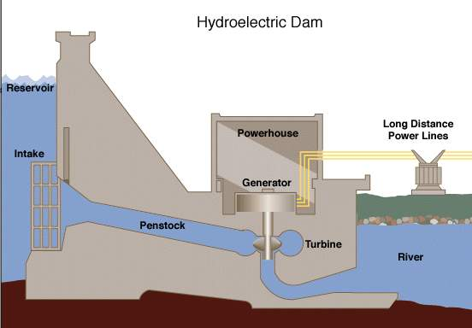
1. Change energy from one form into another.
Example: hydroelectric – converts the energy of falling water into electrical energy.

Slide 5
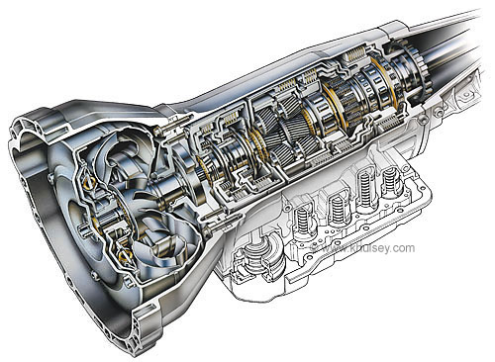
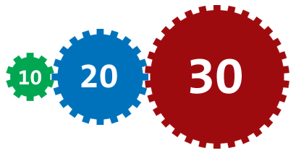
2. Transfer forces
Car transmission – transfers the force from the motor to the wheels

Slide 6
3. Change the direction of the force
Flag pole – pull down on the rope to raise the flag by a pulley system.

Slide 7
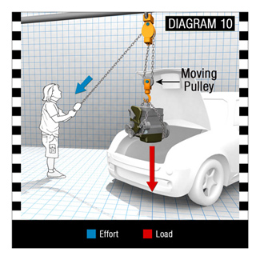
4. Change the magnitude of a force
Pulley system – a chain hoist can be used to help a mechanic raise an engine

Slide 8
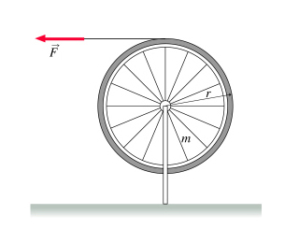
5. Change the distance or speed
The outer circumference of a wheel moves farther and faster than the inner sprocket on the hub.

Slide 9
Simple machines can be split into two groups.
The lever family
Levers, pulleys, wheel and axel, and gears
The inclined family
Inclined plane, the wedge, and the screw.

Slide 10
The Lever Family of Machines
A lever is a ridge bar that can rotate freely around a support called a fulcrum.
An effort force, F_{E}, is a force applied to one part of a lever to move a load at another part; the load exerts a load force, F_{L}.
d_{L}

Slide 11
The Lever Family of Machines

Slide 12
The Lever Family of Machines
There are two other variables measured on levers: the perpendicular distance from the fulcrum to the effort force, the effort arm, symbol d_{E}, and the perpendicular distance from the fulcrum to the load force, the load arm, symbol d_{L}.
d_{L}

Slide 13
Levers are divided into three classes, depending on the position of the load, effort force, and the fulcrum.

Slide 14
First Class Lever
The fulcrum is between the load and the effort force.

Slide 15
Second Class Lever
The load is between the fulcrum and the effort force.

Slide 16
Third Class Lever
The effort force is exerted between the fulcrum and the load.

Slide 17
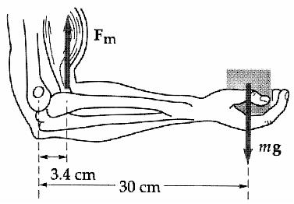
Biomechanical System
- A system of a living body.

Slide 18
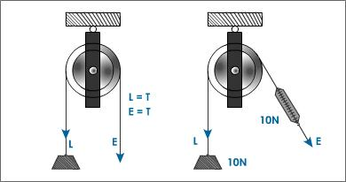
A pulley is a wheel with a grooved part of the lever family of machines. The wheel rotates around a central fulcrum

Slide 19
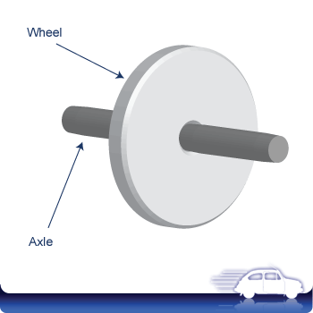
A wheel and axel is a large diameter, rigid, circular disk (the wheel) connected to a small diameter, ridged rod (the axel).

Slide 20
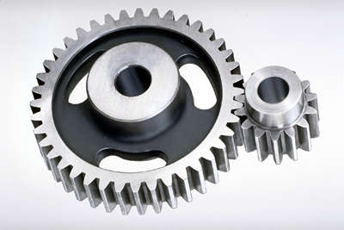
Gears are toothed wheels of different diameters linked together to increase the decrease the speed or to change direction.

Slide 21
Inclined Plane Family of Machines

Slide 22
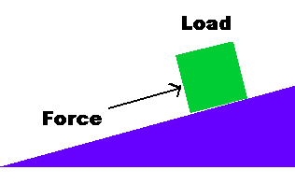
Inclined Plane Family of Machines
Inclined Plane – A ramp that increases the load that can be raised by an effort force.

Slide 23
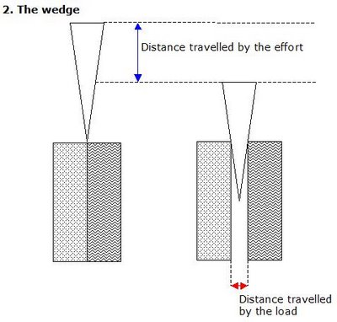
Wedge – A double inclined plane that increases the applied or effort force.

Slide 24
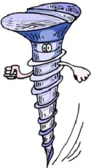
Screw- An inclined plane wrapped around a central shaft that can turn

Slide 25
Questions – hand in
State which simple machine forms the basis of each of the following: K (8)
A doorstop, with the pointed end placed between the floor and the bottom of the door.
An escalator
A mountain highway with twisting switchbacks
A hand held pencil sharpener.
A water slide
A triple beam balance
A letter opener
A screw cap on a water bottle.

Slide 26
Explain why a wheel and axel system is considered a member of the lever family C (1)
Explain why a screw is considered a member of the inclined family. C (1)
For a wheel and axel system, on which part would you apply the effort force in order to:
Increase the force A (1)
Increase the distance or speed. A (1)
When an axe is used as a wedge to split a log, how does the direction of the load force compare to the direction of the effort force? C (1)
Axes used to split logs are heavier than axes used to chop down trees. Explain why. A (1)
Cut a sheet of paper diagonally in half to create two right angled triangles. Wrap one of the triangles around a pencil in a way that illustrates one type of simple machine. Explain which machine and it is and explain why. A (2)

