Slide 1
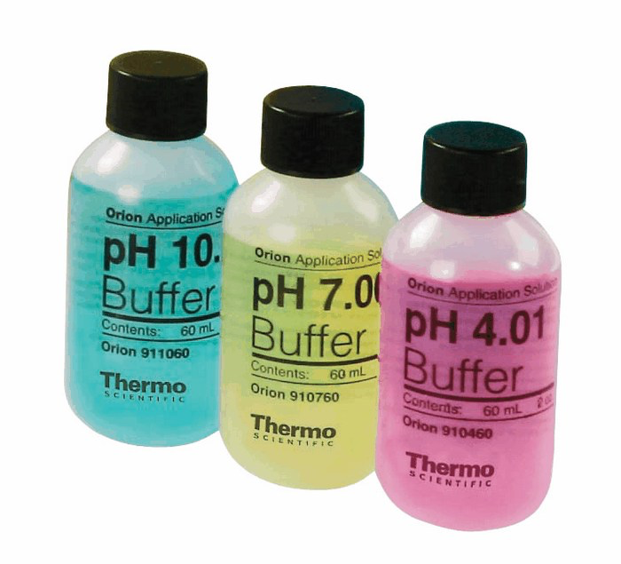
SCH4U: Acids and Bases
BUFFER SOLUTIONS

Slide 2
Common Ion Effect
Adding a common ion to an equilibrium system will shift the equilibrium forward or reverse.
For a weak acid equilibrium this can affect the pH of the solution!
For example: Adding NaF to a solution of HF.
HF H⁺ + F⁻
Adding F- ions will shift the equilibrium to reactants and produce more HF and reduce [H+] ions in the process. Remember, NaF is a salt and ionizes completely in solution.
This makes the pH increase.

Slide 3
The Common Ion Effect
Consider a solution that contains a weak acid, such as Acetic Acid (CH₃COOH), and a soluble salt of that acid, such as Sodium Acetate (CH₃COONa).
Both components of the solution contain a common ion in this case – CH₃COO⁻.

Slide 4
Common Ion Effect
Sodium Acetate (CH₃COONa) is a soluble ionic compound, and is a strong electrolyte. Consequently it dissociates completely in aqueous solution: CH₃COONa (aq) → Na⁺ (aq) + CH₃COO⁻ (aq)
Acetic Acid (CH₃COOH) is a weak electrolyte and partially ionizes. CH₃COOH(aq) ←→ H⁺ (Aq) + CH₃COO⁻ (aq)
Using Le Chataliers Principle, what do we predict happens to the K_{a} CH₃COOH?

Slide 5
Common Ion Effect
According to Le Chatalier’s Principle, CH₃COO⁻ from CH₃COONa causes the equilibrium to shift to the left , thereby decreasing the equilibrium concentrations of H+. This would increase the pH of the solution
CH₃COOH(aq) ←→ H⁺ (Aq) + CH₃COO⁻ (aq)
Whenever a weak electrolyte and a strong electrolyte contain a common ion, the weak electrolyte ionizes less than it would it if were alone in the solution.

Slide 6
Calculating pH when a Common Ion is Involved
What is the pH of a solution made by adding 0.30 mol of acetic acid,CH₃COOH, and 0.30 mol of sodium acetate,CH₃COONa to enough water, to make a 1.0L solution?
This solution contains a weak electrolyte, and a strong electrolyte that share a common ion, CH₃COO⁻

Slide 7
Solution:
CH₃COOH (aq) ←→H⁺ (aq) + CH₃COO⁻ (aq)
Initial | 0.30 | 0 | 0.30
Change | - x | + x | + x
Equilibrium | 0.30 – x | x | 0.30 + x
K_{a}= 1.8 x 10 ⁻⁵ = [H+][CH₃COO⁻]= (x)(0.30 + x) = x(0.30)
[CH₃COOH] (0.30 – x) (0.30) x = 1.8 x 10-4 M = [H⁺] pH= - log( 1.8 x 10-4) = 4.74
From the dissociation of CH₃COONa

Slide 8
Buffered Solutions
Solutions which contain a weak conjugate acid-base pair, can resist drastic changes to pH upon the addition of strong acids or base. These solutions are called buffered solutions.
A buffer resists changes to pH because it contains both an acid to neutralize OH⁻ ions, and a base to neutralize H⁺ ions.
The acid and base cannot consume each other during the reaction.

Slide 9
Explaining a Buffer Solution
Ex: acetic acid + sodium acetate = buffer
[CH₃COOH] and [CH₃COO⁻] are both high
adding acid or base has little effect because the added H₃O⁺ or OH⁻ ions are removed by one of the components in the buffer solution
Acetic acid consumes any added hydroxide ion
CH₃COOH(aq) + OH⁻(aq) ←→ CH₃COO⁻(aq) + H₂O(l)
Acetate ion consumes any added hydronium ion
H₃O⁺(aq) + CH₃COO⁻(aq) ←→ H₂O(l) + CH₃COOH(aq)
equilibrium shifts as predicted by Le Chatelier’s principle
http://www.mhhe.com/physsci/chemistry/essentialchemistry/flash/buffer12.swf

Slide 10
Examples of Buffer Solutions
Buffers are often prepared by mixing a weak acid or a weak base, with a salt of that acid or base.
CH₃COOH and CH₃COO⁻ (acidic buffer) (Weak Acid) Salt such as CH₃COONa
NH₃ and NH₄⁺ (basic buffer) Salt such as NH₄Cl
Acid or Base | Salt
Acetic acid | Sodium acetate
Phosphoric acid | Potassium phosphate
Oxalic acid | Lithium oxalate
Carbonic acid | Sodium carbonate
Ammonium hydroxide | Ammonium nitrate
There are two ways to make buffered solutions !

Slide 11
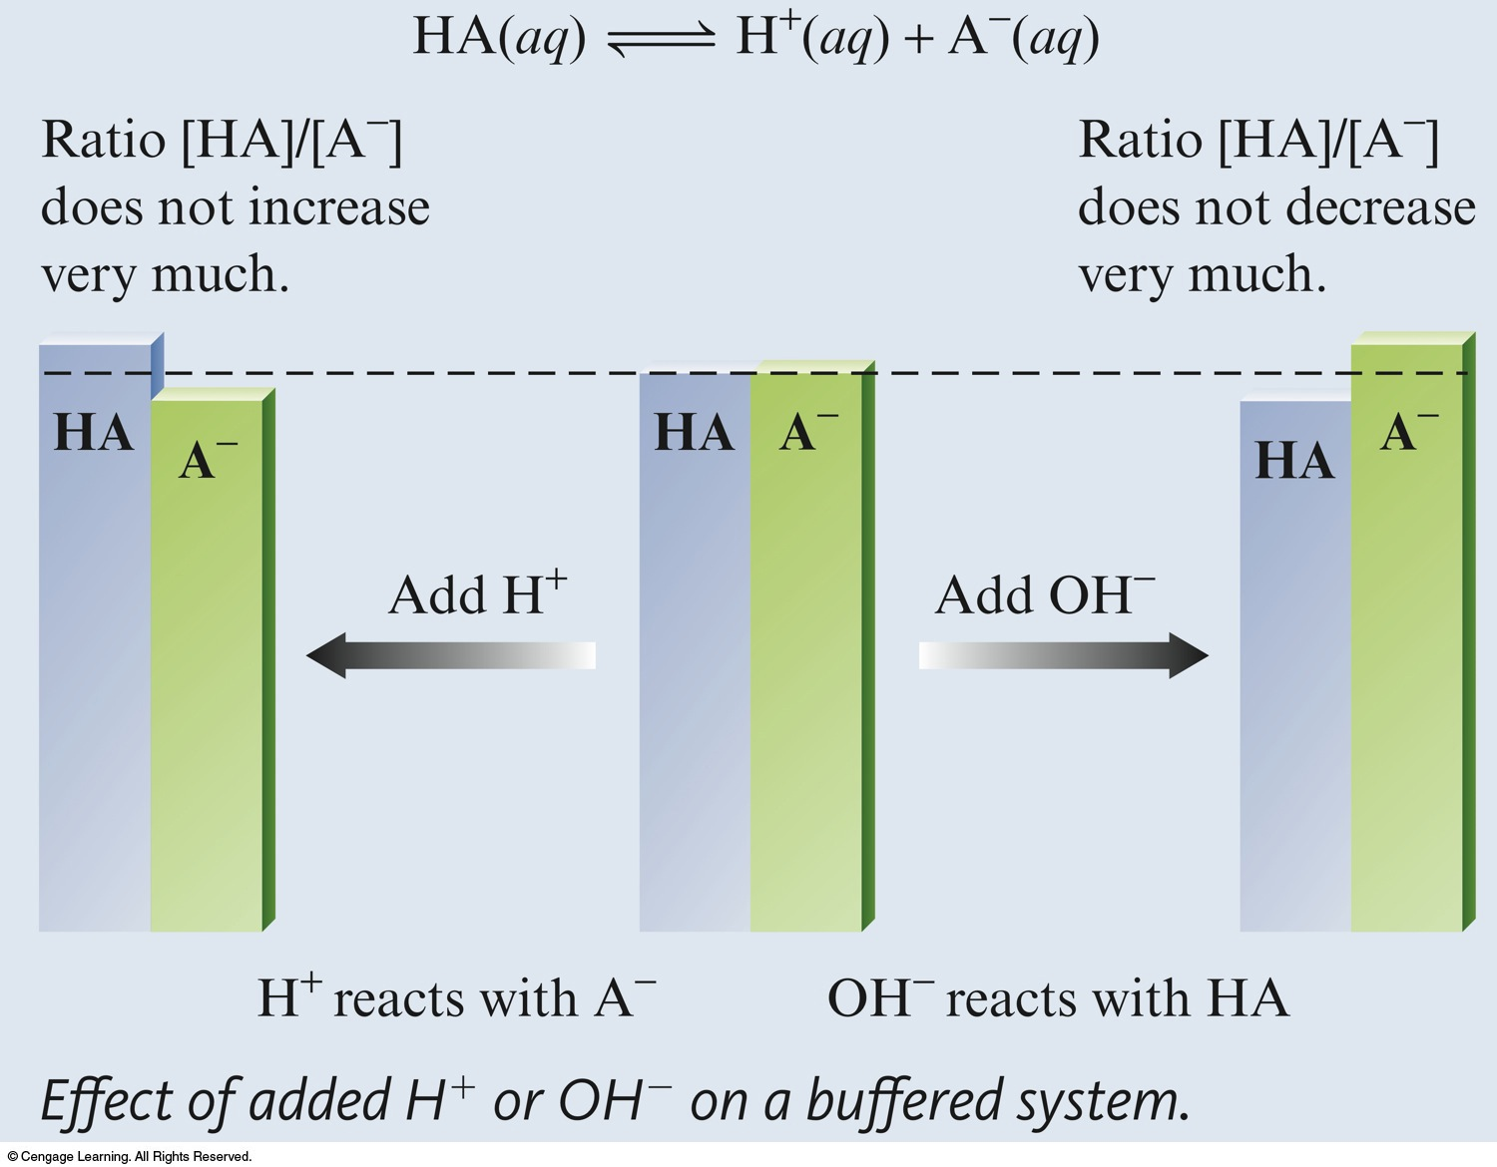

Slide 12
Trivia Time !
Which of the following conjugate acid-base pairs will not function as a buffer. Explain Why! a) C₂H₅COOH and C₂H₅COO⁻ b) HCO₃⁻ and CO₃ ²⁻ c) HNO₃ and NO₃⁻
Notes:
The answer is C) because Nitric Acid is a strong acid and dissociates 100%

Slide 13
1. Calculating the pH of a buffer
What is the pH of a buffer that is 0.12 M in lactic acid [CH₃CH(OH)COOH, or HC₃H₅O₃] and 0.10 M in sodium lactate [CH₃CH(OH)COONa or NaC₃H₅O₃]? For lactic acid, K_{a} = 1.4 × 10^{–4}.

Slide 14
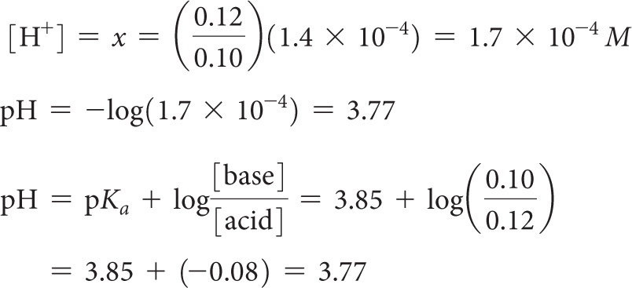
Calculating the pH of a buffer
Alternatively, we can use the Henderson–Hasselbalch equation with the initial concentrations of acid and base to calculate pH directly: ** AP**

Slide 15
Henderson-Hasselbach Equation
AP
Derived from the equilibrium expression of a weak acid and the pH equation.
This equation allows you to determine the pH of a buffer solution
*** pKa = -log Ka
[A-]
[HA]
pH = pKa + log

Slide 16
Henderson-Hasselbach Equation
AP
Example: Determine the pH in which 1.00 mole of H₂CO₃ (Ka = 4.2 x 10⁻⁷) and 1.00 mole NaHCO₃ dissolved in enough water to form 1.00 Liters of solution.
[A-]
[HA]
pH = pKa + log

Slide 17
Henderson-Hasselbach Equation
AP
Example: Determine the pH in which 1.00 mole of H₂CO₃ (Ka = 4.2 x 10⁻⁷) and 1.00 mole NaHCO₃ dissolved in enough water to form 1.00 Liters of solution.
[A-]
[HA]
pH = pKa + log
pH = -log (4.2 x 10⁻⁷) + log (1.00M)/(1.00M)
pH = pKa = 6.4

Slide 18
2. Make a buffer problem
AP
How many moles of NaHCO₃ should be added to 1 liter of 0.100M H₂CO₃ (Ka = 4.2 x 10⁻⁷ ) to prepare a buffer with a pH of 7.00?

Slide 19
2. Make a buffer problem
AP
How many moles of NaHCO₃ should be added to 1 liter of 0.100M H₂CO₃ (Ka = 4.2 x 10⁻⁷ ) to prepare a buffer with a pH of 7.00?
[HCO₃-]
[H₂CO₃]
pH = pKa + log
7.00 = -log(4.2 x 10⁻⁷) + log [HCO₃-]
(0.100)
0.60 = log[HCO₃-]
0.001
[HCO₃-] = 0.40 moles should be added!
10^{0.6} = [HCO₃-]
0.100

Slide 20
3. The pH shift problem:
AP
If you add 2.00 mL of 0.100 M HCl to 100 mL of a buffer consisting of 0.100 M HA and 0.200 M NaA, what will be the change in pH?
Ka of HA is 1.5x10⁻⁵. pKa = 4.82 Step 1: Find the initial pH of the buffer. Step 2:

Slide 21
3. The pH shift problem:
AP
If you add 2.00 mL of 0.100 M HCl to 100 mL of a buffer consisting of 0.100 M HA and 0.200 M NaA, what will be the change in pH?
Ka of HA is 1.5x10⁻⁵. pKa = 4.82.
The initial pH is:

Slide 22
AP
If we add H+ to the equilibrium system it will react with the strong conjugate base ‘A⁻, to form more HA.
H⁺ + A⁻ → HA
Set up an ICE chart to determine how the mole values will change using stoichiometry!
 | HA ←→ | H+ | A-
I | n= 0.01 mol | 2.0 x 10 -4 mol | 0.02 mol
C | + 2x10⁻⁴ |  | -2x10⁻⁴
E | n= 0.0102 mol |  | n= 0.0198 mol
 | C= 0.0102 / 0.102 L |  | C= 0.0198mol/0.102 L

Slide 23
Buffer Capacity
AP
Buffer Capacity: the amount of acid or base the buffer can neutralize before the pH begins to change to an appreciable degree.
This depends on the amounts of acid and base the buffer is made of.
Most efficient buffer is when:
[A-] [HA]
= 1

Slide 24
pH Range
AP
pH Range: the range in pH over which the buffer acts effectively.
Buffers most effectively resist a change in pH in either direction when the concentrations of weak acids and weak bases are approximately the same.
When the concentration of acids and bases are equal, pH= pKa…. This is the optimal pH of any buffer.
If the concentration of one component is 10x more than the concentration of the other component, the buffering action is poor.
Buffers usually have a usable range within +/- 1 pH unit of pKa (The range is pH= pKa +/- 1)

Slide 25
Homework
AP Class: Read 17.1, 17.2
Qs :13-31 (odd questions only)
SCH4U: See Supplementary Package With Practice Qs

