Slide 1
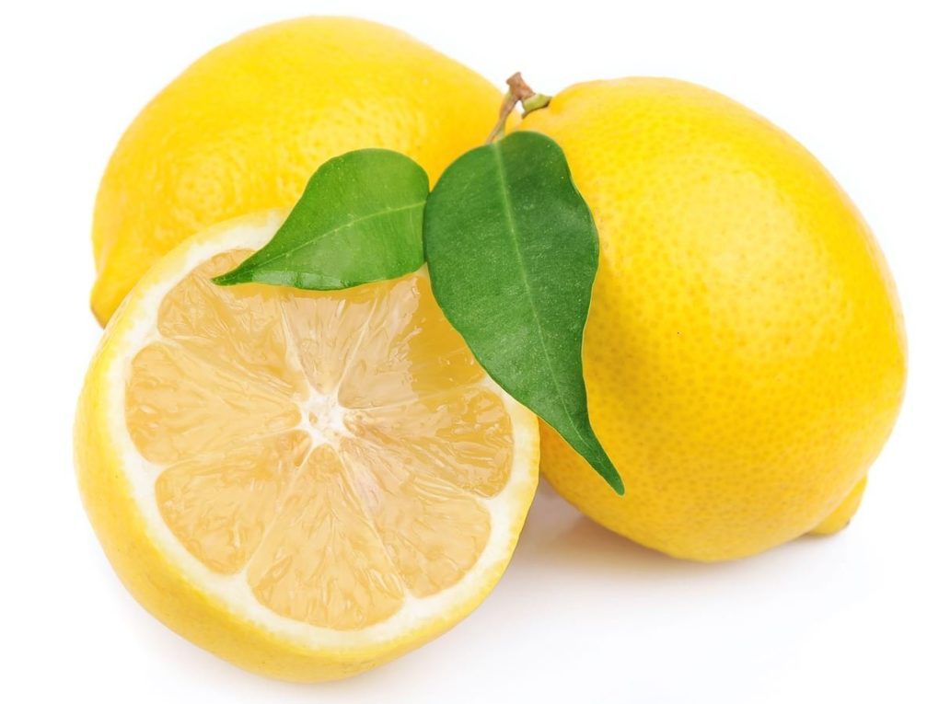
Acid-Base Equilibria
PART 2:
WEAK A & B
EQUILIBRIA

Slide 2
Weak Acids
HA_{(aq)} + H₂O_{(l)} ←→ H₃O⁺_{(aq)} + A⁻_{(aq)}
Or
HA_{(aq)} ←→ H⁺_{(aq)} + A⁻_{(aq)}
_{*** HA represents a WEAK ACID}
K_{c}= [H₃O⁺][A⁻] = [H⁺][A⁻] = K_{a}
[HA] [HA]
Acid-Dissociation Constant, K_{a}: equilibrium constant for the ionization of an acid.

Slide 3
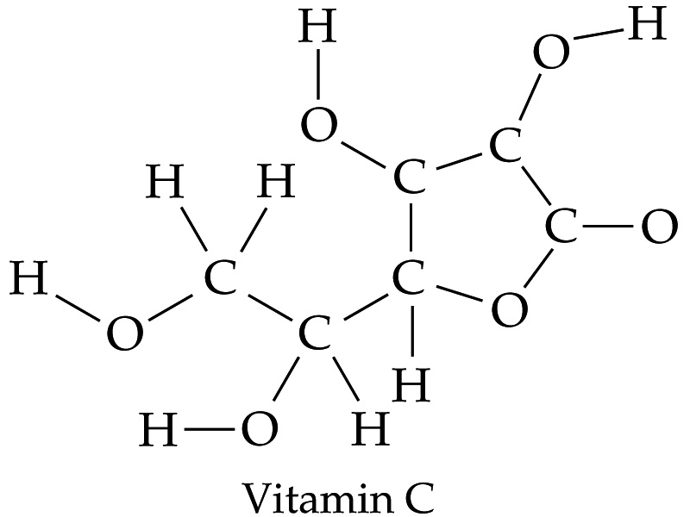
Weak Acids
Most weak acids contain H,C,O.
Hydrogen atoms bonded to carbon do not ionize in water.
The larger the value of K_{a}, the stronger the acid.

Slide 4
Calculating K_{a} from pH
A student prepared a 0.10 M solution of formic acid (HCOOH), and measured its pH to be 2.38 at 25°C. Calculate K_{a.}
Plan
1. Convert pH → [H₃O⁺]
2. Create an ICE chart and determine eqb’m concentrations
3. Solve for K_{a}
Please try problem before going to next slide!

Slide 5
Solution
1. Convert pH → [H₃O⁺]
pH= -log[H⁺] = 2.38
log[H⁺]= -2.38
[H⁺] = 10^{-2.38} = 4.2 x 10⁻³ M
2. Create an ICE chart and determine eqb’m concentrations
 | HCOOH (aq) ←→ | H⁺ | HCOO⁻
Initial | 0.10 | 0 | 0
Change | - 4.2 x 10⁻³ | + 4.2 x 10⁻³ | + 4.2 x 10⁻³
Equilibrium | (0.10 - 4.2 x10⁻³)= ~ 0.10 | 4.2 x 10⁻³ | 4.2 x 10⁻³
3. Solve for K_{a}
K_{a}= (4.2 x 10⁻³)(4.2 x 10⁻³) = 1.8 x 10⁻⁴
0.10
Notes:
Note that we have neglected the small concentration of H+ ions that is due to the autoionization of water. Only 2 in every 10⁹ molecules undergo this.
Also note that the number of HCOOH molecuels that ionize is very tiny.

Slide 6
Percent Ionization
Another measure for the strength of an acid. The stronger the acid, the greater the percent ionization.
Percent Ionization= concentration ionized x 100%
original concentration
Also written as
Percent Ionization= [H⁺] _{equilibrium} x 100%
[HA]_{initial}

Slide 7
Example
If a 0.035 M solution of HNO₂ contains 3.7 x 10⁻³ M H⁺_{(aq),}
The percentage ionization is:
Percent Ionization= [H⁺] _{equilibrium} x 100%
[HA]_{initial}
Percent Ionization= 3.7 x 10⁻³ x 100% = 11%
0.035

Slide 8
Using K_{a} to Calculate pH
Knowing the value of K_{a} and initial concentrations, we can calculate the concentration of H⁺_{(aq)} in a solution of weak acid. This will involve the use of a ICE chart, which you have already learned how to create and use.
Let’s see an example.

Slide 9
Example #1
Lets calculate the pH of a 0.30 M solution of acetic acid, CH₃COOH, the weak acid responsible for the characteristic odor and acidity of vinegar, at 25 °C.
K_{a} is 1.8 x 10⁻⁵.
Step 1: Write the ionization equilibrium
CH₃COOH_{(aq)} ←→ H⁺_{(aq)} + CH₃COO⁻ _{(aq)}
Step 2: Write the equilibrium-constant expression.
K_{a}= [H⁺][CH₃COO⁻] = 1.8 x 10⁻⁵.
[CH₃COOH]

Slide 10
Example # 1 Cont’d
Step 3: Create Ice Chart
Step 4: Solve for ‘x’
 | CH₃COOH _{(aq)} ←→ | H⁺ _{(aq)} | CH₃COO⁻ _{(aq)}
Initial | 0.30 | 0 | 0
Change | - x | + x | + x
Equilibrium | 0.30 – x | + x | + x
K_{a}= [H⁺][CH₃COO⁻] = (x)(x) = 1.8 x 10⁻⁵
[CH₃COOH] 0.30-x

Slide 11
Solution Continued
K_{a}= [H⁺][CH₃COO⁻] = (x)(x) = 1.8 x 10⁻⁵
[CH₃COOH] 0.30-x
x² + 1.8x10⁻⁵ x – 5.4x10⁻⁶ = 0
Using the quadratic formula:
x₁ = 2.32 x 10⁻³
x₂ = - 2.33 x 10^{-3 →} this answer is not possible
Therefore, [H⁺] = 2.32 x 10⁻³ M. Now you can use this value to solve for the pH of the solution.
pH=-log[H⁺]
pH= - log [2.32 x 10⁻³]
pH= 2.64

Slide 12
Calculations with Polyprotic Acids
Many acids have more than one ionizable H atom. Each ionization has a unique K_{a} value. A acid with two ionizable hydrogen's would have K_{a1} and K_{a2.} Ka₂ is always much smaller than K_{a1} since it is much easier to remove the first proton from an acid. The difference in magnitude is at least 10³.
Step1 : H₂SO_{3(aq)} ←→ H⁺_{(aq)} + HSO₃⁻_{(aq)} K_{a1}= 1.7 x 10⁻²
Step 2: HSO₃⁻_{(aq)} ←→ H⁺_{(aq)} + SO₃²⁻_{(aq)} K_{a2}= 6.4 x 10⁻⁸

Slide 13
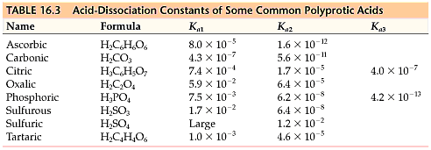
Common K_{a} values for Polyprotic Acids

Slide 14
Simplifying Questions
For many acids, K_{a1} is significantly larger (more than 10³) than K_{a2}. This suggests that most of the H⁺ (aq) in the solution comes from the first ionization reaction. This also means it is possible to obtain a satisfactory estimate of pH of a polyprotic acid solutions, by treating them as if they were monoprotic and considering only K_{a1}.
Please keep this in mind for the following example.

Slide 15
Calculting pH of a Polyprotic Acid Solution
The solubility of CO_{2(g)} in pure water at 25°C and 0.1 atm is 0.0037 M. The common practice is to assume that all of the dissolved CO₂ is in the form of carbonic acid, H₂CO₃ which is produced by reaction between CO₂ and H₂O.
CO_{2(aq)} + H₂O_{(l)} ←→ H₂CO_{3(aq)}
What is the pH of a 0.0037 M solution of H₂CO₃ ?
By looking in your textbook appendix or reference chart:
K_{a1} = 4.3 x 10⁻⁷ K_{a2} = 5.6 x 10⁻¹¹

Slide 16
Solution
H₂CO₃ is a diprotic acid, and has two acid-dissociation constants which differ by more than 10³. Therefore, pH can be calculated by considering only K_{a1}.
K_{a1} / K_{a2} = 4.3 x 10⁻⁷/ 5.6 x 10⁻¹¹ = 7.67 x 10³
Please try the question before looking at the solution on the next slide ☺

Slide 17
Solution Continued
 | H₂CO_{3(aq)} ←→ | H⁺_{(aq)} | HCO₃⁻_{(aq)}
[Initial] | 0.0037 | 0 | 0
[Change] | - x | + x | + x
[Equilibrium] | 0.0037 -x | x | x
K_{a1}= [H⁺][HCO₃⁻] = (x)(x) = 4.3 x 10⁻⁷
[H₂CO₃] 0.0037-x
x² + 4.3 x 10⁻⁷x – 1.59 x 10⁻⁹ = 0
Using the quadratic equation we get
x₁ = 4.0 x 10⁻⁵ x₂ = - 4.0 x 10 ^{– 5} (not possible)
Therefore, x₂= [H⁺] = 4.0 x 10⁻⁵
pH= -log[H⁺] = -log(4.0 x 10⁻⁵ )= 4.40
Notes:
Note with all of these questions since K_{a} is small – you may chose to make your simplification.

Slide 18
Weak Bases
B_{(aq)} + H₂O_{(l)} ← → HB⁺_{(aq)} + OH⁻ _{(aq)}
B = a weak base. It abstracts a proton from water, creating HB⁺ (conjugate acid) and hydroxide ions.
K_{b}, the base-dissociation constant always refers to the equilibrium in which a base reacts with water to form the corresponding conjugate acid and OH⁻.
K_{b} = [HB⁺][OH⁻]
[B]

Slide 19
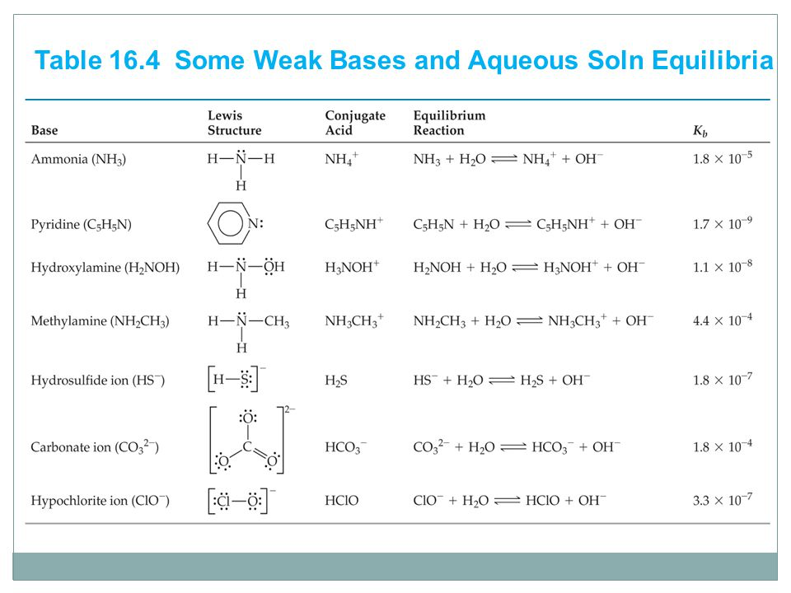
Common Weak Bases

Slide 20
Using K_{b} to calculate [OH⁻]
Calculate the concentration of OH⁻ in a 0.15 M solution of NH₃. The K_{b} at 25°C is 1.8 x 10 ⁻⁵
Plan: Use the same steps as used in solving ionization of weak acids.
a) Write the ionization reaction
b) Set up Corresponding equilibrium-constant expression
c) solve for ’x’
* once you have known [OH⁻], you are able to calculate percentage ionization, pH and pOH.

Slide 21
Solution
 | NH_{3(aq)} | H₂O_{(l)} ← → | NH₄⁺_{(aq} | OH⁻ _{(aq)}
Initial | 0.15 | ____ | 0 | 0
Change | - x | ______ | + x | + x
Equilibrium | 0.15 – x | _____ | x | x
K_{b} = [NH₄⁺_{(aq)}] [ OH⁻_{(aq)}]= (x)(x) = 1.8 x 10 ⁻⁵
[ NH_{3(aq)}] (0.15 –x)
You may check assumption that K_{b} is small, or you may use the quadratic formula.
Using the quadratic formula we get :
x² + 1.8x10⁻⁵ x - 2.7 x 10⁻⁶ = 0
Therefore: x₁ = 1.6 x 10⁻³ x₂ = - 1.7 x 10⁻³ (not possible)
Therefore, x=[OH⁻] = 1.6 x 10⁻³ M
** You can now also use this value to calculate pH, pOH, and % ionization.

Slide 22
The Relationship between K_{a} and K_{b}
NH₄⁺_{(aq)} ←→ NH_{3(aq)} + H⁺_{(aq)} [ 1 ]
NH_{3(aq)} + H₂O_{(l)} ← → NH₄⁺_{(aq)} + OH⁻_{(aq)} [ 2 ]
NH₃ and NH₄⁺ are a conjugate acid/base pair.
From [1] K_{a}= [NH_{3(aq)}][H⁺_{(aq)}] From [2] K_{b}= [NH₄⁺_{(aq)}][OH⁻_{(aq)}]
[NH₄⁺_{(aq)}] [NH_{3(aq)}]
Adding the equations together, we are left only with the autoionization of H₂O
NH₄⁺_{(aq)} ←→ NH_{3(aq)} + H⁺_{(aq)} [ 1 ]
NH_{3(aq)} + H₂O_{(l)} ← → NH₄⁺_{(aq)} + OH⁻_{(aq)} [ 2 ]
______________________________________________________
H₂O_{(l)} ← → H⁺_{(aq)} + OH⁻_{(aq)}
K_{a} x K_{b} = K_{w}
When we add two equations together to produce a third, K₃ is equivalent to K₁ x K₂.

Slide 23
Calculating K_{a} and K_{b} for a Conjugate Acid/Base Pair
Calculate:
a) base dissociation constant, K_{b} for the fluoride ion (F⁻)
K_{a} for HF= 6.8 x 10⁻⁴
b) The acid-dissociation constant, K_{a} for the ammonium ion (NH₄⁺)
K_{b} for NH₃ = 1.8 x 10⁻⁵

Slide 24
pK_{a} & pK_{b}
Sometimes acid/base strength is reported as a pK value.
pK_{a}= - log(K_{a})
pK_{b} = -log(K_{b})
pK_{a} + pK_{b} = pK_{w}= 14.00 @ 25.

Slide 25
Lewis Acids and Bases (AP)
For a substance to be a proton acceptor ( Bronsted-Lowry Base) it must have an unshared pair of electrons for binding a proton. Therefore …
Lewis Acid: electron pair acceptor.
Lewis Base: electron pair donor.
Everything that is considered a Bronsted-Lowry Base is also considered a Lewis Base.

Slide 26
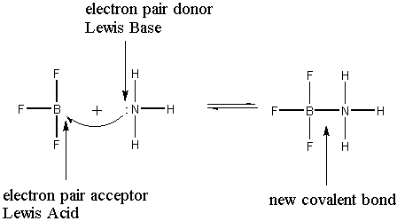
Lewis Acids & Bases
Lewis Bases can donate electrons to something other than H⁺. More substances fit the definition of an acid or a base.

Slide 27
Lewis Acids and Bases
Formation of hydronium ion is an excellent example
+

Slide 28
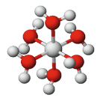
Lewis Acids & Bases
Lewis Acids are often molecules with incomplete octets (eg. Boron), or cations ( such as Fe³⁺).
The combination of metal ions (Lewis Acids) with Lewis bases such as H₂O and NH₃ forms complex ions.
All metal ions form complex ions with water- and are of the type [M(H₂O)_{x}]^{n+} where x = 4 and 6.
[Cu(NH₃)₄]²⁺

Slide 29
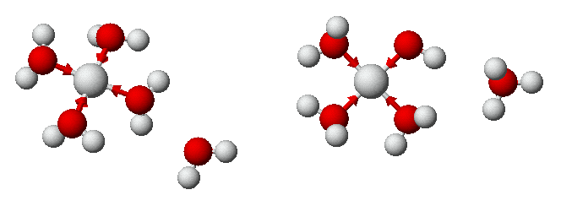
Lewis Acids and Bases
Many complex ions containing water undergo hydrolysis to give acidic solutions.
This explains why water solutions of Fe³⁺, Al³⁺, Cu²⁺, Pb²⁺, etc. are acidic
[Cu(H₂O)₄]²⁺ + H₂O ---> [Cu(H₂O)₃(OH)]⁺ + H₃O⁺

