Slide 1
Describing Chemical Reactions

Slide 2
Chemical Reactions
A chemical reaction is the process by which one or more substances change into one or more new substances.
Reactants are the original substances in a chemical reaction.
Products are the substances that are created in a chemical reaction.

Slide 3
Chemical Reactions
How to make chili
Ingredients + heat → chili
How to make water
2 H₂ + O₂ → 2 H₂0
Products
Reactants

Slide 4
Evidence of a chemical change

Slide 5
Evidence of a chemical change

Slide 6
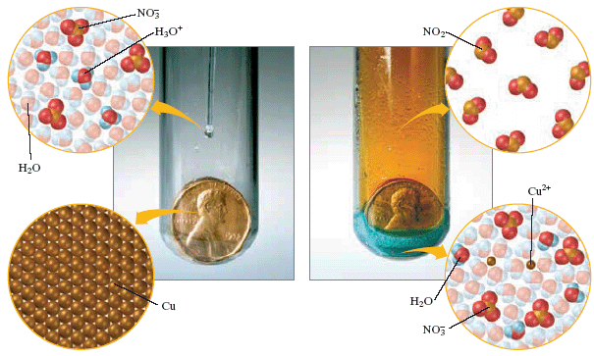
Evidence of a chemical change

Slide 7
Chemical v. Physical
chemical change – new substance forms with properties that differ from original substance
density
boiling point
melting point
physical change - changes of state
evaporation
condensation
melting
freezing

Slide 8
Constructing a Chemical Rxn
A chemical equation shows the chemical formulas and relative amounts of all reactants and products.
A word equation contains the names of the reactants and products.
Equations must be balanced.

Slide 9
Constructing a Chemical Rxn
Word Equation
methane + oxygen → carbon dioxide + water
Formula Equation
CH₄ + O₂ → CO₂ + H₂O

Slide 10
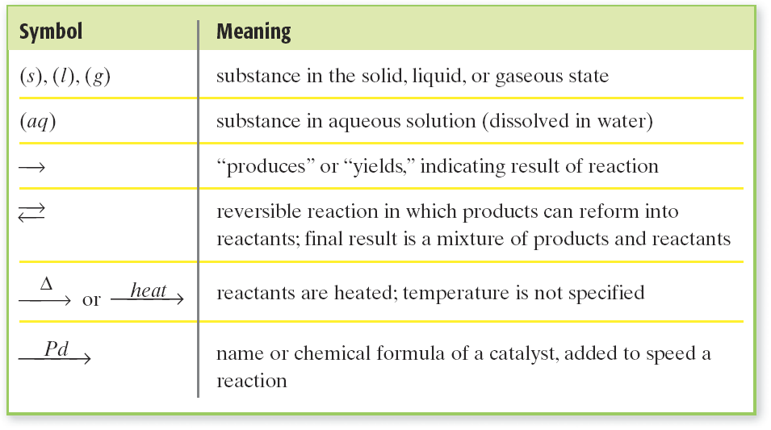
Constructing a Chemical Rxn Other symbols

Slide 11
Balancing Equations

Slide 12
Think…
Law of Conservation of Mass states that mass cannot be created or destroyed by a chemical or physical change
Therefore, ALL chemical equations must be balanced. That is, having the same number of atoms on both sides of the arrow

Slide 13
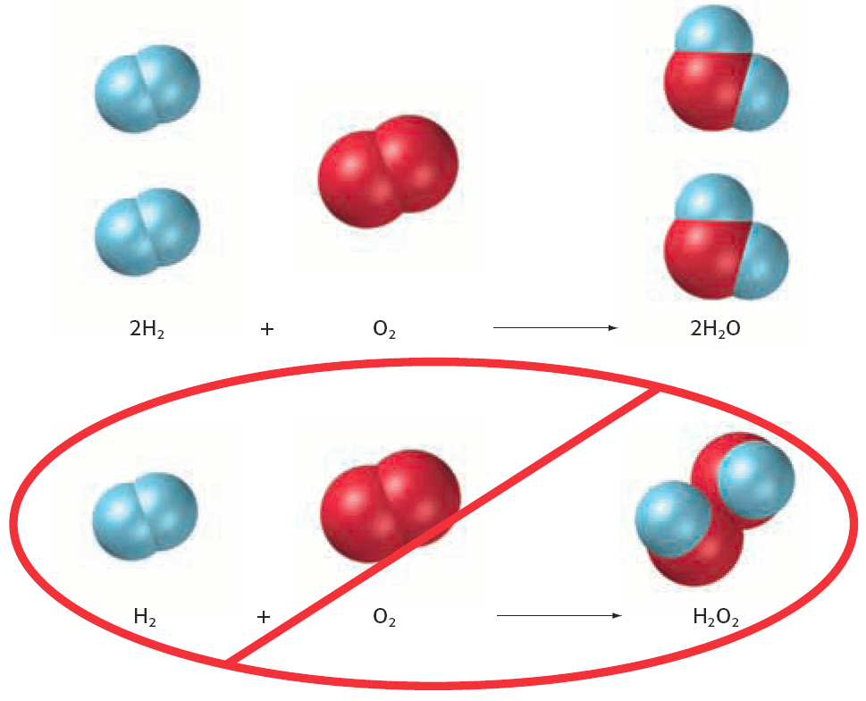

Slide 14
Balancing Equations
The number of atoms for each element must be the same on the reactants’ side and on the products’ side.
A coefficient multiplies the number of atoms of each element in the formula that follows.
H₂O: 2 hydrogen atoms, 1 oxygen atom
2H₂O: 4 hydrogen atoms, 2 oxygen atoms

Slide 15
Sample Problem
Balance the equation for the reaction of iron (III) oxide with hydrogen to form iron and water.

Slide 16
Sample Problem
Aluminum reacts with arsenic acid, HAsO₃, to form H₂ and aluminum arsenate. Write a balanced equation for this reaction.

Slide 17
Summarize the steps
1. NEVER CHANGE CHEMICAL FORMULAS!
2. Draw a table that shows the number of atoms before and after the arrow
3. Change the equation so that the number of each element are the same before and after the equation. Do this by adding COEFFICIENTS
4. Redo the table to match change, and repeat as needed.

Slide 18
Reaction Types

Slide 19
The 5 Reaction Types

Slide 20
Synthesis Reactions
In a synthesis reaction a single compound forms from two or more reactants.
Two elements form a binary compound
C + O₂ → CO₂
2C + O₂ →2CO
Two compounds form a ternary compound
CaO(s) + H₂O(l) → Ca(OH)₂(s)
CO₂(g) + H₂O(l) → H₂CO₃(aq)

Slide 21
Decomposition Reactions
In a decomposition reaction a single compound breaks down, often with the input of energy, into two or more elements or simpler compounds.
Decomposition of water
electricity
2H₂O(l)
O₂(g) + 2H₂(g)
A metal carbonate decomposes to form a metal oxide and carbon dioxide.
CaCO₃(s)
heat
CaO(s) + CO₂(g)

Slide 22
Sample Problem
Predict the product(s) and write a balanced equation for the reaction of potassium with chlorine.

Slide 23
Double-Displacement Reactions
In a double-displacement reaction two compounds in aqueous solution appear to exchange ions and form two new compounds.
One of the products must be a solid precipitate, a gas, or a molecular compound, such as water.
HCl(aq) + NaOH(aq) → HOH(l) + NaCl(aq)

Slide 24
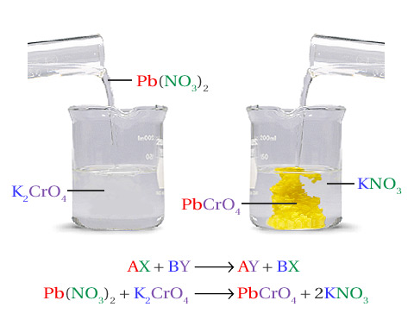

Slide 25
Displacement Reactions
In a displacement reaction a single element reacts with a compound and displaces another element from the compound.
2Al(s) + 3CuCl₂(aq) → 2AlCl₃(aq) + 3Cu(s)
Aluminum displaces copper.

Slide 26
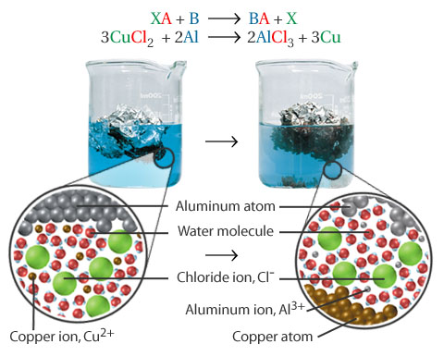

Slide 27
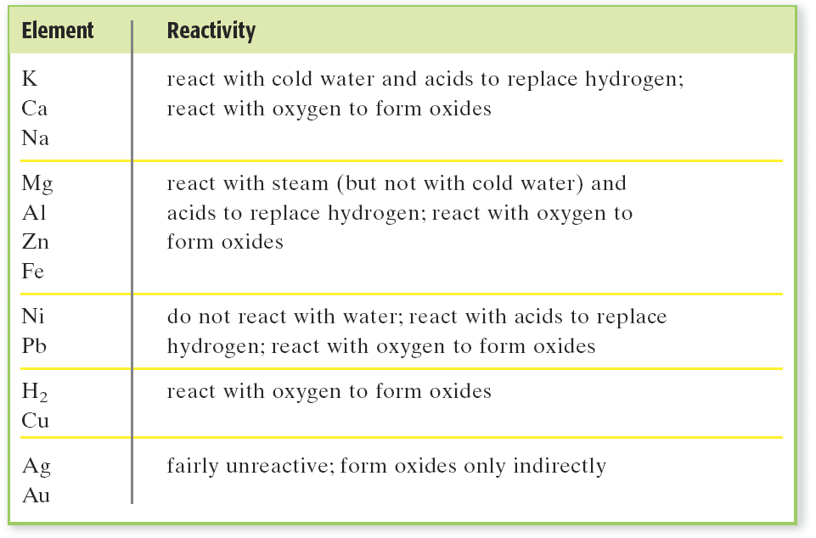

Slide 28
Sample Problem
Determining Products by Using the Activity Series Magnesium is added to a solution of lead(II) nitrate. Will a reaction happen? If so, write the equation and balance it.

Slide 29
Combustion Reactions
A combustion reaction is a reaction of a carbon based compound with oxygen.
Combustion of propane
C₃H₈ + 5O₂ → 3CO₂ + 4H₂O
Combustion of ethanol
CH₃CH₂OH + 3O₂ → 2CO₂ + 3H₂O

