Slide 1
GreenHouse Effect
UNIT 4:

Slide 2
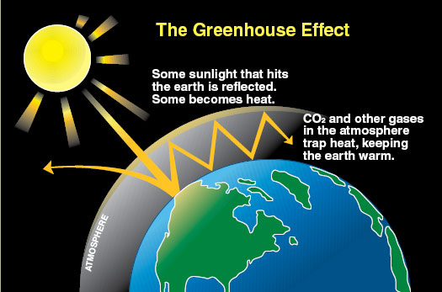
Lesson 1 – Greenhouse Effect
Introduction to climate and climate change
Greenhouse Effect

Slide 3
The Greenhouse Effect
It is a natural process that has been happening for millions of years
Gases and clouds absorb infrared radiation emitted from Earth’s surface and radiate it, heating the atmosphere and Earth’s surface
http://www.youtube.com/watch?v=OqVyRa1iuMc

Slide 4
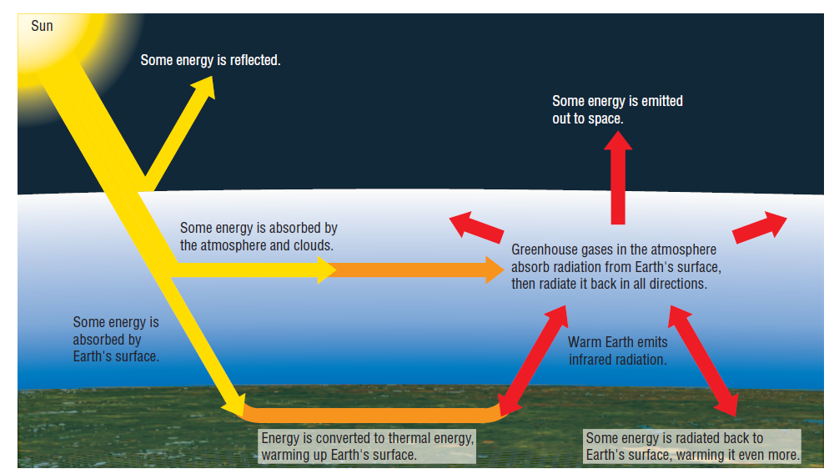

Slide 5
What if there was no Greenhouse effect?
The Earth’s average global temperature would be -18ºC instead of 15ºC

Slide 6
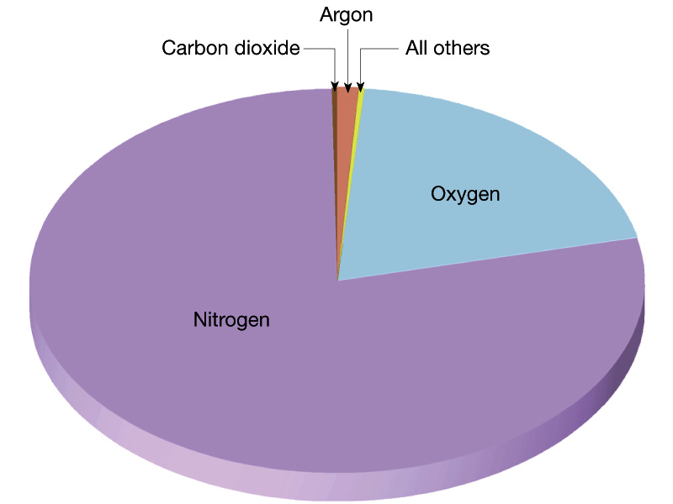
Greenhouse Gases
Any gas in the atmosphere (ie: water vapour, carbon dioxide, and methane) that absorbs lower energy infrared radiation

Slide 7
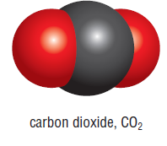
Greenhouse Gas – Carbon Dioxide
CO₂ makes up only 385 ppm of the Earth’s atmosphere which represents only about 0.0385%
But, CO₂ is estimated to cause up to a quarter (1/4) of the natural greenhouse effect on Earth
CO₂ molecules have atoms that can vibrate and wiggle in many ways and can absorb different types of energy

Slide 9
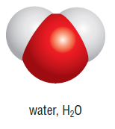
Greenhouse Gas – Water Vapour
2/3 of Earth’s natural greenhouse effect is caused by water vapour in the atmosphere
Amount of water in atmosphere depends on temperature; about 4%

Slide 10
Positive Feedback Loop
A produces more of B
which in turn produces more of A
example:
someone starts to take drugs, the drug has effects on the body, the body eventually adjusts to the drug, and the person requires more of the drug for the same effect

Slide 11
Negative Feedback Loop
-self-regulating system that works to maintain stability
example
Thermostat -the temperature in a heated room reaches a certain upper limit, the room heating is switched off so that the temperature begins to fall. When the temperature drops to a lower limit, the heating is switched on again

Slide 12
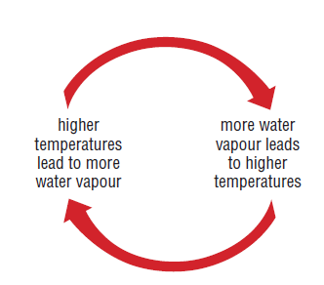
Greenhouse Gas – Water Vapour
Water vapour and temperature are related by a positive feedback loop

Slide 13
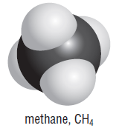
Greenhouse Gases – Methane (CH₄)
There is less methane in the atmosphere than carbon dioxide
Methane can absorb more thermal energy than carbon dioxide (23 more times)

Slide 14
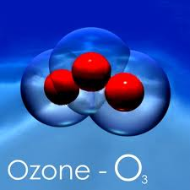
Greenhouse Gases – Ozone (O₃)
Forms a layer protecting the Earth’s surface from the Sun’s higher-energy UV radiation
Ozone also acts as a greenhouse gas

Slide 15
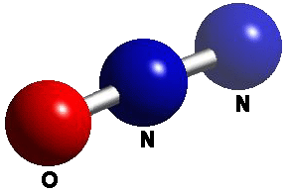
Greenhouse Gases – Nitrous Oxide (N₂O)
300 times more effective than a molecule of CO₂ as a greenhouse gas
Lower levels of nitrous oxide can be found in the atmosphere than carbon dioxide

Slide 16
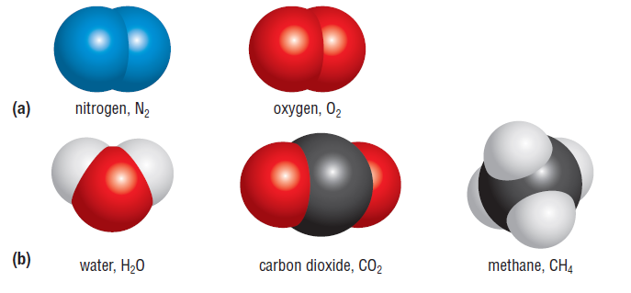
The molecule’s increased ability to vibrate will allow for greater absorption of energy
Notes:
Nitrogen and oxygen have identical atoms and only 2 atoms; as such they can only vibrate in one direction minimizing the amount of energy absorption

Slide 17
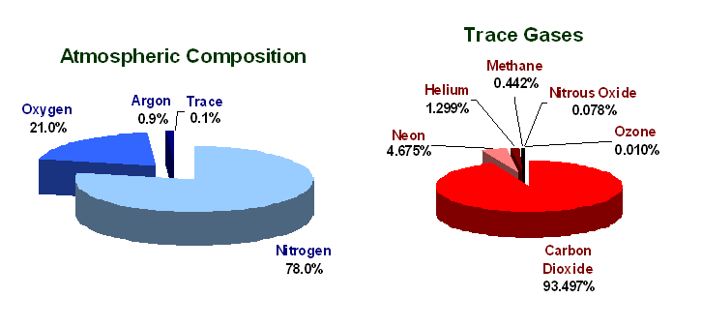

Slide 18
Greenhouse Gases – Changing the Climate
Greenhouse gases have been a part of our atmosphere for hundreds of thousands of years and have contributed to the naturally occurring greenhouse effect

Slide 19
But, what’s happening now?
Increases since about 1750 are attributed to human activities in the industrial era.

Slide 21
Anthropogenic (Human Influenced) Sources of Greenhouse Gases
Carbon Dioxide:
Burning fossil fuels (coal, gasoline, natural gas) releases CO₂
Deforestation – inhibits photosynthesis which would remove CO₂ from the atmosphere; also as left over forest waste decomposes, it produces greenhouse gases

Slide 22
Anthropogenic (Human Influenced) Sources of Greenhouse Gases
Methane
Agricultural activities – rice farming, cattle ranching
Landfills and sewage treatment plants – methane is released as organic material decays
Coal mining and natural gas extraction releases methane

Slide 23
Anthropogenic (Human Influenced) Sources of Greenhouse Gases
Nitrous Oxide
Management of livestock feed and waste
Use of nitrogen fertilizers
Chloroflurocarbons (CFCs)
no natural sources of CFCs
Leak out of refrigerators and air conditioners

Slide 24
Anthropogenic Greenhouse Effect
The increase in the amount of lower-energy infrared radiation trapped by the atmosphere as a result of higher levels of greenhouse gases in the atmosphere due to human activities, which is leading to an increase in Earth’s average global temperature

Slide 25
Carbon Dioxide & Global Temperature
Increases in carbon dioxide levels result in increases in global temperature due to the greenhouse effect; however, increases in temperature can also cause increases in carbon dioxide levels
As the temperature increases, carbon dioxide stored in plants and oceans (carbon sinks) get released

Slide 26
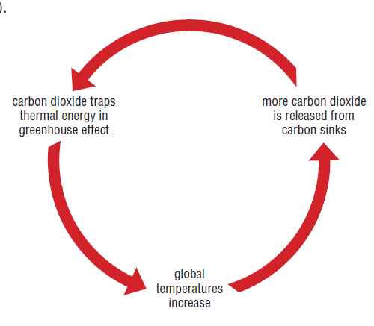
Positive Feedback Loop

Slide 27
http://www.youtube.com/watch?v=ZzCA60W
noMk
http://www.youtube.com/watch?v=gLk5Y1YOmO0 Drought in Brazil – Coffee at risk!
http://www.youtube.com/watch?v=Sey5Q6aJiM8 California Drought
Google Ice Storm and Toronto Flood

