Slide 1
Refraction
The bending or change in direction of light when it travels from one medium into another.

Slide 2
Index of Refraction
Medium | n
Vacuum/space and Air | 1.00
Ice | 1.31
Water (pure) | 1.33
Ethyl alcohol | 1.36
Quartz | 1.46
Vegetable oil | 1.47
Olive oil | 1.48
Acrylic | 1.49
Glass | 1.52
Diamond | 2.42

Slide 3
Index of Refraction

Slide 4
When light moves from a faster medium to a slower medium, it bends …..
n
Speed of light (m/s)
∠i
vacuum
1.00
3.00 x 10⁸
1.33
2.26 x 10⁸
water
∠R

Slide 5
When light moves from a slower medium to a faster medium, it bends …..
when n₂ is less than n₁
∠R
air
n₂ = 1.00
water
n₁ = 1.33
∠i
∠i is less than ∠R

Slide 6
What happens when you keep increasing the angle of incidence?
air
water
∠i can be any angle

Slide 7
What happens when you keep increasing the angle of incidence?
air
water
∠i can be any angle

Slide 8
Critical angle
∠R
air
water
∠i
If ∠R becomes 90°
∠i must be less than 90°

Slide 9
Critical Angle
the angle of incidence that produces a refracted angle of 90°.
Only occurs when n₁ is greater than n₂
A physical property of the medium.

Slide 10
Total Internal Reflection
What happens when an incident angle is greater than the critical angle?
∠R
air
water
∠i
critical angle
Reflection occurs on the surface.
Critical angle for water: 48.8°

Slide 12
Total Internal Reflection
When the angle of incidence is greater than the critical angle, light is reflected at the surface of the medium.
Note: only occurs when n₁ is greater than n₂

Slide 13
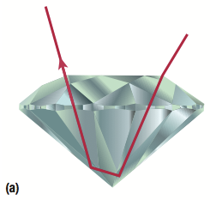
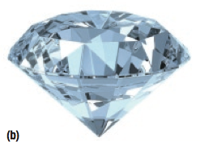
Refraction in a diamond
critical angle for diamond: 24.4°

Slide 14
Refraction in a diamond

