Slide 1
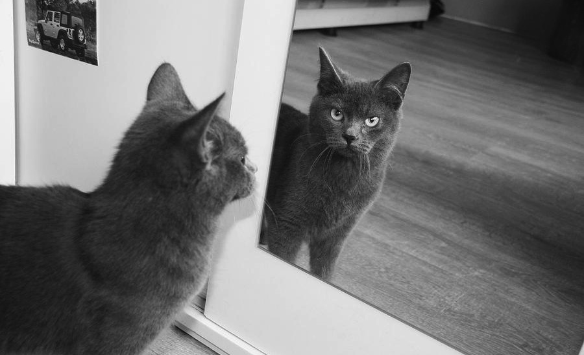

Slide 2
Plane Mirror – Reflection

Slide 3
Concave Mirror – Reflection
principle axis
C
F
V

Slide 4
Convex Mirror – Reflection
principle axis
V
F
C

Slide 5
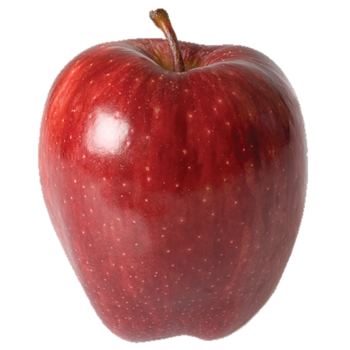
Reflection
Incident Ray
angle of
incidence
normal
angle of
reflection
Reflected Ray

Slide 6
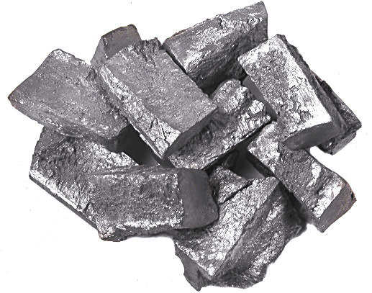
Light is reflected from some objects.

Slide 7
You can clearly see through some objects.

Slide 8
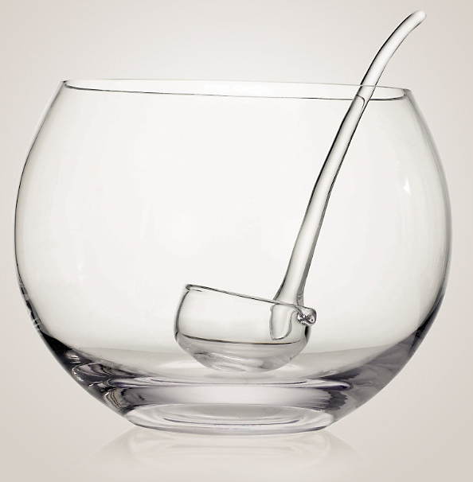
Transparent Objects
When a material transmits all or almost all incident light
Objects can be clearly seen through the material

Slide 9
Transparent object/medium
Medium 1
Medium 2
Medium 1

Slide 10
The speed of light varies, depending on the medium of transmission.
Speed of light changes
Medium 1
Medium 2
Medium 1

Slide 11
Difference in speed causes light to bend!
Incident Ray
Medium – Air
Medium – Water
Refracted Ray

Slide 12
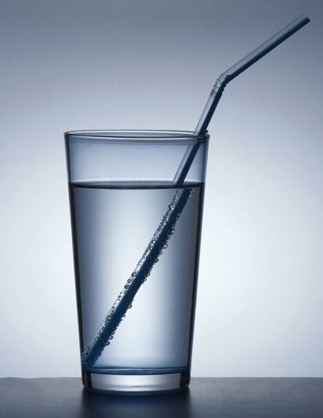

Slide 13
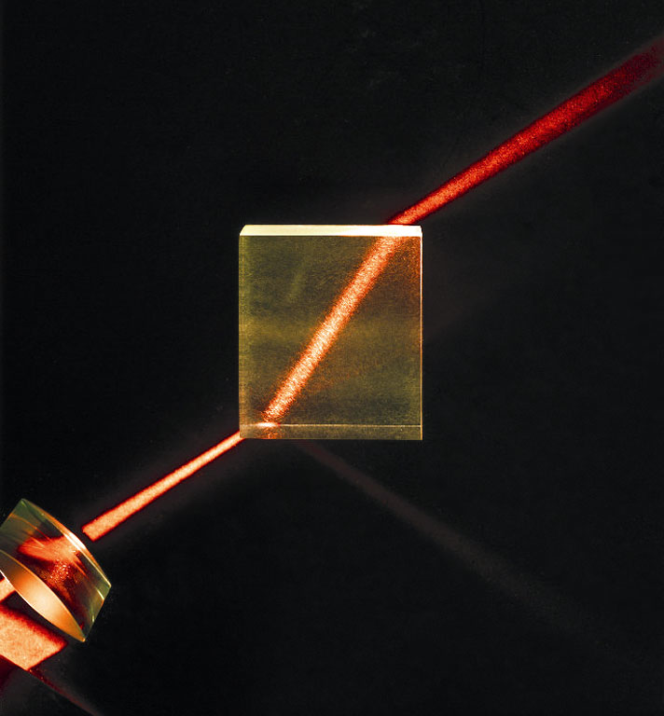

Slide 14
Refraction
The bending or change in direction of light when it travels from one medium into another.

Slide 15
How to Measure Refraction
normal
Incident Ray
angle of
incidence
Medium – Air
angle of
refraction
Medium – Water
Refracted Ray

Slide 16
Experiment
normal
A
Incident Ray
Medium – Air
Medium – Acrylic or Glass
B
Refracted Ray

Slide 17
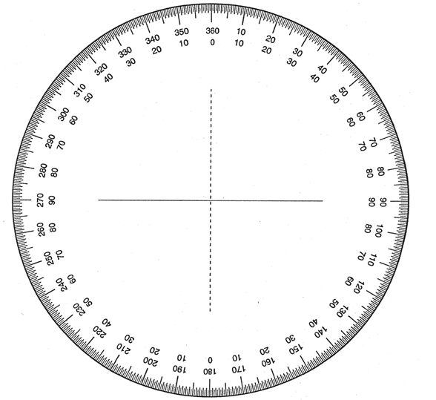
Experiment
normal
A
Incident Ray
Medium – Air
Medium – Acrylic or Glass
Refracted Ray
B

Slide 18
Why does light bend when it hits a medium?

Slide 19
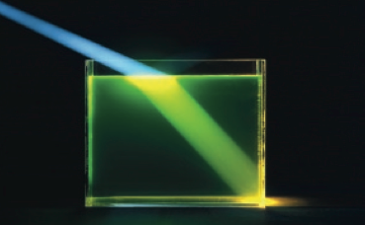
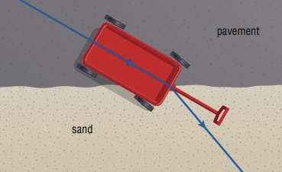

Slide 20
Observations
Light travelling from air into glass or acrylic:
normal
Incident angle at 0°:
Light travelled straight through
angle of
incidence (A)
Incident Ray
Medium – Air
From air to glass or acrylic:
Medium – Acrylic
Angle of refraction less than incident angle
A > B
angle of
refraction (B)
Refracted Ray

Slide 21
Observations
Light travelling from glass or acrylic to air:
normal
Angle of refraction more than incident angle.
C < D
angle of
incidence (C)
Incident Ray
Medium – Acrylic
A = D
B = C
Medium – Air
angle of
refraction (D)
Refracted Ray

Slide 22
Conclusions – Refraction
Incident Ray, Refracted Ray, and normal all on the same plane (just like reflection).
Incident Ray and Refracted Ray are on the opposite sides of the line indicating the separation of two mediums.
normal
Incident Ray
Refracted Ray

Slide 23
Conclusions – Refraction
Light bends towards the normal when light in the second medium is slower than the first medium.
Light bends away from the normal when light in the second medium is faster than the first medium.
normal
Incident Ray
Refracted Ray

Slide 24
Observations and Results
∠i | ∠R | ∠i ∠R | sin∠i | sin∠R | sin∠i sin∠R
0°
30°
40°
50°
60°

Slide 25
Observations and Results
∠i | ∠R | ∠i ∠R | sin∠i | sin∠R | sin∠i sin∠R
30° | 19.0 | 1.55 | 0.49 | 0.33 | 1.51
40° | 25.0 | 1.60 | 0.64 | 0.42 | 1.52
50° | 30.0 | 1.67 | 0.77 | 0.50 | 1.53
60° | 34.5 | 1.74 | 0.87 | 0.57 | 1.53

Slide 26
Index of Refraction

Slide 27
Index of Refraction
Medium | n
Vacuum/space and Air | 1.00
Ice | 1.31
Water (pure) | 1.33
Ethyl alcohol | 1.36
Quartz | 1.46
Vegetable oil | 1.47
Olive oil | 1.48
Acrylic | 1.49
Glass | 1.52
Diamond | 2.42

Slide 28
What of the Speed of Light?
normal
Speed of light (vacuum)
c
∠i
Space/vacuum
∠R
medium
v
Speed of light (medium)

Slide 29
Comparing the Speed of Light

Slide 30
Index of Refraction

Slide 31
Index of Refraction

Slide 32
normal
Speed of light (vacuum)
c
∠i
Space/vacuum
∠R
medium
v
Speed of light (medium)

Slide 33
Index of Refractions
Medium | n
Vacuum/space and Air | 1.00
Ice | 1.31
Water (pure) | 1.33
Ethyl alcohol | 1.36
Quartz | 1.46
Vegetable oil | 1.47
Olive oil | 1.48
Acrylic | 1.49
Glass | 1.52
Zircon | 1.92
Diamond | 2.42

Slide 34
Example 1
The speed of light in ice is $2.29×{10}^{8}$. Calculate the index of refraction.

Slide 35
Example 1
The speed of light in ice is $2.29×{10}^{8}m/s$ . Calculate the index of refraction.
$$n=\frac{c}{v}$$
$$n=\frac{3.00×{10}^{8}m/s}{2.29×{10}^{8}m/s}$$
$$n=1.31$$

Slide 36
Example 2
Calculate the speed of light in zircon.

Slide 37
Example 2
Calculate the speed of light in zircon.
$$v=\frac{c}{n}$$
$$v=\frac{3.00×{10}^{8 }m/s}{1.92}$$
$$v=1.56×{10}^{8} m/s$$
$$n=\frac{c}{v}$$
$nv=c$
$$v=\frac{c}{n}$$

Slide 38
Questions
The speed of light in salt (sodium chloride) is 1.96×10⁸ m/s. Calculate the index of refraction for sodium chloride.
Calculate the speed of light as it is transmitted through olive oil.
Light from air is observed to enter a medium with an incident angle of 51° and a refracted angle of 32°. What is the medium? How fast does light travel through the medium?
Notes:
n = 3.00/1.96
v = (3.00/1.48)*10^8
medium is quartz (n = 1.46); v = (3.00/1.46)*10^8

