Slide 1
Natural Changes in Climate

Slide 2
8.9 Long Term and Short Term Changes in Climate
8.10 Feedback Loops and Climate
8.11 Clues to Past Climates

Slide 3
Long Term and Short Term Changes in Climate
The Earth’s climate is not static and goes through natural cyclic changes (ex: Ice Age 20000 years ago)
Changes in climate are triggered by changes in Earth’s energy balance (ie: if the Sun’s energy is absorbed differently, climate changes)

Slide 4
Long Term Changes
Continental Drift
When continents move, ocean currents and wind patterns change causing changes in climate

Slide 5
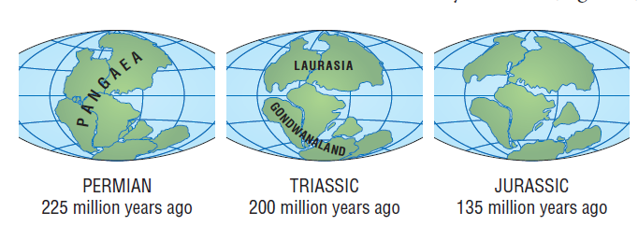
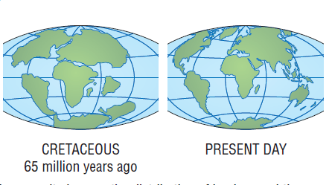

Slide 6
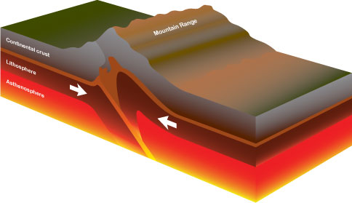
Long Term Changes
As mountain ranges form, regional climates change

Slide 7
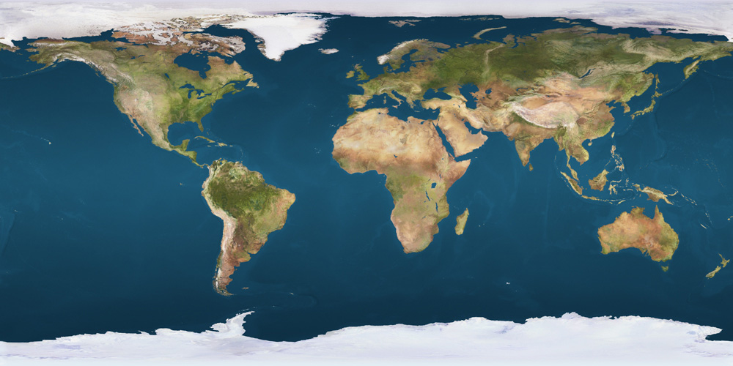
Long Term Changes
When surrounded by more larger bodies of water, you get more moderate climates (ie: Southern Hemisphere)
When you have fewer, large bodies of water you get harsher winters and hotter summers (ie: Northern Hemisphere)

Slide 8
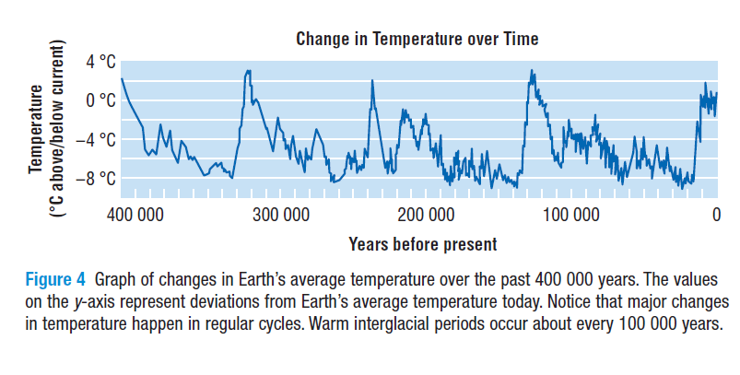
Over the last 400 000 years or more, climate has continually cycled from ice ages to warmer interglacial periods about every 100 000 years.

Slide 9
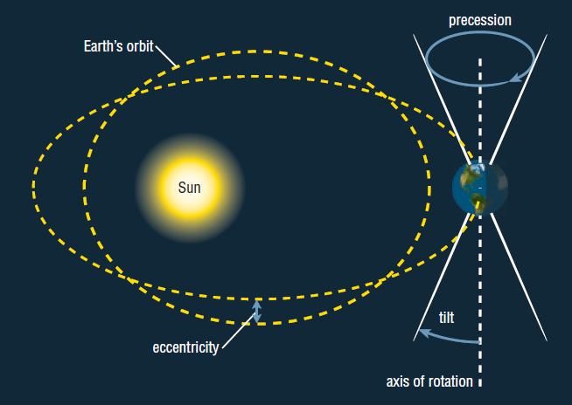
Why do Interglacial Periods and Ice Ages Happen?
Earth’s orbit around the sun changes due to eccentricity, tilt and its wobble

Slide 10
Why do Interglacial Periods and Ice Ages Happening?
A decrease in the energy from the Sun causes lower temperatures (ice age) and an increase will cause higher temperatures (interglacial)
http://www.youtube.com/watch?v=6lbJrvtxWNE

Slide 12
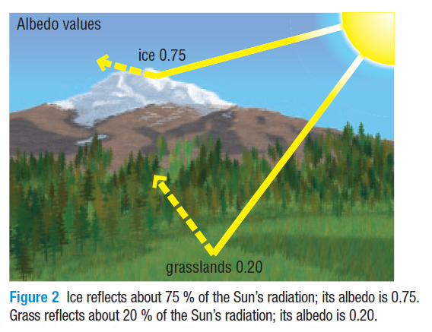
Albedo
Albedo: a measure of how much of the Sun’s radiation is reflected by a surface. (related to percent of radiation reflected)
ice and snow have high albedo (therefore it’s cold)
grass and trees have a low albedo (therefore it’s warm)

Slide 14
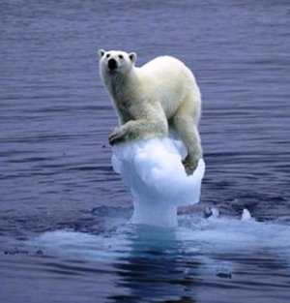
Albedo Effect
an increase in the Earth’s temperature causes ice to melt, so more radiation is absorbed by Earth’s surface, leading to further increases in temperature

Slide 15
Albedo Effect
Is the albedo effect a positive or a negative feedback loop?
It is a positive loop!

Slide 16
Short-Term Variations In Climate
Small term variations occur over 10s of years to 100s of years

Slide 17
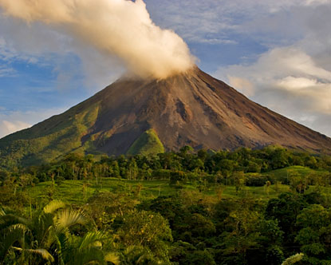
Short-Term Variations In Climate
Volcanic Eruptions
More dust in the air inhibits Sun’s energy from reaching that area causing a temporary cool down

Slide 18
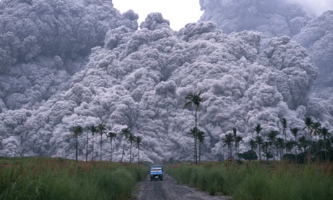
Volcanic Eruptions
Mount Pinatubo in the Phillipines erupted in June 1991
There was so much lava and ash in the stratosphere that the amount of sunlight reaching earth’s surface reduced by 10%
Global temperatures lower an average of $0.5°$

Slide 19
Short Term Variations in Climate
Air and Ocean Currents
Changes in the circulation of these currents can result in climate changes
If the salinity of the water changes, it can have an effect on the thermohaline circulation
El-Nino effect occurs every 3-7 years. It involves a change in prevailing winds that causes changes in climate
http://www.youtube.com/watch?v=7FVZrw7bk1w

Slide 20
How do we study climate change?
Proxy Records
Stores of information in tree rings, ice cores, and fossils that can be measured to give clues to what the climate was like in the past

Slide 21
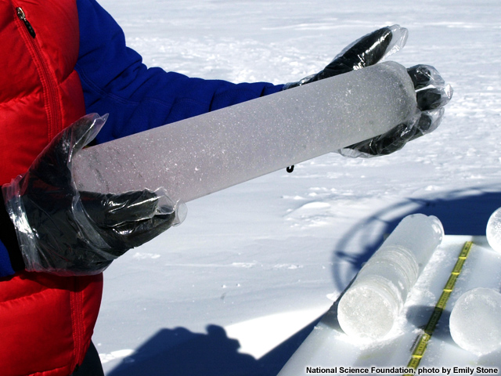
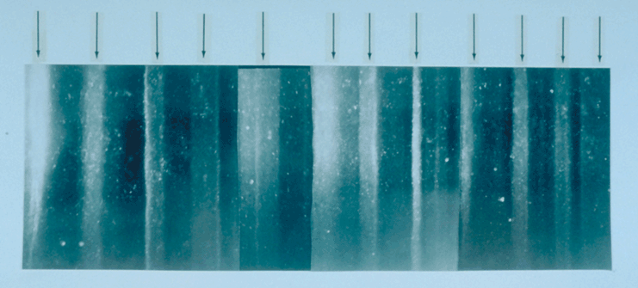
Ice Cores
Ice has tiny air bubbles that have been trapped for thousands of centuries and can be tested for various gases

Slide 22
Ice Cores
http://www.youtube.com/watch?v=JS2PhRd_5NA

Slide 23
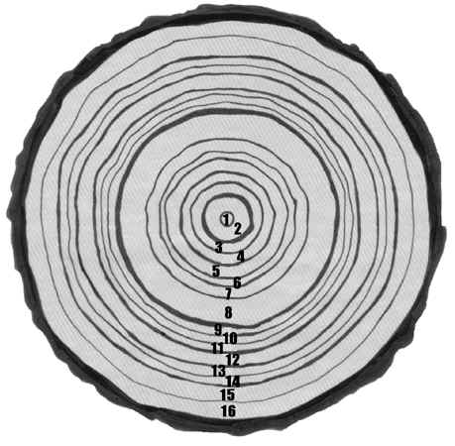
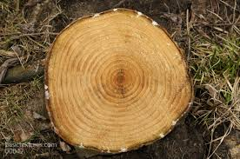
Tree Rings
The thickness of a tree ring indicates the growing conditions
Warm, wet year will produce a thick ring
Cold, dry year will produce a thin ring

Slide 24
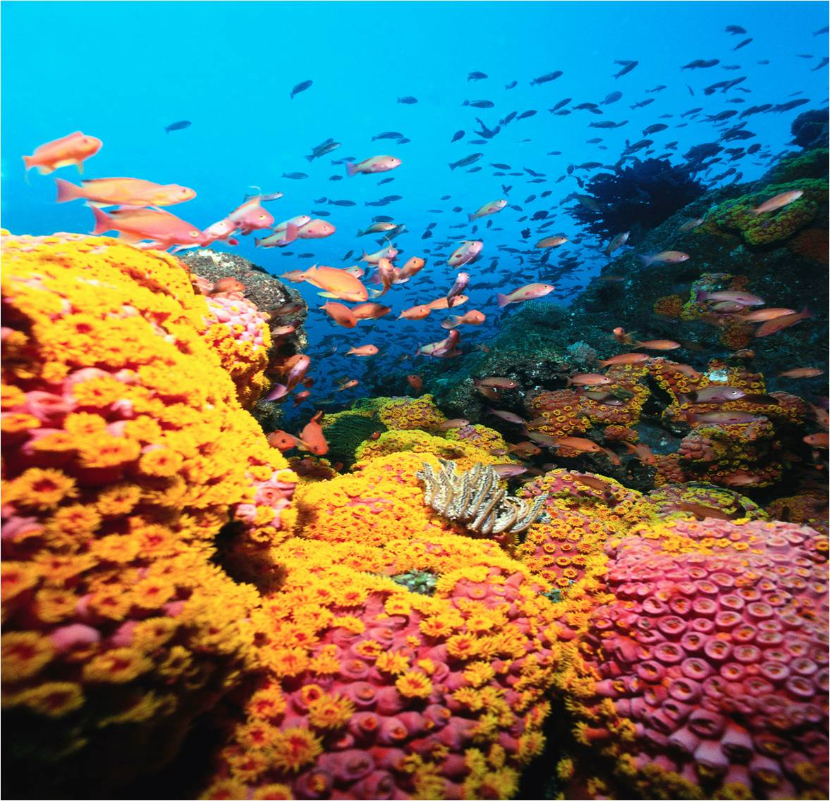
Coral Reefs
Corals have layers of growth each season and give clues about the temperature of the ocean

Slide 25
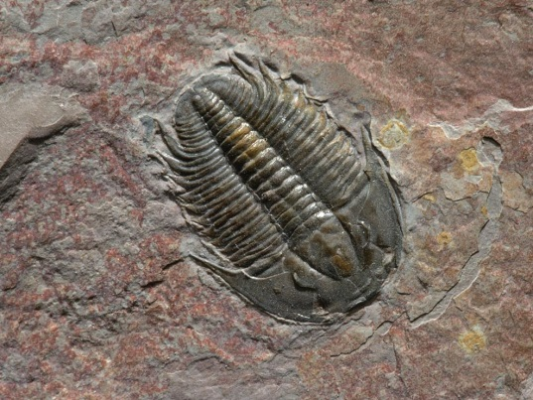
Rocks & Fossils
Scientists can look at rocks and layers of soil for clues like plant pollen or fossils that would give us an idea about what the climate was like
In the ocean floor, scientists can find fossils of marine plants and animals that may not have been there previously suggesting a change in climate

