Slide 1
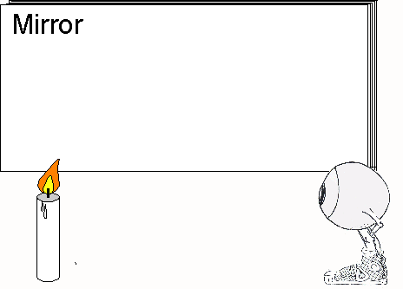
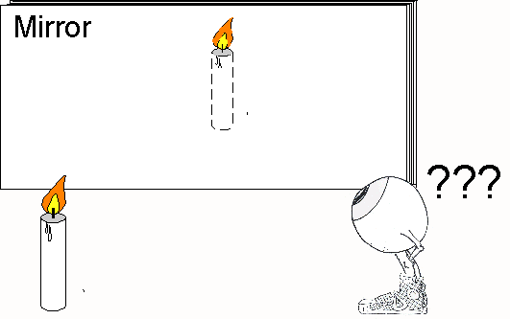
Seeing Things Plane Mirror Image Characteristics

Slide 2
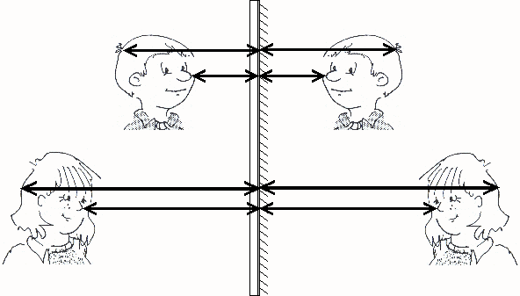
Looking from the Side
The distance of points on the object to the mirror is the same as that of corresponding points on the image to the mirror.
The object and image appear to be flipped or folded about the mirror.

Slide 3
AMBULANCE
OBJECT IMAGE
In a plane mirror, RIGHT is changed to LEFT
by lateral inversion.

Slide 4
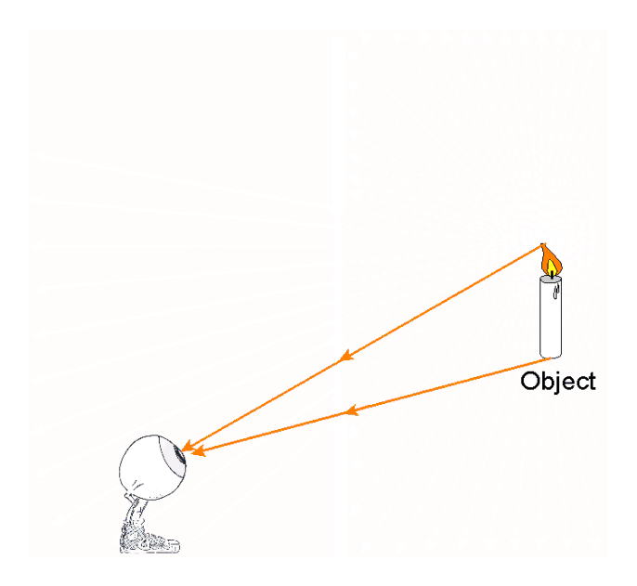
Finally, the image in a plane mirror is called VIRTUAL.
We usually see things because rays of light go from what we are looking at straight into our eyes.
This applies to real objects as well.

Slide 5
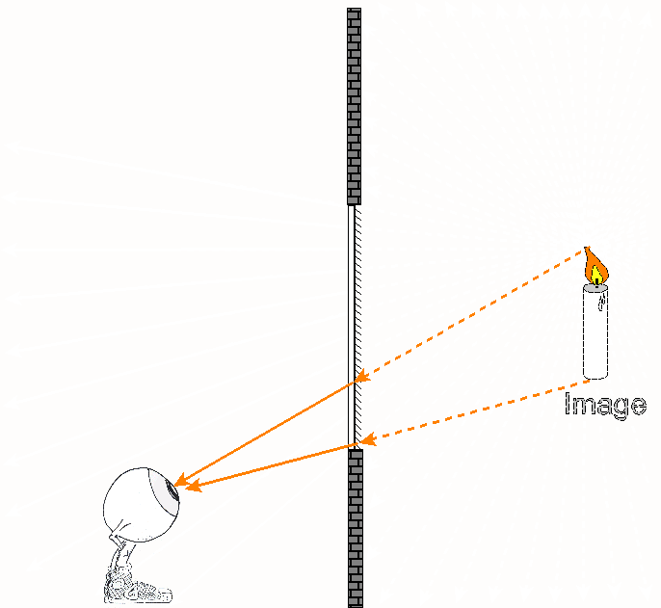
Images.
When light rays enter the Eye-Brain, it cannot tell where they actually come from.

Slide 6
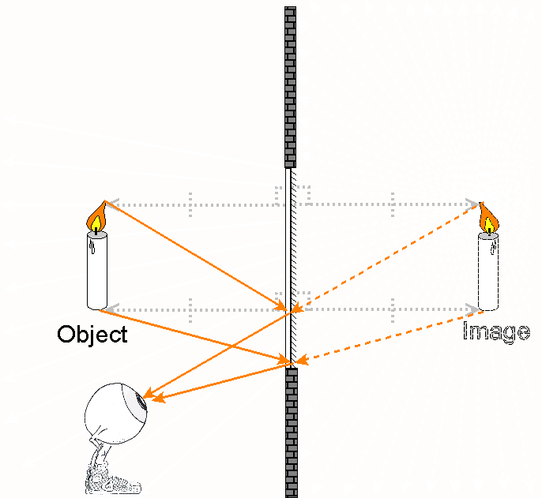
Images
When light rays enter the Eye-Brain, it cannot tell where they actually come from.
The image only appears to be behind the mirror because of the way light reflects off the mirror.

Slide 7
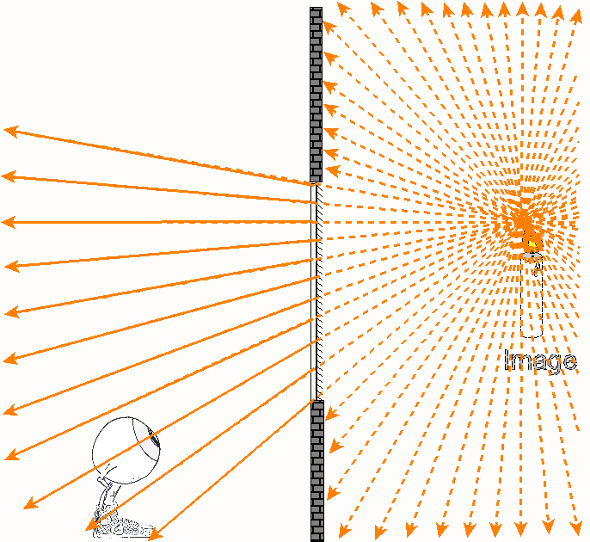
A plain mirror can be treated like a window.
The image is seen through this “window”.

Slide 8
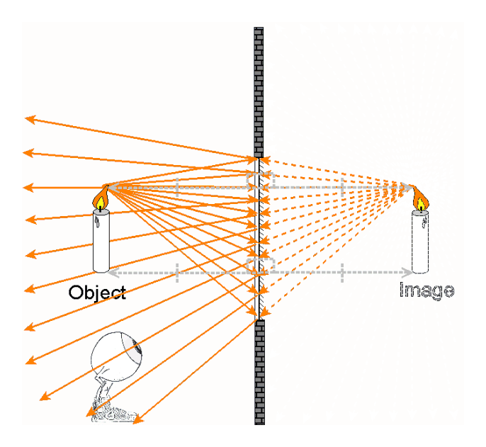
Of course, mirrors are not windows. Mirrors are opaque. The only light rays that exist are those that reflect off the mirror.
This is why images in plane mirrors are called VIRTUAL.

Slide 9
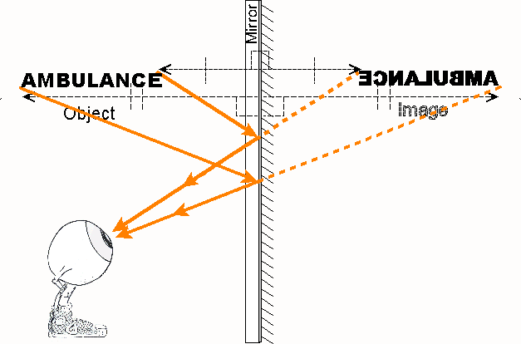
Review
Images in plane mirrors have the following characteristics:
They are the same size as the object.
They are Inverted Front to Back which makes them appear to be left/right or top/bottom inverted.
They are located an equal distance from the mirror as the object is and the line connecting the object and image intersects the mirror at 90 °.
They are virtual.

Slide 10
Review in Table Form
SILT - Image Characteristics Review Table
Size | Same
Inversion | Front to Back
Location | Equal to Object Distance, 90º Behind Mirror
Type | Virtual

Slide 11
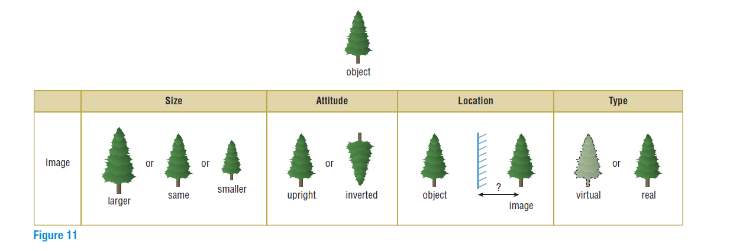
REMEMBER SILT (OR SALT)
Inversion/Attitude

Slide 12
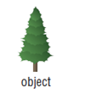
REMEMBER SILT (OR SALT)
We use 4 main characteristics to describe an image.
Size of an image compared to the object (Ex. Same Size, Smaller, Larger)

Slide 13
REMEMBER SILT (OR SALT)
Inversion (Attitude) of Image
– which way the image is oriented compared to the object: Upright or Inverted (Upside down)
Inversion/Attitude

Slide 14
REMEMBER SILT (OR SALT)
Location of Image
-in front/behind a mirror or lens
-distance from mirror or lens compared to object distance

Slide 15
REMEMBER SILT (OR SALT)
Type of Image (Real or Virtual)
– Real being an image formed when light is actually arriving at the image location (Think of movie projectors).
-Virtual being something that looks beyond the mirror (Think of when you see your reflection).

Slide 16
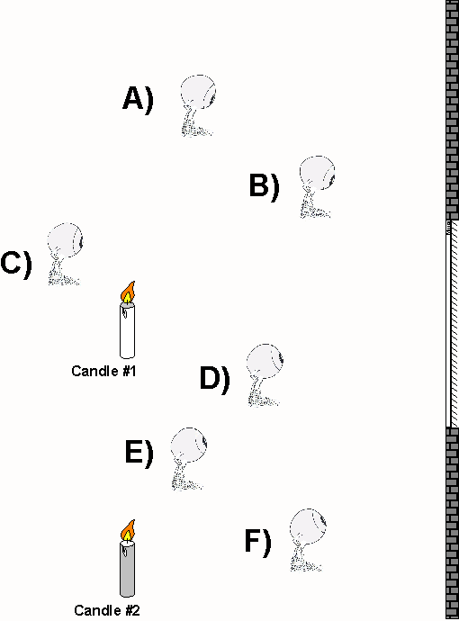
Can all Eye-Brain observers see all images??
a) Show where the images are located.

Slide 17
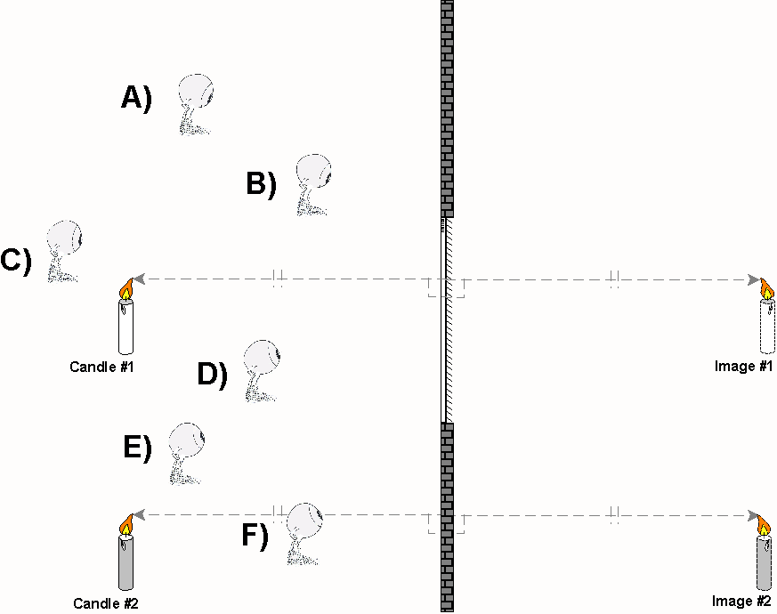
Show where the images are located.
Both candles can form an image. The mirror must be extended to find the location of image #2.

Slide 18
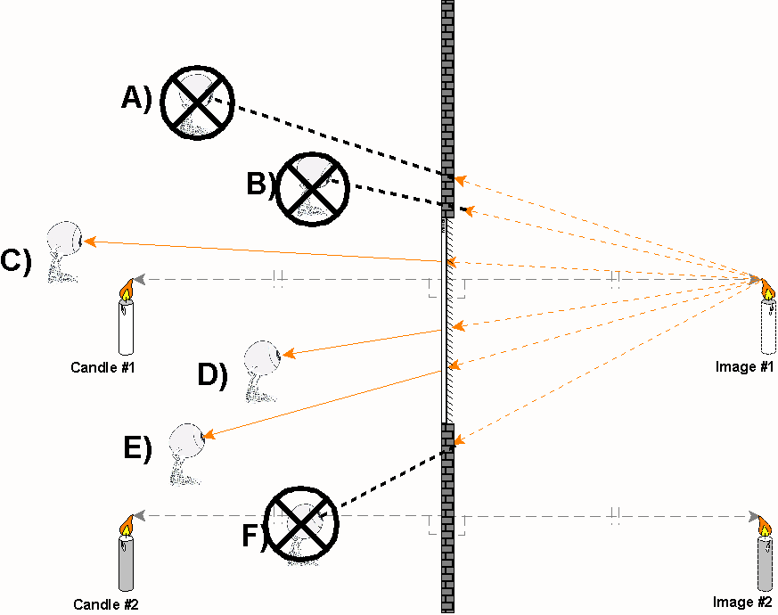
i. Which Eye-Brain can see the image of candle #1?
C) D) & E) can see image #1. The mirror acts like a window. A straight line must exist between the Eye-Brain and image through the mirror.

Slide 19
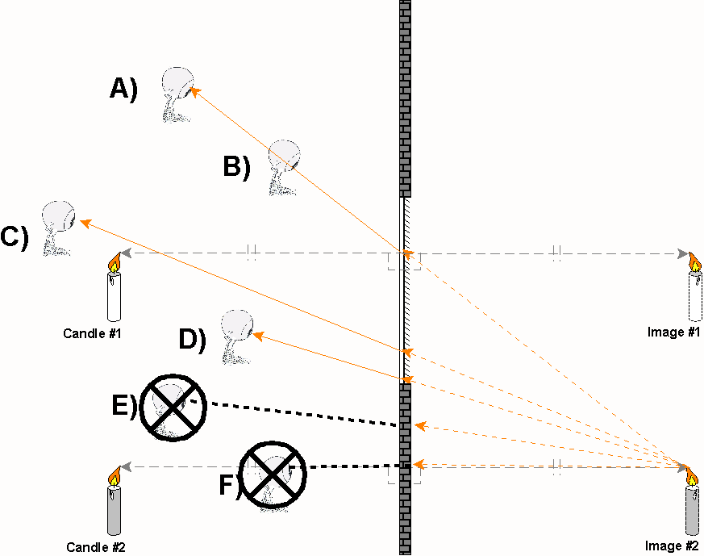
ii. Which Eye-Brain can see the image of candle #2?
A) B) C) & D) can see image #2. The mirror acts like a window. A straight line must exist between the Eye-Brain and image through the mirror.

Slide 20
What determines whether an Eye-Brain observer can see an image or not?
Mirrors act like windows. A straight line through the mirror must exist between the Eye-Brain and image.
Notes:
For a free applet to further explain the answers to questions 2-5, go to NTNUJAVA Virtual Physics Laboratory http://www.phy.ntnu.edu.tw/ntnujava/index.php Registered users (free) will be able to get files for offline use. Once you have done this, search for “Image formed by plane mirror”. Once you have downloaded, the file name is “mirror_e.html” .

