Slide 1
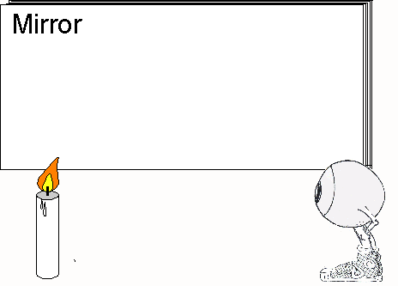
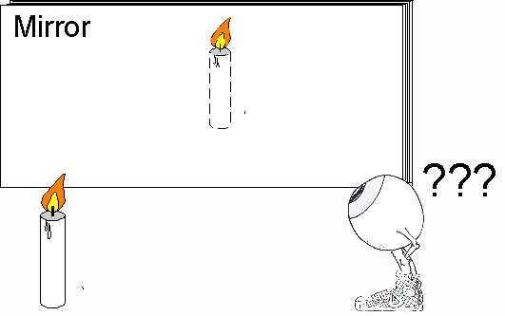
Seeing Things
Viewing Images in Plane Mirrors

Slide 2
When we look in the mirror, we see an image of the object.

Slide 3
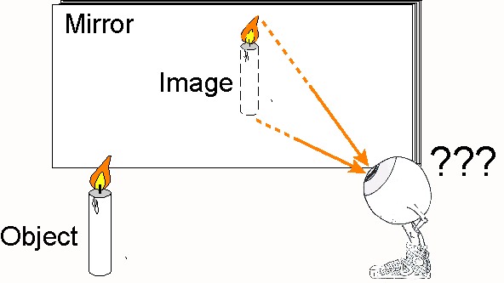
In the previous slide show, you saw that the image appears to be the same distance behind the mirror as the object is in front of it.
You also saw that a line connecting the object and image intersects the mirror at 90 °.

Slide 4
The image appears to be behind the mirror. But the light rays cannot come through the mirror since mirrors are opaque.

Slide 5
Question 2) How can the light rays appear to go through an opaque mirror?

Slide 6
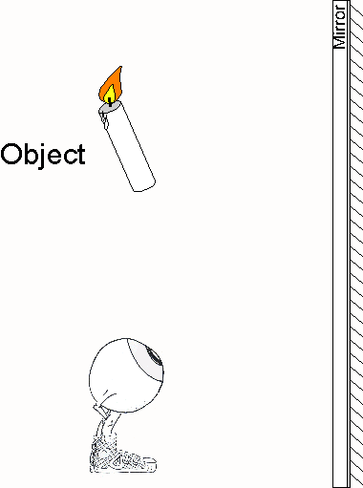
Get this graphic from your notes .

Slide 7
On the graphic in your notes, the back of the mirror is identified by diagonal lines. This is where light is reflected on glass mirrors.
Notes:
The arrow over the candle is there because it’s easier to draw as an image.

Slide 8
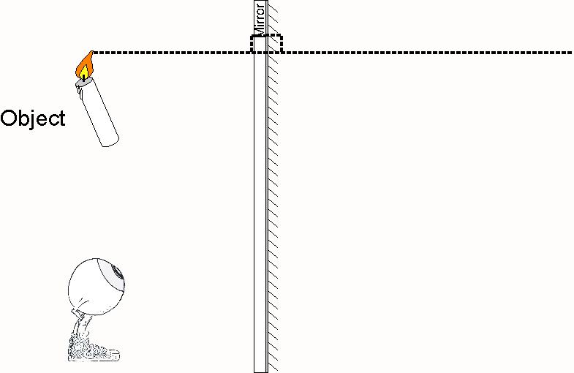
First, find the location of the image by drawing a line from the top of the object through the mirror so that it intersects at 90°.
Notes:
This line should be drawn very lightly so that it does not confuse the diagram later.
The arrow over the candle is there because it’s easier to draw as an image.

Slide 9
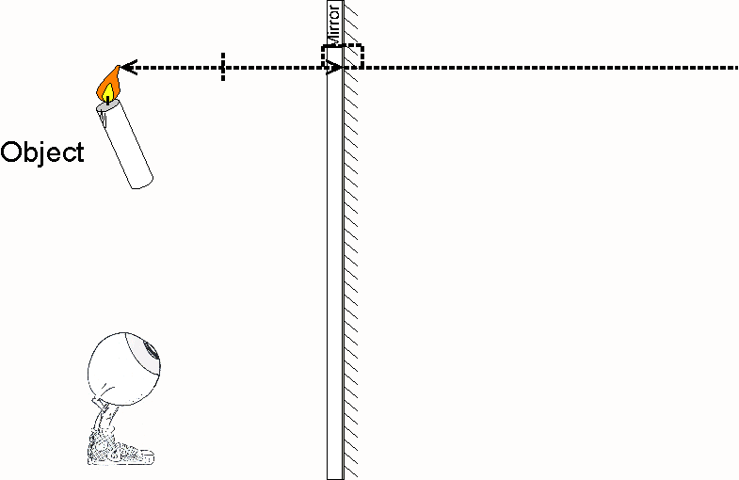
Measure the distance from the top of the object to the mirror (d_{O}).
Notes:
The arrow over the candle is there because it’s easier to draw as an image.

Slide 10
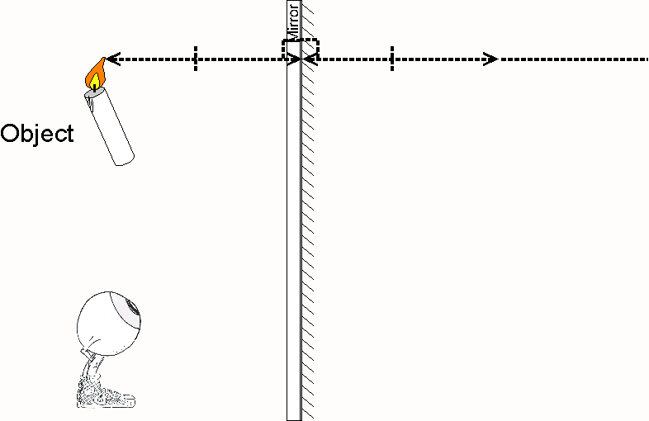
Copy this distance (d_{Otop}) to the other side of the mirror. It becomes (d_{Itop}).

Slide 11
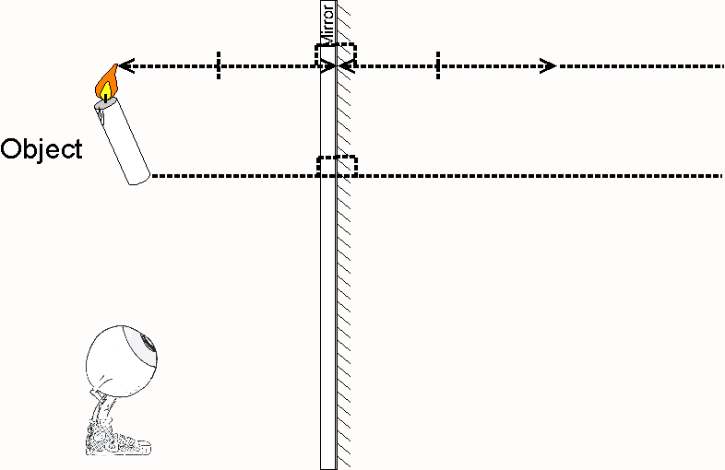
Repeat this process for the bottom of the object.
Notes:
This line should be drawn very lightly so that it does not confuse the diagram later.
The arrow over the candle is there because it’s easier to draw as an image.

Slide 12
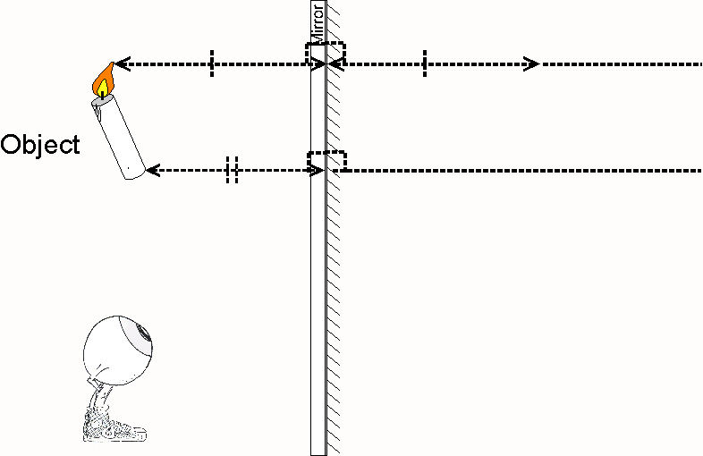

Slide 14
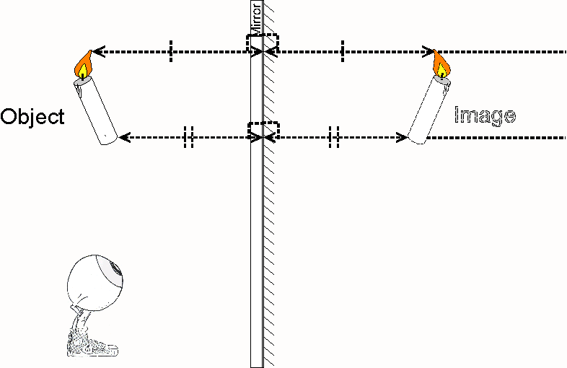
These two points give the location of the top and bottom of the image. For any point d_{O} = d_{I.}
Notes:
The arrow over the candle is there because it’s easier to draw as an image.

Slide 15
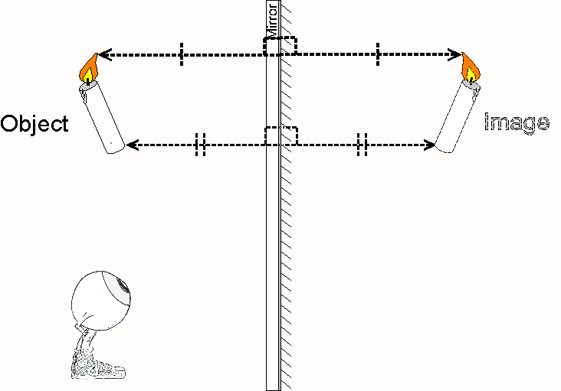
To make the diagram less cluttered, I’ve removed the unneeded part of the dotted line

Slide 16
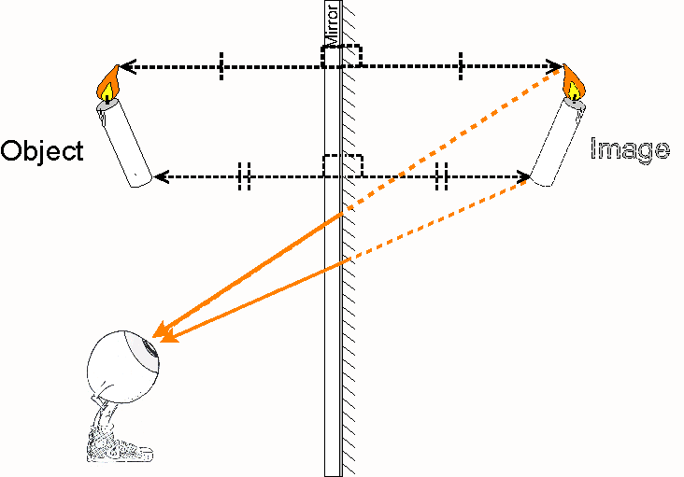
Rays of light must be entering the eye as if they had come straight from the image. That is the way the eye sees things.

Slide 17
The line is dotted behind the mirror because light rays cannot go through an opaque mirror. They travel in this direction but could not come from the image’s location.

Slide 18
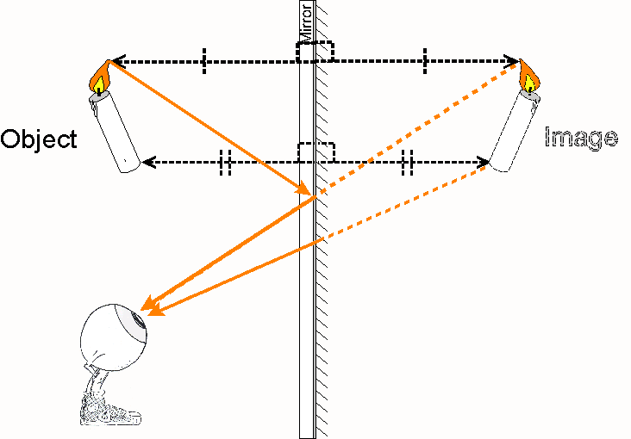
The light rays that appear to come from the top of the image really came from the top of the object and reflect off the mirror into the eye.

Slide 19
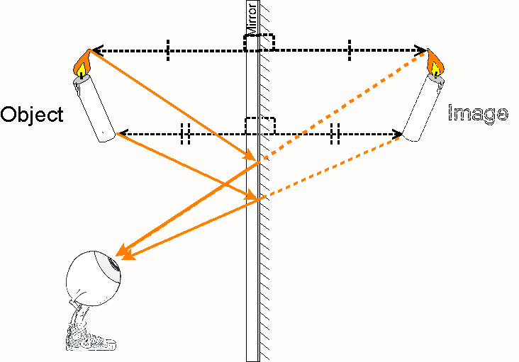
The light rays that appear to come from the bottom of the image really came from the bottom of the object and reflect off the mirror into the eye.

Slide 20
The light rays reflect most strongly off the back of glass mirrors. A metallic coating applied to the back of the glass causes the reflection.

Slide 21
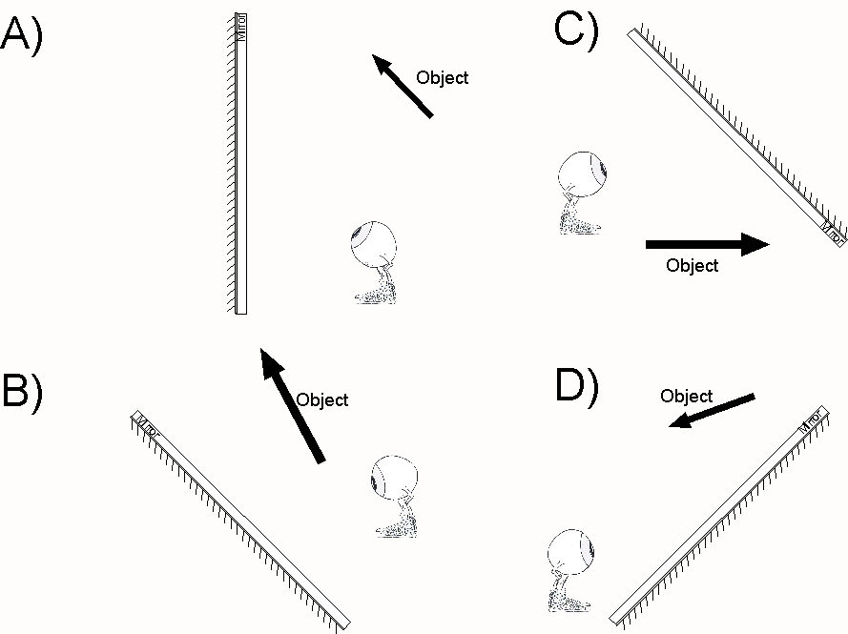
Your Turn
In your notes, show how light is reflected from the mirror so that the eye sees the image behind it.
Notes:
Note page

Slide 22
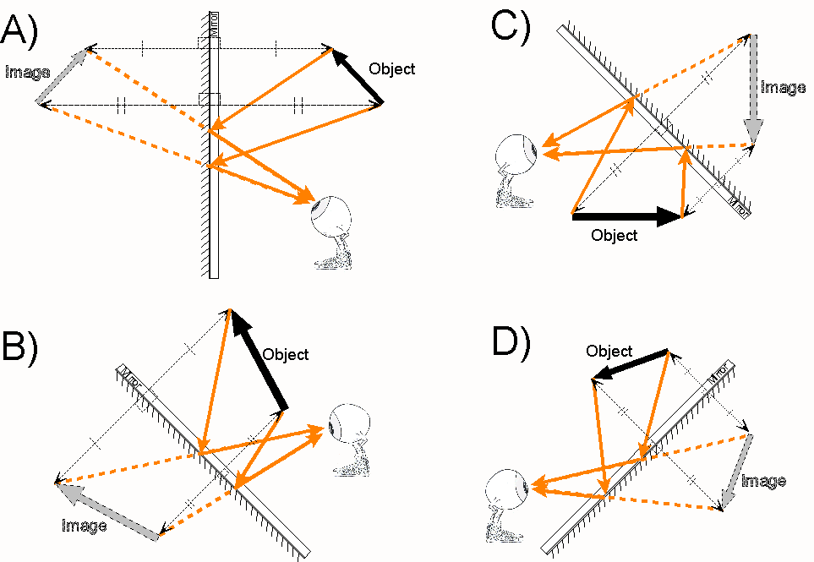
A) should look like this. Try B).
Notes:
Note page

Slide 23
B) should look like this. Try C).
Notes:
Note page

Slide 24
C) should look like this. Try D).
Notes:
Note page

Slide 25
D) should look like this. Try the next questions.
Notes:
Note page

Slide 26
Which Eye-Brains can see the object?

Slide 27
Which Eye-Brains can see the object?
C) and D) only. Light travels in a straight line from the object to the Eye-Brain. Rectilinear Propagation is the term for this.

Slide 28
Which Eye-Brains can see the image in the mirror?

Slide 29
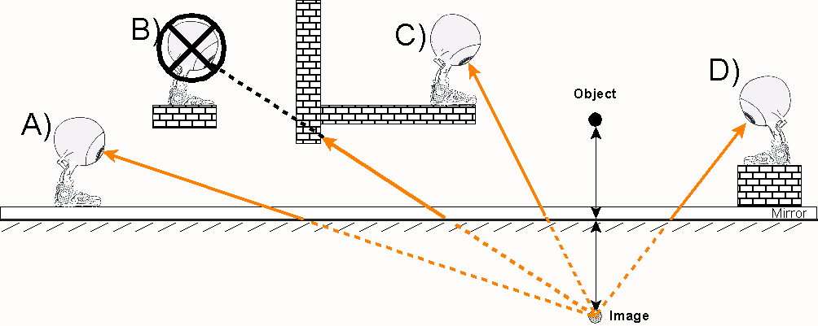
Which Eye-Brains can see the image in the mirror?
A) C) and D) only. Light appears to travel in a straight line from the image to the Eye-Brain. Rectilinear Propagation is the term for this.

