Slide 1
How We See

Slide 2
UNDERSTANDING SIGHT
To understand sight, you have to understand:
Light
Eye-Brain combination
We will focus mostly on how light behaves in the physical world.
The study of this is called Optics

Slide 3
SAY HELLO TO EYEVAN!
Eyevan the Eye-Brain will be used throughout our lessons, so get used to seeing him!

Slide 4
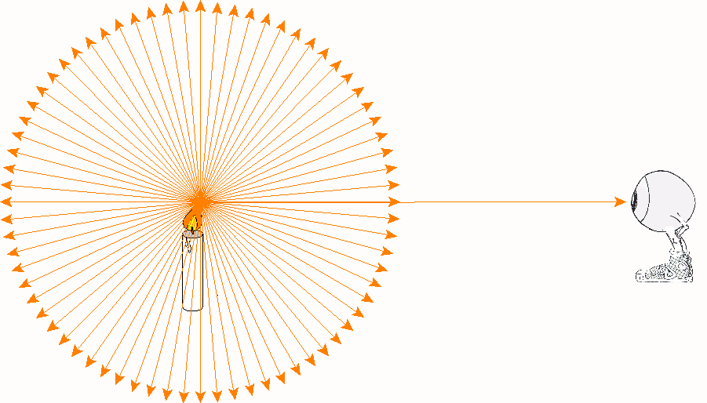
ANOTHER WAY TO THINK OF LIGHT
Light leaving the candle travels in all directions, but we only SEE the light that travels in to our Eye-Brain

Slide 5
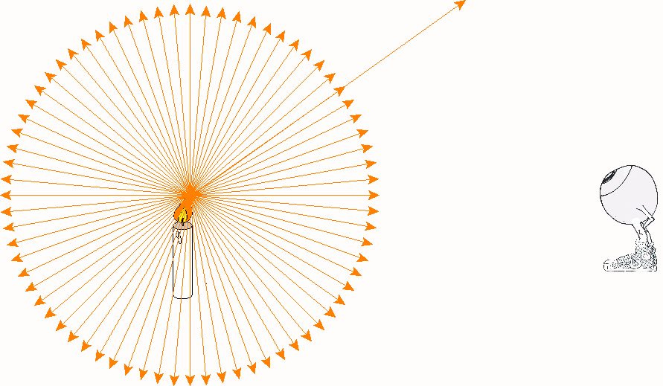
ANOTHER WAY TO THINK OF LIGHT (CONT’D)
We don’t see light that doesn’t enter our eyes.

Slide 6
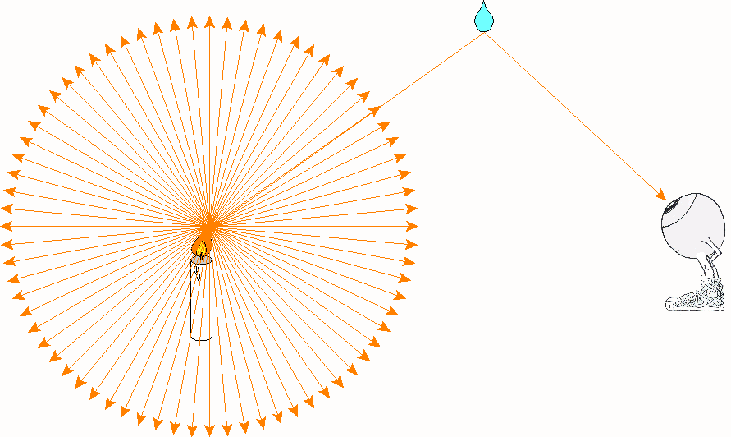
ANOTHER WAY TO THINK OF LIGHT (CONT’D)
If the light going away from eyes is reflected in to our Eye-Brain, then we will see it.

Slide 7
SIDE NOTE
When we look at diagrams, we will ignore light that doesn’t enter our Eye-Brain.
Don’t forget that the other light exists, we are just ignoring it to simplify our lives!

Slide 8
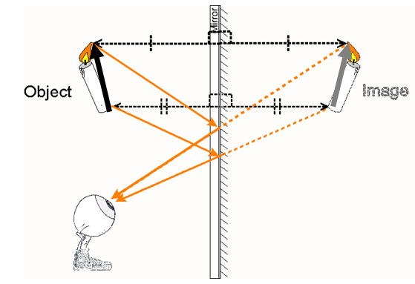
RAYS & DIAGRAMS
Ray Diagrams show how light moves from the object to the eye.
Light Ray – a line on a diagram representing the direction and path that light is travelling.

Slide 9
RAYS & DIAGRAMS
Light is a type of energy our eyes are sensitive to.
Considered an Operational Definition because it only describes HOW we detect light, but doesn’t tell us WHAT light is.

Slide 10
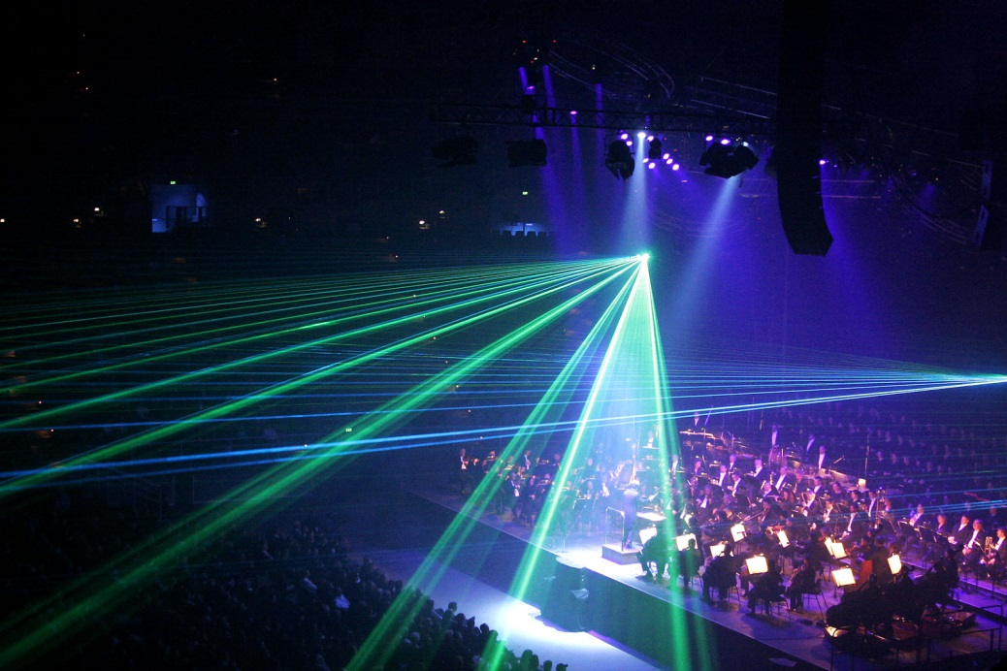
RAYS & DIAGRAMS
Rectilinear Propogation describes how light always travels in straight lines.
Think of shadows and what they look like. They perfectly copy whatever the object is.

Slide 11
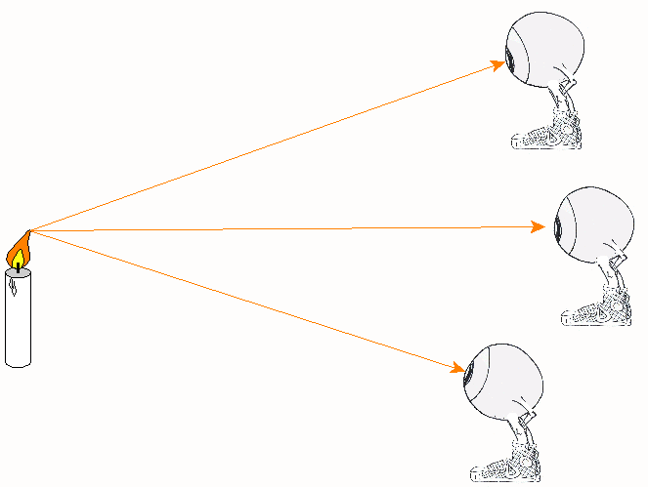
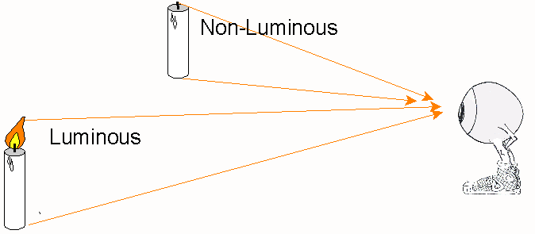
KEEP IT SIMPLE
To make diagrams simpler, we only show one ray of light from the top and bottom of objects.
We simplify it even more and just show only the rays coming from the top of the object.

Slide 12
MEDIUMS
A TRANSPARENT MEDIUM allows nearly all rays to pass straight through unaltered. (Ex. Air)
An OPAQUE MEDIUM absorbs or scatters all the rays. (Ex. Textbook, wall, etc.)

Slide 13
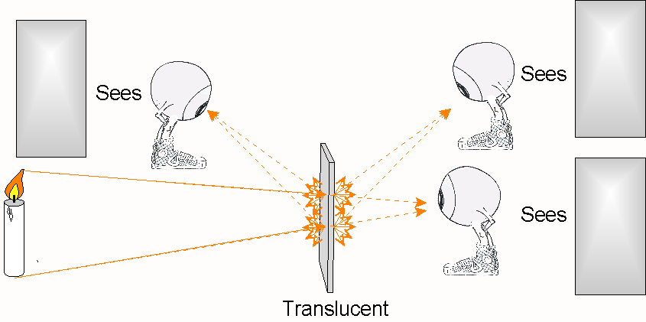
MEDIUMS (CONT’D)
A TRANSLUCENT MEDIUM transmits and scatters the rays. The medium indicates whether it is being illuminated by the object can not be clearly seen. (Ex. Wax Paper)

