Slide 1
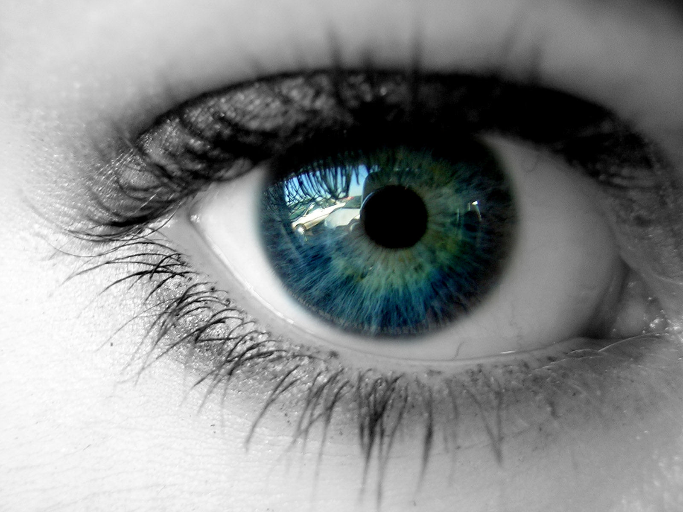
The Human Eye

Slide 2
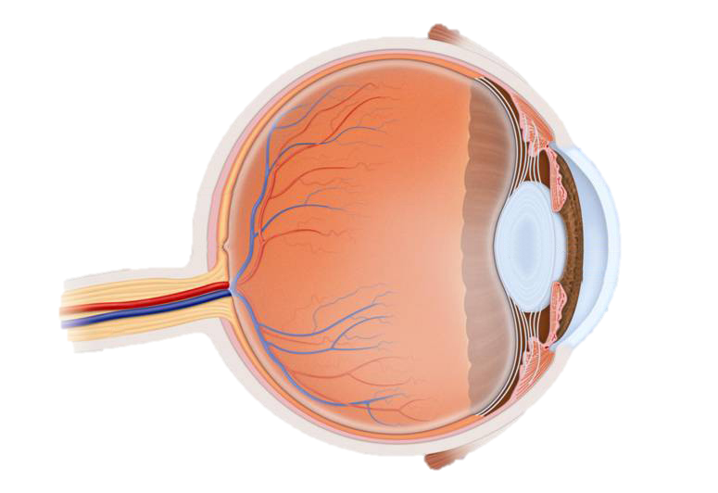
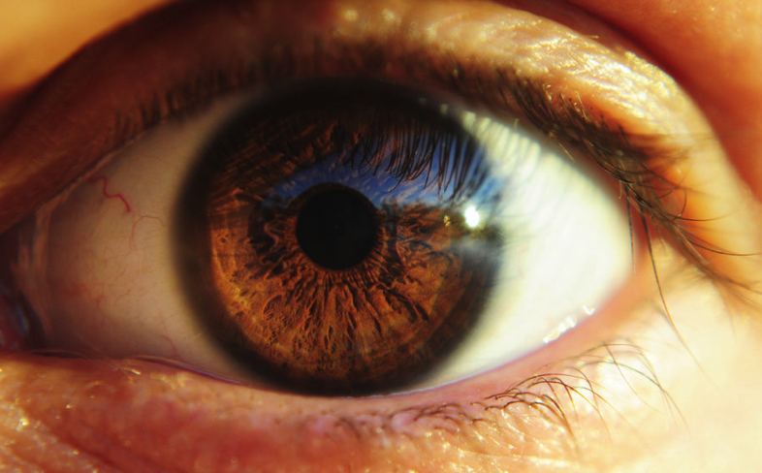
Parts of the Eye
Retina
Iris
Pupil
Cornea
Optic nerve
Lens

Slide 3
Videos to watch
YouTube: Anatomy and function of the eye
YouTube: Bill Nye – The Eyeball

Slide 4
Seeing
d_{o}
f
Retina
F
F’
object
image
d_{i}

Slide 5
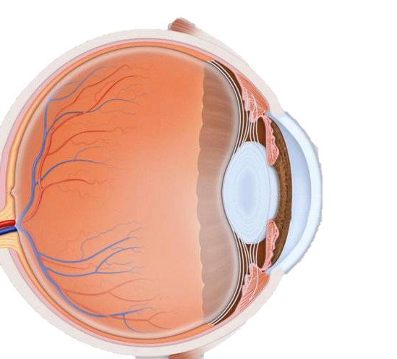
Focusing on objects
d_{o}
f
Retina
F
F’
object
d_{i}

Slide 6
Eye Accommodation
d_{o}
f_{new}
Retina
F
object
F’
d_{i}

Slide 7
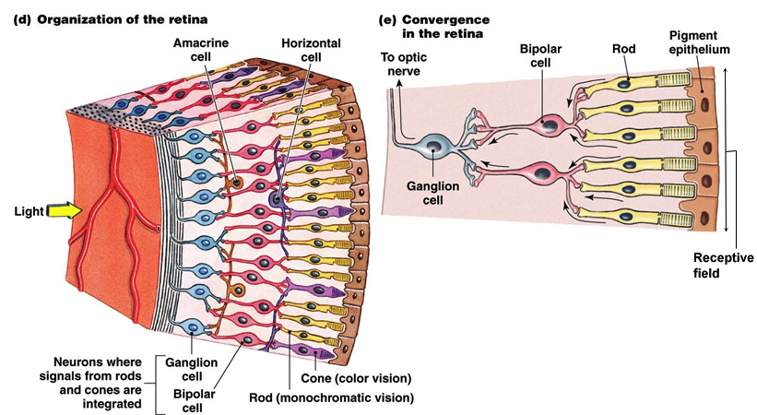
Rods and Cones
YouTube: Khan Academy – Photoreceptors

Slide 8
Hyperopia (Far-sightedness)
d_{o}
f
Retina
F
object
F’
image
d_{i}

Slide 9
Hyperopia
Positive Meniscus
a modified form of the converging lens shape.
More cosmetically appealing than a basic convex lens, but it is also thicker in the middle

Slide 10
Hyperopia
Presbyopia
A form of far-sightedness
eye lens loses its elasticity when people get older
people have a harder time reading small print
can be corrected by glasses

Slide 11
Myopia (Near-sightedness)
d_{o}
f
Retina
F
F’
image
d_{i}

Slide 12
Myopia
Negative Meniscus
a modified form of the diverging lens shape.
More cosmetically appealing than a basic concave lens, but it is also thinner in the middle and thicker on the edges

Slide 13
Correcting sight
YouTube: The Eye, Focus and Optical Lens

