Slide 1
Lens Applications
Focusing on the big picture.

Slide 2
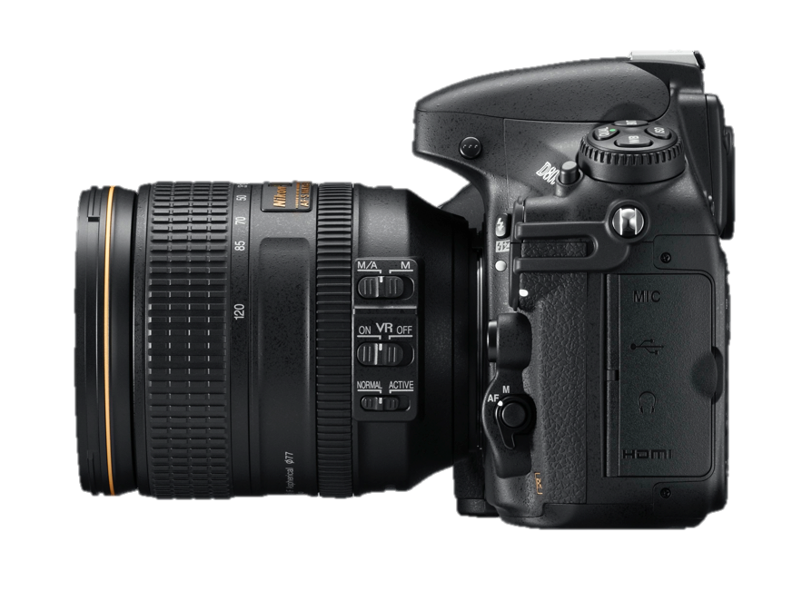
Camera
d_{o}
f
Digital sensor
F
2F’
F’
2F
image
object
d_{i}

Slide 3
Camera
d_{o}
f
Digital sensor
F
2F’
F’
2F
image
object
d_{i}

Slide 4
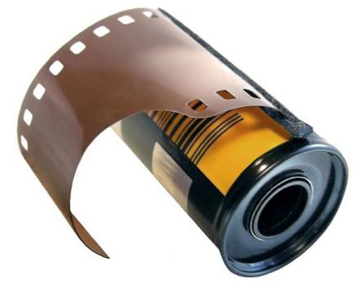
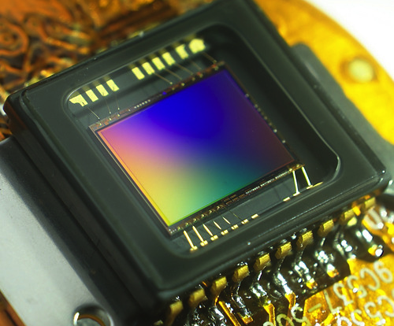
Captured on “film”
Film roll
Charge-coupled Device (CCD)

Slide 5
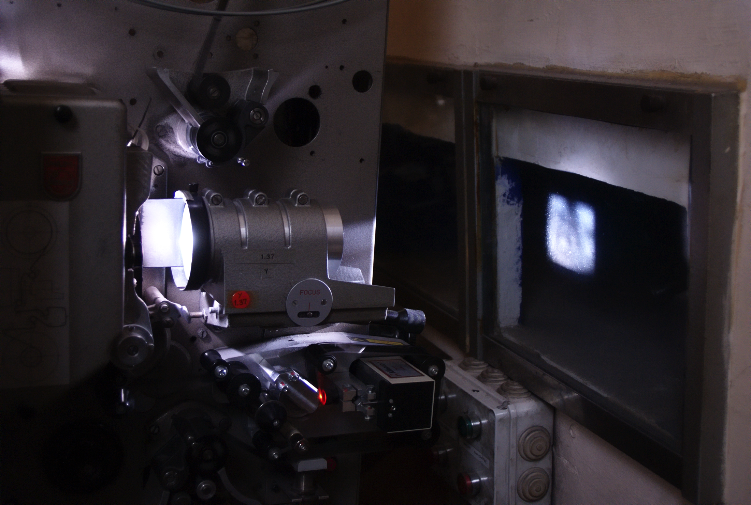
Projector

Slide 6
Projector
f
F’
2F’
F
2F
d_{o}
d_{i}
object
image

Slide 7
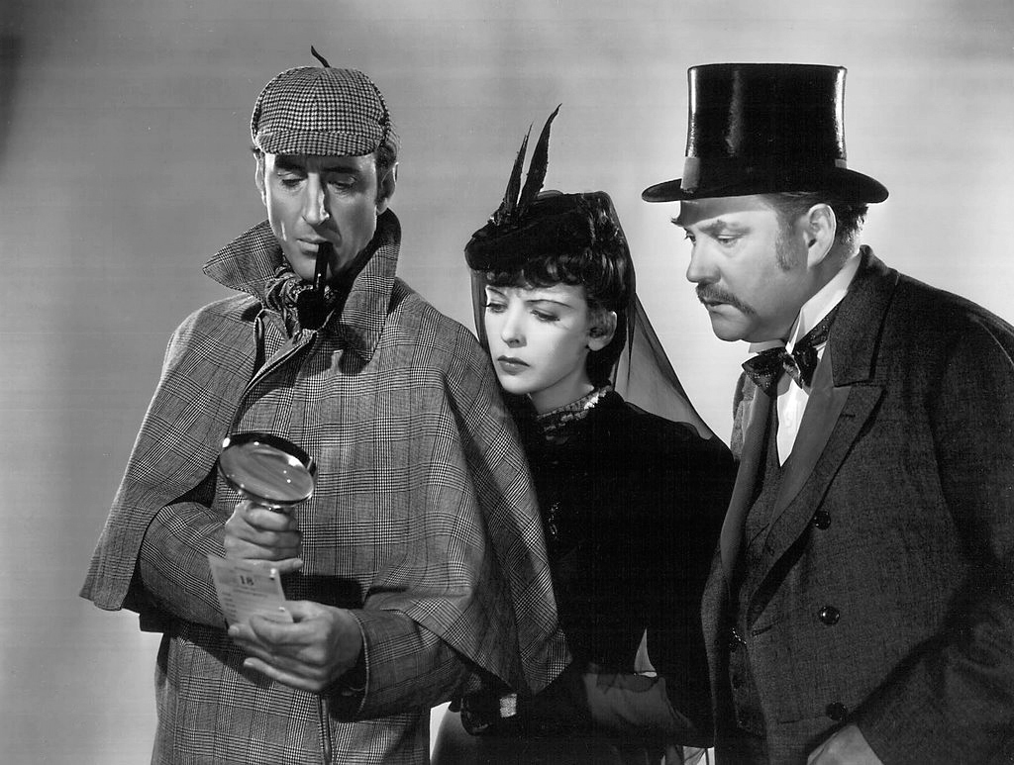
Magnifying Glass

Slide 8
Magnifying Glass
d_{i}
f
image
2F’
F’
object
F
2F
d_{o}

Slide 9
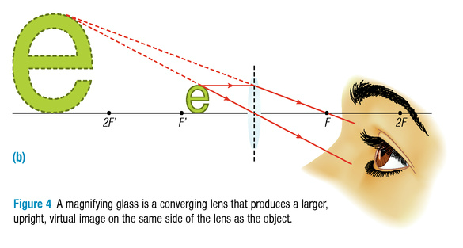
Magnifying Glass

Slide 10
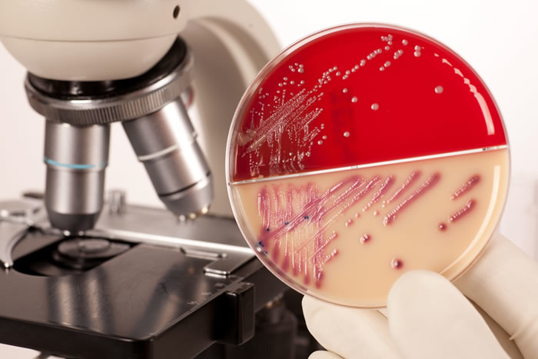
Compound Microscope

Slide 11
Compound Microscope
image 1
F
2F
F
2F’
F’
F’
object
objective lens
image 2
eyepiece lens

Slide 12
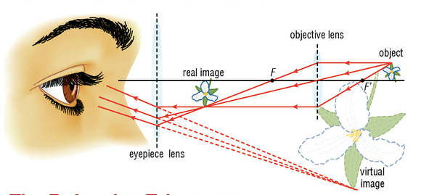
Compound Microscope

Slide 13
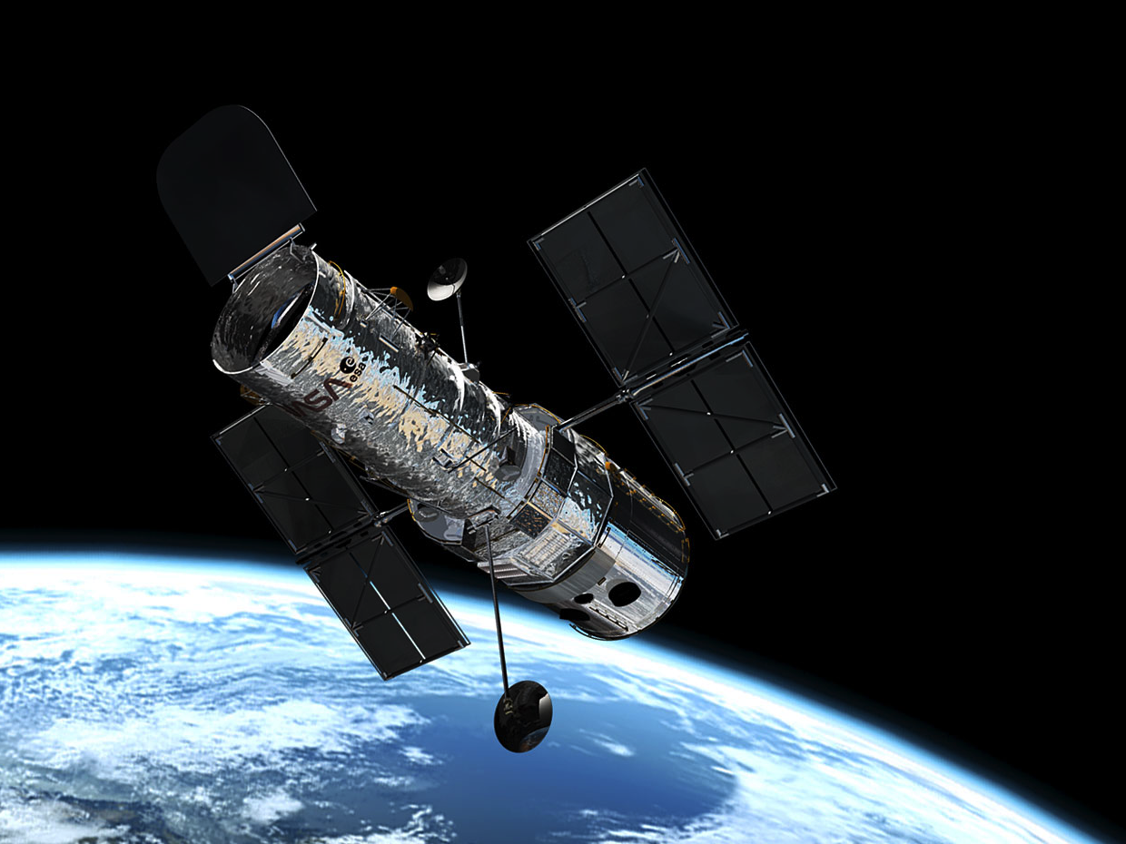

Slide 14
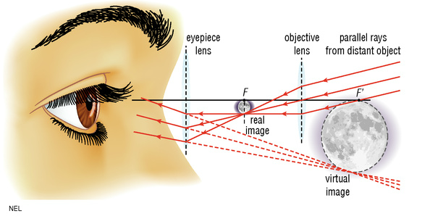
Telescopes

