Slide 1
Solutions

Slide 2
Which ones are solutions?
Tea?
Stainless steel spoon?
Hand sanitizer?
Hand lotion?
Notes:
Put examples in beakers and classify them together

Slide 3
Definitions
Solution:
Binary Solution:
Solvent:
A solution is a homogenous mixture of two or more substances. The composition of a solution can vary within certain limits
This type has only two constituents, called the solute and the solvent
The substance present in the larger quantity and that does the dissolving

Slide 4
Definitions
Solute:
Dilute:
Concentrated:
Aqueous Solution:
The substance present in the smaller quantity which is dissolved in the solvent
A dilute solution is one which contains a relatively small amount of solute compared to the amount of solvent
A concentrated solution contains a large amount of solute compared to the amount of solvent
A solution in which the solvent is water

Slide 5
Definitions
Miscible:
Immiscible:
When liquids can mix in any proportion to form a homogeneous solution (e.g. ethanol and water).
When substances are added together they DO NOT form a homogeneous mixture (e.g. oil and water).

Slide 6
Examples of Solutions
Solvent | Solute | Example | Use
Liquid | Liquid | Ethylene glycol in water | Engine Antifreeze
Liquid | Solid | Ammonium nitrate in water | Ice pack
Liquid | Gas | Carbon dioxide in water | Carbonated beverages
Gas | Gas | Oxygen in helium | Deep sea diving
Gas | Liquid | Gasoline in air | Car engines
Gas | Solid | Naphthalene in air | Mothballs
Solid | Solid | Copper in gold | Jewellery

Slide 7
The Dissolving Process for a Salt
1. Solvent particles are attracted to solute particles at the surface of the soild.
2. Ionic Bonds are broken between the solute particles
3. Hydrogen bonds are broken between the solvent molecules
4. Solute particles become surrounded by solvent molecules, forming ion-dipole bonds.
Notes:
Show youtube video

Slide 8
Factors Affecting the Rate of Dissolving
What can make a solutes dissolve faster?
Factor | Effect | Explanation
Particle Size
Temperature
Stirring
Smaller particles will dissolve faster
Increased surface area is exposed to solvent
Solute dissolves faster at higher temperatures
More frequent collisions between molecules
Agitating a solution increases the rate of dissolving
Fresh solvent in continually comes into contact with the undissolved solute

Slide 9
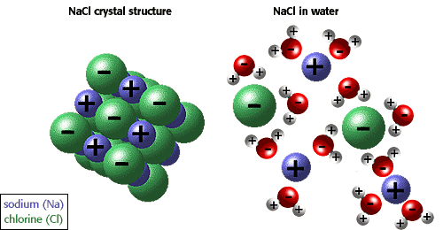
Dissociation
The dissolving of ionic compounds in which the ions separate from each other and the crystal lattice.
The resulting ions are called hydrated or aqueous ions.

Slide 10
Definitions
Saturated:
Unsaturated:
Supersaturated:
One which contains the maximum amount of solute that can be dissolved in a given amount of solvent at a particulate temperature
One which contains less than the maximum amount of solute that can be dissolved in a given amount of solvent at a particulate temperature
A solution with more solute than a saturated solution

Slide 11
Testing for Saturation
Simply place a small crystal in a solution:
If the crystal gets smaller, the solution is unsaturated
If the crystal does not change, the solution is saturated
If the crystal grows, the solution is supersaturated

