Slide 1
Functional Group
Ester
Created by: Jenny Chase

Slide 2
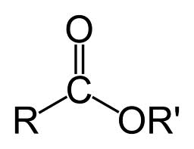
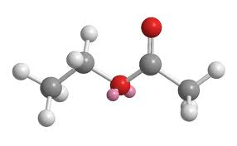
Ester

Slide 3
What is Ester
Esters are one of a number of compounds known collectively as acid derivatives. In these the acid group is modified in some way. In an ester, the hydrogen in the -COOH group is replaced by an alkyl group (or possibly some more complex hydrocarbon group).
Esters are found everywhere. Most naturally occurring fats and oils are the fatty acid esters of glycerol. Esters with low molecular weight are commonly used as fragrances and found in essential oils and pheromones. (Phosphoesters form the backbone of DNA molecules)

Slide 4
How is it formed?
Esters are chemical compounds created by reacting an oxoacid with a hydroxyl compound such as an alcohol or phenol. Esters are usually resulted from an inorganic acid or organic acid in which at least one -OH (hydroxyl) group is replaced by an -O-alkyl (alkoxy) group, and most commonly from carboxylic acids and alcohols. Esters are formed by condensing an acid with an alcohol.

Slide 5
Where can Ester be found
Esters encompass a large family of organic compounds with broad applications in medicine, biology, chemistry and industry.
Esters occur naturally in plants and animals. Small esters produce the pleasant aroma of fruits. In general, a work of chemicals is responsible for specific fruity fragrances. However, very often one single compound plays a leading role.
For example, an artificial pineapple flavor contains more than twenty ingredients but ethyl butyrate is the major component that accounts for the pineapple-like aroma and flavor. It is amazing that so many fragrances and flavors can be prepared by simply changing the number of carbons and hydrogens (the R groups) in the ester

Slide 6
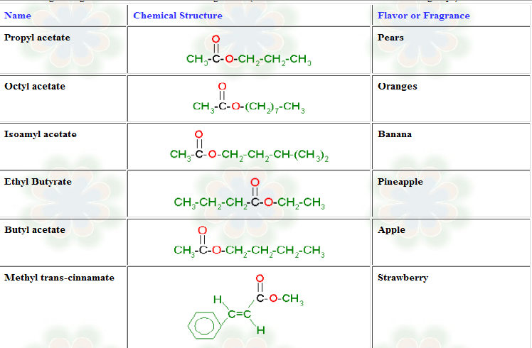

Slide 7
How to name Ester groups
Example 1: Write the structural formula for methyl propanoate.
An ester name has two parts - the part that comes from the acid (propanoate) and the part that shows the alkyl group (methyl).
Start by thinking about propanoic acid - a 3 carbon acid with no carbon-carbon double bonds.
The hydrogen in the -COOH group is replaced by an alkyl group - in this case, a methyl group.

Slide 8
How to name . . .
Example 2: Write the structural formula for ethyl ethanoate.
This is probably the most commonly used example of an ester. It is based on ethanoic acid ( hence, ethanoate) - a 2 carbon acid. The hydrogen in the -COOH group is replaced by an ethyl group.
Make sure that you draw the ethyl group the right way round. A fairly common mistake is to try to join the CH₃ group to the oxygen. If you count the bonds if you do that, you will find that both the CH₃ carbon and the CH₂ carbon have the wrong number of bonds.

Slide 9
Some more about Esters
Esters are alkyl derivatives of carboxylic acids.
The easiest way to deal with naming esters is to recognise the carboxylic acid and the alcohol that they can be prepared from.
The general ester, RCO₂R' can be derived from the carboxylic acid RCO₂H and the alcohol HOR‘
The first component of an ester name, the alkyl is derived from the alcohol, R'OH.
The second component of an ester name, the -oate is derived from the carboxylic acid, RCO₂H.
Alcohol component
the root name is based on the longest chain containing the -OH group.
The chain is numbered so as to give the -OH the lowest possible number.
Carboxylic acid component
the root name is based on the longest chain including the carbonyl group.
Since the carboxylic acid group is at the end of the chain, it must be C1.
The ester suffix for the acid component is appended after the hydrocarbon suffix minus the "e" : e.g. -ane + -oate = -anoate etc.
The complete ester name is the alkyl alkanoate

