Slide 1
Electricity and Magnetism: Unit 3 Review
Lesson 12

Slide 2
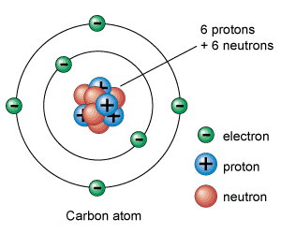
Electrically Charged Particles
Protons have a positive electric charge (+)
Electrons have a negative electric charge (–).
Only Electrons can move
Neutrons have no electric charge, they are neutral.

Slide 3
Static Charges
The electric charge that builds up on the surface of the object is called a static charge or static electricity.
One common cause of electron transfer is friction.
Friction is the force resisting the relative motion of two surfaces in contact. The force of friction can remove electrons from one object and
Electron Affinity
Different substances have different abilities to hold on to electrons

Slide 4
Laws of Attraction and Repulsion
• The law of attraction states that particles with opposite charges attract each other.
The law of repulsion states that particles with like charges repel each other.

Slide 5
Electrical Insulators and Conductors
Conductivity is the ability of materials to allow electrons to move freely in them.
An electrical insulator is a solid, liquid, or gas that resists or blocks the movement of electrons.
Materials that allow electrons to change positions are called conductors

Slide 6
Charged Objects
An electroscope is an instrument that can be used to detect static charge.
Charging by contact occurs when electrons transfer from the charged object to the neutral object that it touches.
The neutral object gains the same type of charge as the object that touched it because the electrons move from one object to the other

Slide 7
Charged Objects
Charging by Induction
When charging an object by induction, a charged object is used to induce a charge in a neutral object and then ground the charged object so it retains the charge.
This newly charged object has the opposite charge to the charge on the charging object.

Slide 8
Charged Objects
Coulombs - One coulomb equals 6.24 x 10¹⁸ electrons added to or removed from a neutral object.
Q = Ne
Where Q is the amount of charge in coulombs,
N is the total number of electrons in either deficit or excess, and
e is the charge on an electron 1.602 x 10⁻¹⁹ C.

Slide 9
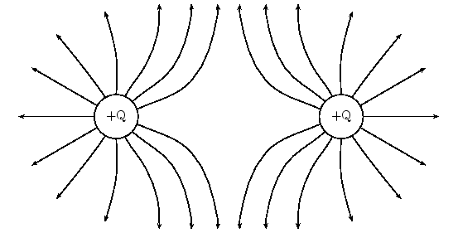
Forces at a distance
Electrostatic forces do not need to be in contact with each other for them to act on each other. In general, the farther the forces are apart from one another the weaker the force.
To describe the forces that exist in areas around electrostatic charges, we use a field map which describes an electric field.

Slide 10
Current
the rate of charge flow and is given the symbol I. Current is the total amount of charge moving past a particular point in a conductor divided by the time taken.
I is the current in amperes (A)
Q is the charge in coulombs (C)
t is the time in seconds
One ampere is one coulomb of charge moving past a particular point in a conductor every second. A = C/s

Slide 11
Direction of Current Flow
Historically, current was thought to flow from positive (+) terminal to the negative (-) terminal of any supply unit. The model of positive charge flow is called conventional current and is still used today.
For this class we will think of electrons from the black negative (-) terminal to the red positive (+) terminal.

Slide 12
Measurement of current
An Ammeter (a current measuring device) must be wired so that all current flows through it. The ammeter must be an excellent conductor so that no energy is lost due to its addition to the circuit.

Slide 13
AC DC
In DC or direct current, the current flows in a single direction from the power supply through the conductor to a load, such as a light bulb, and back to the power supply.
In AC or alternating current, the electrons periodically reverse the direction of flow.

Slide 14
The electrical potential energy for each coulomb of charge in a circuit is called the electric potential difference (V)
Where E is the energy required to increase the electric potential of a charge, Q. Potential difference is often called voltage.
One volt (V) is the electric potential difference between two points if one joule of work (J) is required to move one coulomb (C) of charge between the points.

Slide 15
Potential difference between any two points can be measured using a voltmeter. A voltmeter must be connected in parallel with a load in the circuit in order to compare the potential before and after the load.

Slide 16
Resistance – Ohm’s Law
The measure of opposition to flow is called electrical resistance.
Where R is the resistance in volts/ampere, which is given the unit of Ohm (Ω), V is the potential difference in Volts (V) and I is the resulting current in amperes (A)

Slide 17
Ohm’s Law
The amount of current flowing though a resistor varies directly as the amount of potential difference applied across the resistor as long as other variables, such as temperature, are controlled. There is a resistance of 1 Ω when 1 A flows with a potential difference of 1 V across a resistor.

Slide 18
Factors that Determine Resistance
Length
The longer the conductor, the greater the resistance
Cross-sectional Area
The larger the cross sectional area or thickness of the conductor, the less resistance it has to charge flow.
Type of material
Some materials are better conductors than others. The general measure of the resistance of a substance is called the resistivity which has the units Ωm.
Temperature
Since moving charge is impeded by molecules, greater motion at higher temperatures tends to increase resistance.

Slide 19
Series and Parallel Circuits
two simplest ways to connect conductors and load are series and parallel circuits.
Series circuit - A circuit in which loads are connected one after another in a single path.
Parallel circuit – A circuit in which loads are connected side by side.

Slide 20
Kirchhoff’s Laws
Kirchhoff’s current law – the total amount of current into a junction point of a circuit equals the total current that flows out of that same junction.
I₁ + I₂ + I₃ = I₄ + I₅
Kirchhoff’s Voltage Law – The total of all electric potential difference in any complete circuit loop is equal to any potential increases in the circuit loop.
The potential increase, V_{T} is equivalent to the sum of all the potential losses so that
V_{T} = V₁ + V₂ + V₃

Slide 21
Kirchhoff’s Laws
Resistance in series
R_{T} = R₁ + R₂ + R₃ If all the resistors are the same, use the formula
Resistance in parallel
If all the resistors are the same, use the formula

Slide 22
Applying Kirchhoff’s Voltage law to a mixed circuit
To analyze a mixed circuit, start by separating the circuit into sections that are connected in parallel and sections that are connected in series.
Series Circuit
Parallel Circuit

Slide 23
Electrical power and Energy
Power is described as the rate of transforming energy, essentially the rate at which work is done.
Power can be measured in joules per second (J/s), or watts (W).
ΔE is the energy transformed in joules (J)
Δt is time interval in seconds (s)

Slide 24
Power | Potential Difference | Current
Power, | Power , | Amperes

Slide 25
ΔV is electric potential difference in volts (V), (1 V = 1 J/C)
I is electric current in amps (A)
One watt is a small amount of power, so electrical power is often stated in kilowatts (1 kW = 10³) or megawatts (1MW = 10⁶)

Slide 26
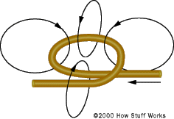
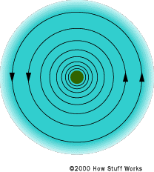
Electromagnets
Force at a distance is the common element between electrostatics and magnetism. Hans Oersted studied this and came up with the following principle.
Charge moving through a conductor produces a circular magnetic field around the conductor.

Slide 27
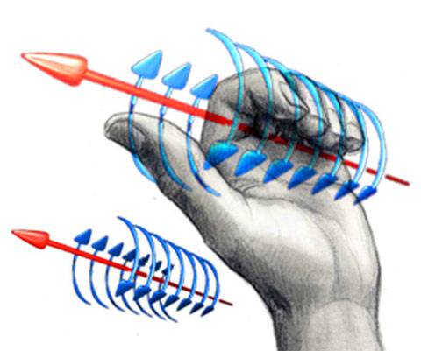
Left-hand rule # 1 for Conductors (LHR #1)
Grasp the conductor with your left hand such that the thumb points in the direction of the electron (-) current flow. The curved fingers point in the direction of the circular magnetic field around the conductor.

Slide 28
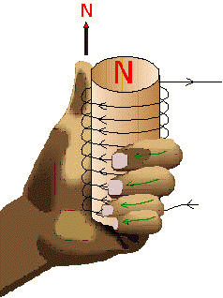
Left hand rule # 2 (LHR#2)
Grasp the coiled conductor with the left hand such that the curled fingers point in the direction of the electron (-) current flow through the conductor. The thumb points in the direction of the magnetic field within the coil. Outside the coil, the thumb represents the north (N) end of the electromagnet produced by the coil

Slide 29
The strength of the electromagnet can be controlled by the following factors.
Current in the coil
The greater the current flow, the greater the field strength. Strength varies directly as the current in the coil.
Number of turns in the coil
The greater the number of coils, the greater the field strength. Strength varies directly as the number of turns in the coil of the current is constant.
Type of material in the coils centre
The more ferromagnetic the material within the coil, the greater the magnets strength. Iron is one of the better materials to use.
Size of the coil
the smaller the diameter of the coil, the stronger the magnetic field.

Slide 30
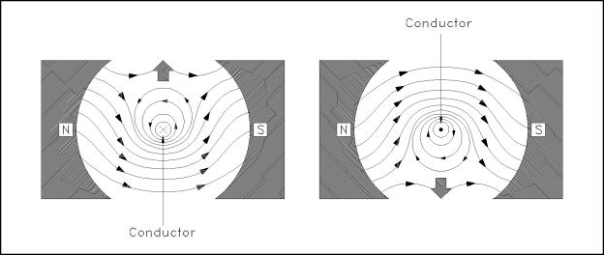
The Motor Principle
Two magnetic fields interact with each other to produce a force. If the conductor that carries a current cuts through an existing magnetic field, it experiences a force perpendicular to both the conductor’s charge flow and the external magnetic field. The strength of this force depends on the strength of the external magnetic field and the current through the conductor.

Slide 31
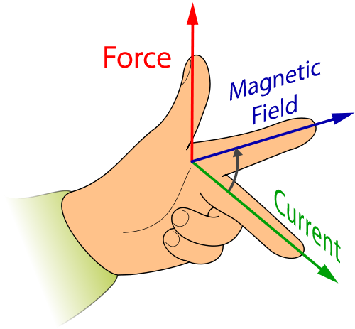
Left Hand Rule #3 (LHR#3)
Open your left hand so that your fingers point in the direction of the magnetic field (from south to north). Rotate the middle finger so that it points in the direction of electron (-) current flow. The orientation of the thumb the direction of the force produced.

Slide 32
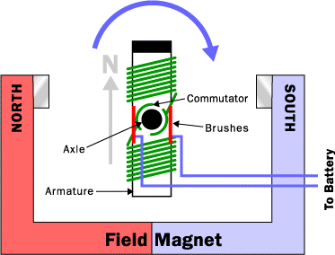
Electric Motors
The electric motor is a device that directs electric force full circle, without stopping part way. A DC current motor is safe, efficient, and cost effective. In a DC motor, the electromagnet changes its polarity once every rotation. This polarity change is made because the split ring communicator reverses the current flow in the armature.

Slide 33
The Simple Induction AC Motor
There are several types of AC motors that exist. We will look at the most basic type.
As previously stated, AC current alternates back and forth; the current does not flow in one constant direction as it does in DC. In North America, this cycles 60 times per second. The AC motor works on the same principle as the DC motor, like charges repel causing the motor to spin. If the motor seen to the right was used it would spin at around 30 RPS because the current is cycling at 60 Hz.

