Slide 1
DNA Deoxyribonucleic Acid
Anatomy and Structure

Slide 2
DNA stands for deoxyribonucleic acid.
DNA carries hereditary information that is passed on from one generation to the next.
It is found in all living organisms – from bacteria to plants to mammals.
It holds the chemical message for producing every part of the organism.
It regulates life by carrying the directions for growth, repair, and replacement of cells and their parts.

Slide 3
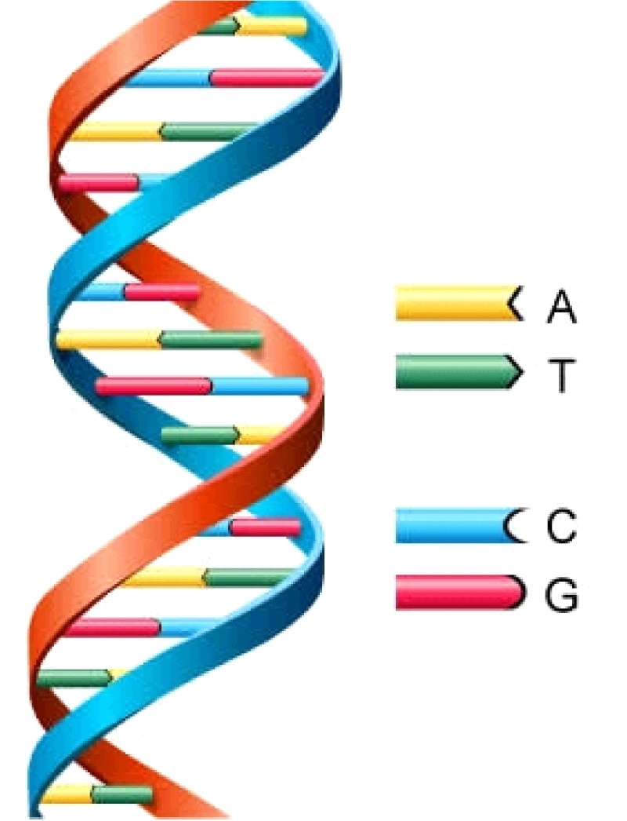
Nucleotides
DNA is a macromolecule. That means it is a large molecule that is actually a polymer. A polymer is a molecule made of many repeating units called monomers. The monomer of DNA is a nucleotide.
A nucleotide is made of 3 parts:
5 carbon pentose sugar (deoxyribose/ribose)
1 to 3 phosphate groups (PO₄³⁻)
nitrogenous base (Adenine (A), Thymine (T), Cytosine (C), Guanine (G)

Slide 4
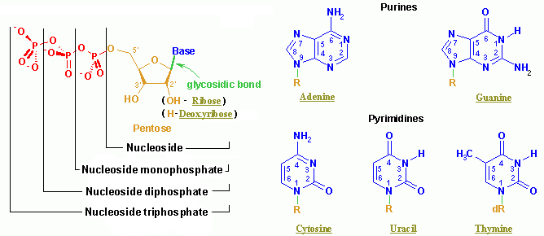

Slide 5
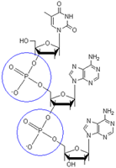
The nitrogen bases are found facing the middle of the double helix and form the rungs of the DNA ladder. The sugar and phosphate groups make up the sides of the ladder. The sides of the ladder are referred to as the sugar-phosphate backbone or the phosphodiester backbone of the DNA double helix. Each nucleotide is attached to the next nucleotide through the sugar-phosphate backbone by a hydrolysis reaction forming a phosphodiester linkage.The blue circles indicate the phosphate groups attached to the five carbon ring ribose structure. | A 5 Carbon sugar attached to a phosphate makes up the phosphodiester backbone of DNA

Slide 6
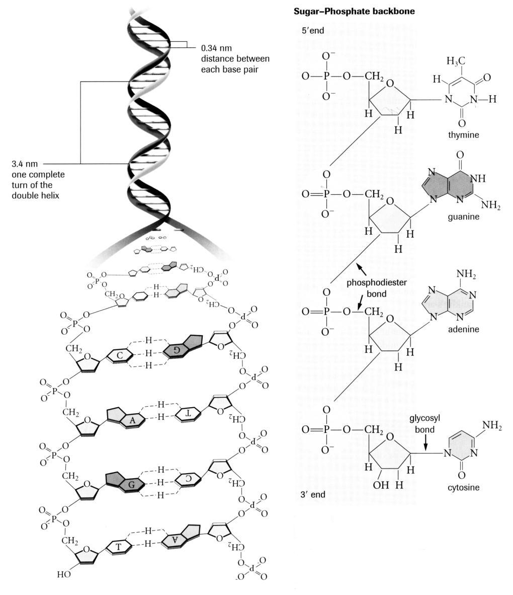

Slide 7
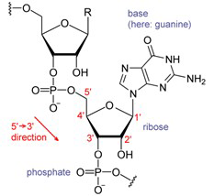
The ribose sugar has all five carbons numbered. At carbon 2’ there is a hydroxyl group. When the oxygen in the hydroxyl group is missing, the ribose sugar is called deoxyribose. In DNA there is no oxygen at carbon 2’. However in RNA there is an oxygen atom, so the sugar in RNA is called ribose rather than deoxyribose.

Slide 8
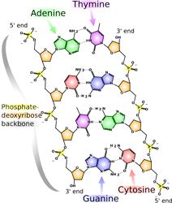
The sugar-phosphate backbone makes the sides of the ladder and the rungs are made of the 4 nitrogen bases. Their names are often represented by the letter of the base name (A, C, G, & T). The actual ladder itself is made of two strands of DNA which is why it is called a double helix. Each strand attaches by the nitrogen bases that pair in the middle (the rungs of the ladder). A pairs with T – held by 2 H-bonds G pairs with C – held by 3 H-bonds Note that a purine pairs with a pyrimidine (e.g. adenine a purine pairs with thymine-a pyrimidine) forming H-bonds with amino, and carbonyl functional groups.

Slide 9
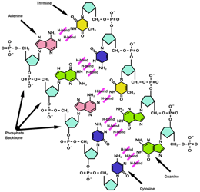
As shown in the image above, on each strand of DNA there is a 3’end and a 5’end. The 3’ refers to the carbon 3 on the ribose that is free and not linked to another nucleotide. The 5’ refers to carbon 5 on the ribose that is not linked to another nucleotide. Note that the 3’ end of one strand is opposite to the 5’ end of the other strand of DNA. This configuration makes the two strands antiparallel – in the opposite directions.

Slide 10
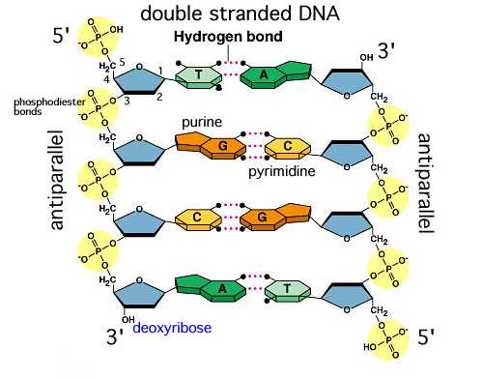

Slide 11
LINKS FOR DEEPER UNDERSTANDING
DNA STRUCTURE
http://www.blc.arizona.edu/Molecular_Graphics/DNA_Structure/DNA_Tutorial.HTML#helixaxis
DNA ANATOMY
http://www.johnkyrk.com/DNAanatomy.html

Slide 12
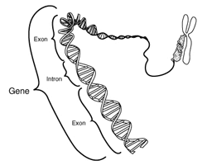
Genes
Genes are units of heredity that are passed on from parent to offspring. Genes give specific instructions for one characteristic or protein. Genes are actually made of DNA that is folded and coiled upon itself. When a cell is preparing to divide, the genetic material containing the genes becomes visible as chromosomes. The DNA is folded on itself repeatedly or said to be supercoiled.

Slide 13
The actual coiling of the DNA double helix is much more complex than shown above. Humans have 46 chromosomes and each chromosome is made up of DNA that is coiled and folded repeatedly. DNA is folded and coiled around proteins called histones. This makes it more difficult to find a particular gene and locate which chromosome it is on. Pictured below is a different overview of DNA

Slide 14
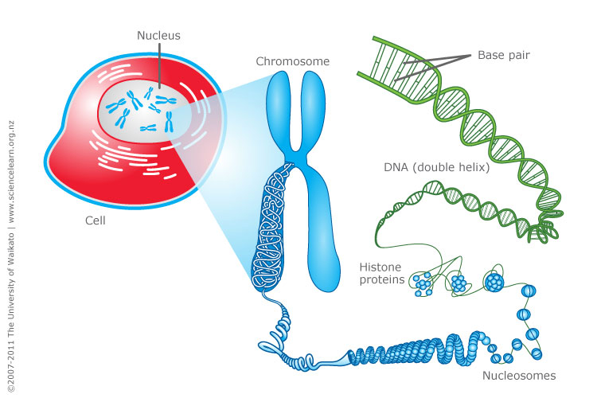

Slide 15
Use the following resources to learn more about DNA structure, chromosomes and alleles.
http://learn.genetics.utah.edu/content/begin/tour/

