Slide 2
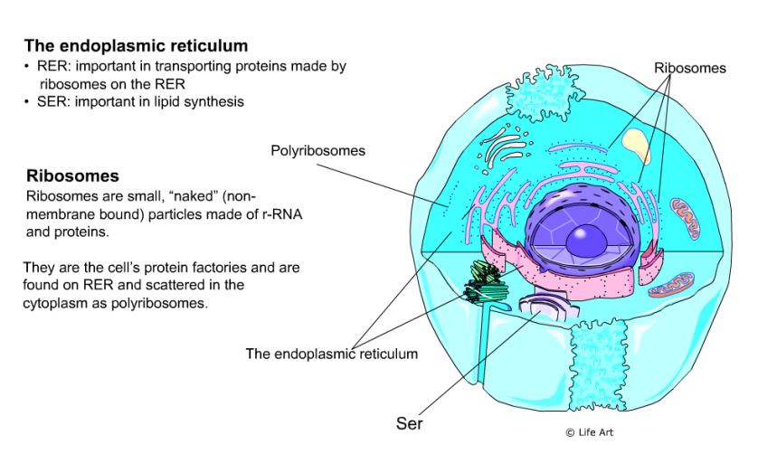

Slide 3
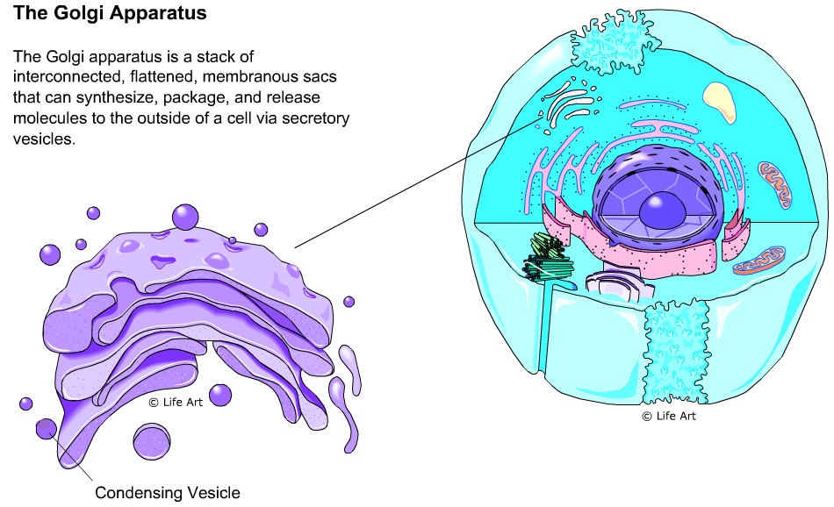

Slide 4
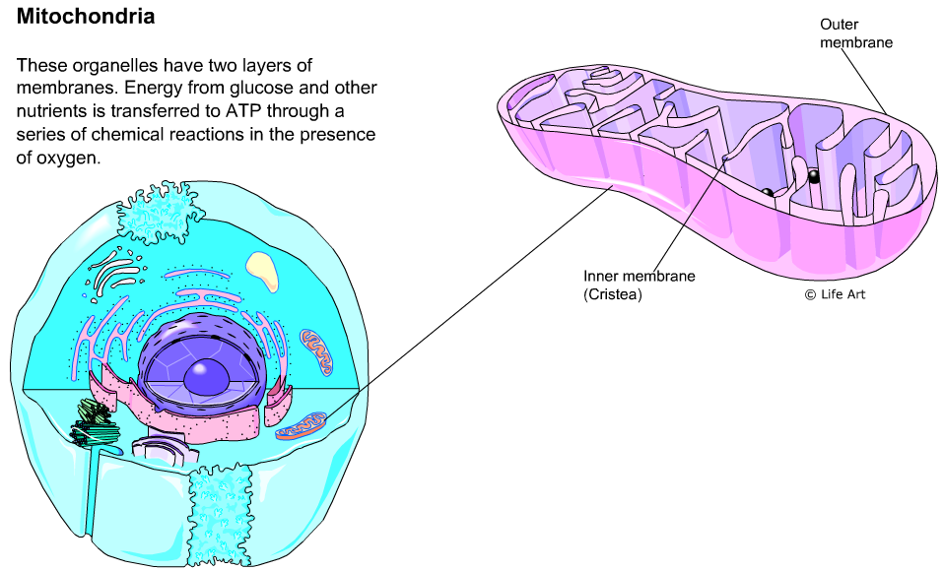

Slide 5
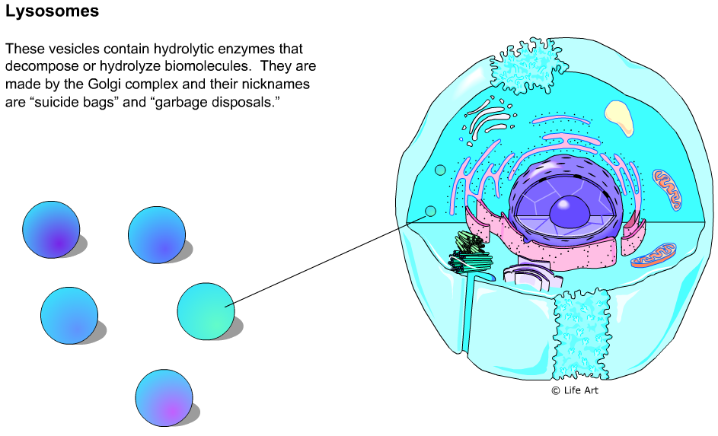

Slide 6
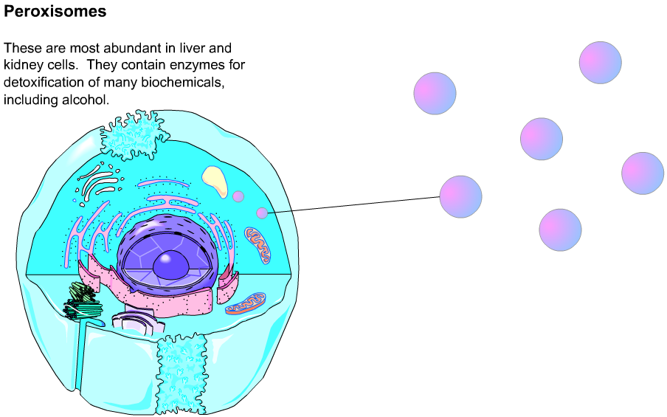

Slide 7
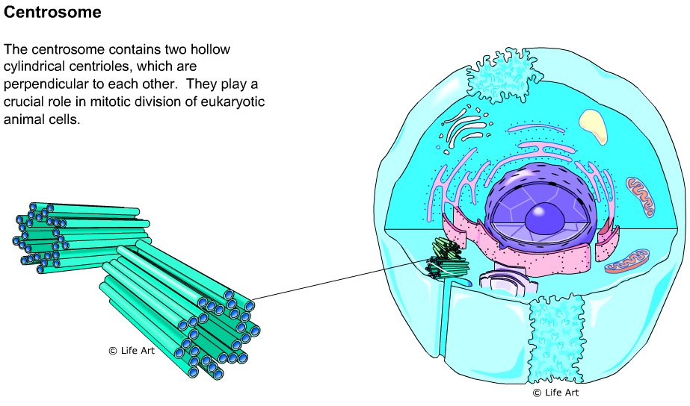

Slide 8
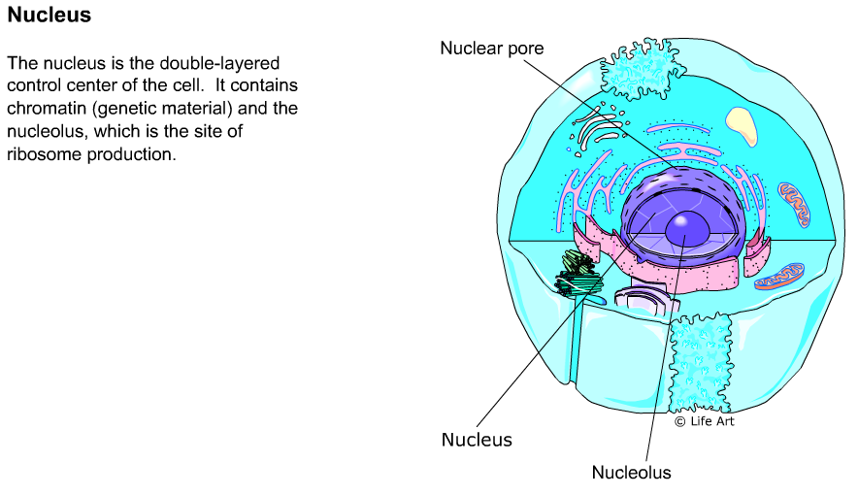

Slide 9
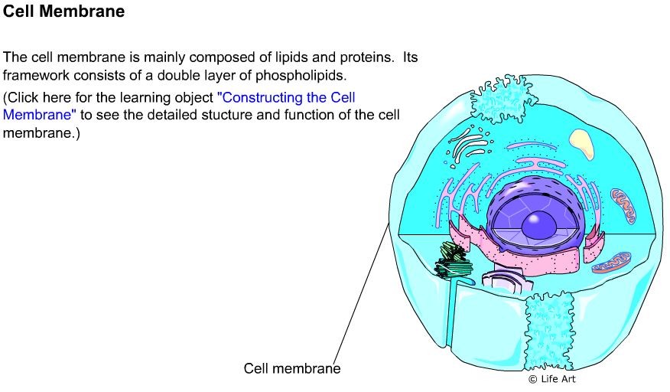

Slide 10
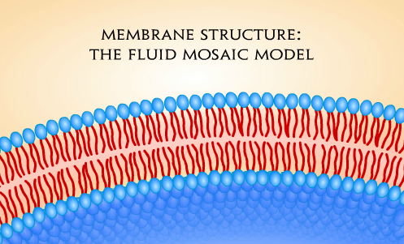

Slide 11
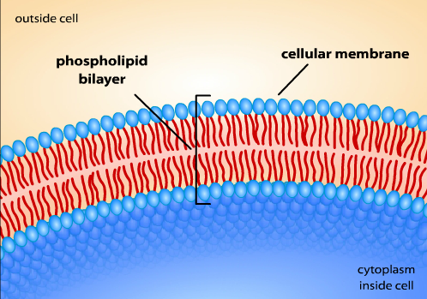

Slide 12
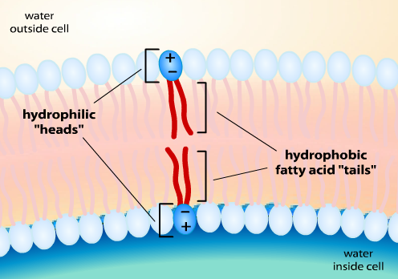

Slide 13
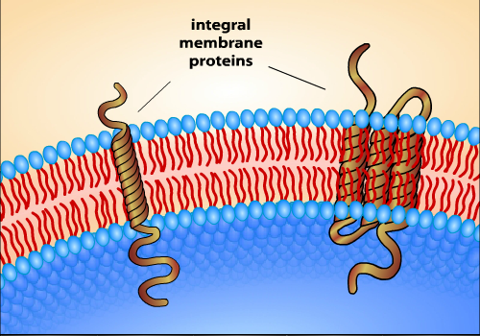
These proteins are called trans-membrane or integral proteins. Many proteins have a quaternary structure and are made of several polypeptide chains

Slide 14
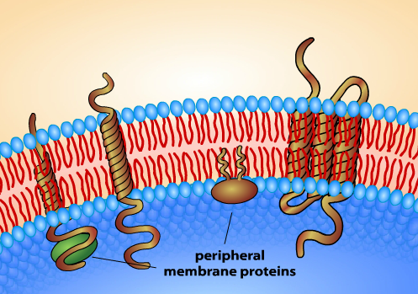
Some of the proteins rest on one side or the other of the membrane. These are called peripheral proteins or monotopic proteins

Slide 15
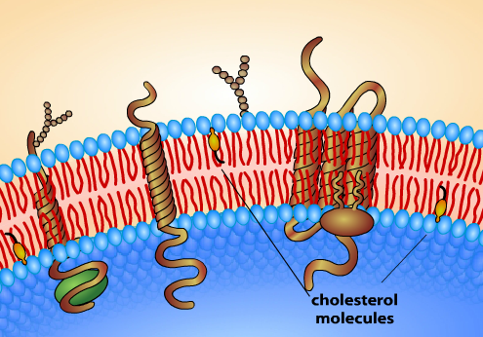
Other parts of the membrane include molecules of cholesterol with adds to the structural integrity of the membrane. Glycolipids form when a carbohydrate attaches to a lipid (fat) molecule.

Slide 16
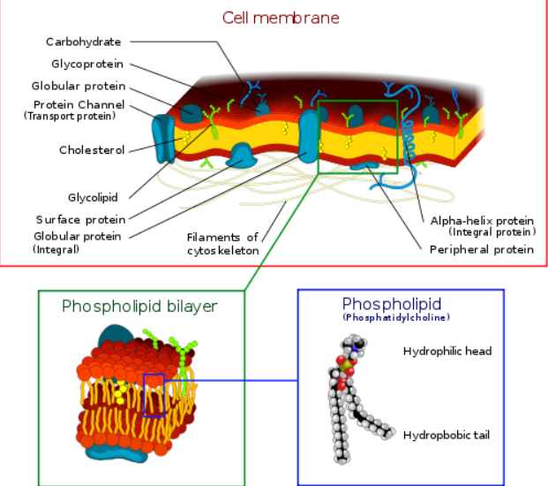

Slide 17
http://www.northland.cc.mn.us/biology/BIOLOGY1111/animations/active1.swf

