Slide 1
Simple Ions

Slide 2
Chemical Reactivity
How much an element reacts depends on the electron configuration of its atoms.
Every elements wants 8 valence electrons.
Oxygen only has six, so it wants two more
Neon already has eight.

Slide 3
Chemical Reacitivity
Neon is a noble gas.
The noble gases, which are found in Group 18 of the periodic table, show almost no chemical reactivity.
The noble gases have filled outer energy levels.

Slide 4
Octet Rule
In most chemical reactions, atoms tend to match the s and p electron configurations of the noble gases.
This tendency to have either empty outer energy levels or full outer energy levels of eight electrons is called the octet rule.

Slide 5
Valence Electrons
Potassium after it loses one electron has the same electron configuration as chlorine after it gains one.
The atoms of many elements become stable by achieving the electron configuration of a noble gas.
The electrons in the outer energy level are known as valence electrons

Slide 6
Valence Electrons
All atoms are uncharged because they have equal numbers of protons and electrons.
For example, a potassium atom has 19 protons and 19 electrons.
After giving up one electron, potassium still has 19 protons but only 18 electrons.
Because the numbers are not the same, there is a net electrical charge.

Slide 7
Ions
An ion is an atom, radical, or molecule that has gained or lost one or more electrons and has a negative or positive charge.
An ion with a positive charge is called a cation.
An ion with a negative charge is called an anion.

Slide 8
Ionic Bonding and Salts

Slide 9
Ionic Bonding
The force of attraction between the 1+ charge on the sodium cation and the 1− charge on the chloride anion creates the ionic bond in sodium chloride.
Sodium chloride is a salt, the scientific name given to many different ionic compounds.

Slide 10
Salts
All salts are electrically neutral ionic compounds that are made up of cations and anions held together by ionic bonds in a simple, whole-number ratio.

Slide 11
Salts
Salts that are made of a simple cation and a simple anion are known as binary ionic compounds.
The adjective binary indicates that the compound is made up of just two elements.

Slide 12
Names and Formulas of Ionic Compounds

Slide 13
Naming Ionic Compounds
The name of a binary ionic compound is made up of just two words: the name of the cation followed by the name of the anion.
NaCl sodium chloride CuCl₂ copper(II) chloride
ZnS zinc sulfide Mg₃N₂ magnesium nitride
K₂O potassium oxide Al₂S₃ aluminum sulfide

Slide 14
More than two elements
Instead of having ions made of a single atom, many ionic compounds have groups of atoms that are ions.
A polyatomic ion is a charged group of two or more bonded atoms that can be considered a single ion.

Slide 15
Naming Polyatomics
The endings -ite and -ate in the name for a polyatomic indicate the presence of oxygen and the number of oxygen atoms present.

Slide 16
Covalent Bonds

Slide 17
Sharing Electrons
When an ionic bond forms, electrons are rearranged and are transferred from one atom to another to form charged ions.
In another kind of change involving electrons, the neutral atoms share electrons.

Slide 18
Sharing Electrons
A covalent bond is a bond formed when atoms share one or more pairs of electrons.
A molecular orbital is the region of high probability that is occupied by an electron as it travels around one of two or more associated nuclei.

Slide 21
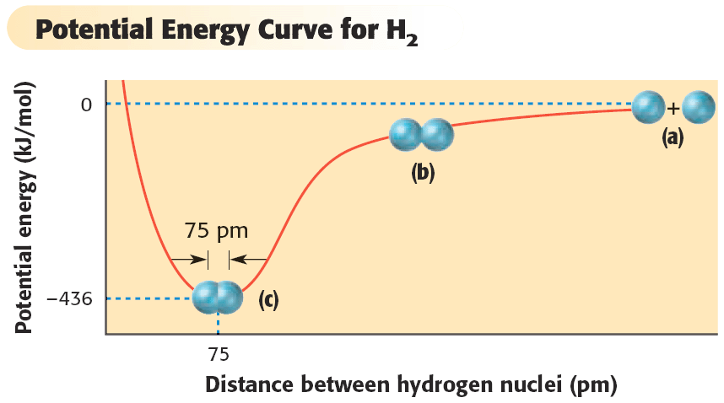

Slide 22
Stability
The bond length is the distance between two bonded atoms at their minimum potential energy.
However, the two nuclei in a covalent bond vibrate back and forth. The bond length is thus the average distance between the two nuclei.

Slide 23
Polar or NonPolar
A covalent bond in which the bonding electrons in the molecular orbital are shared equally is a nonpolar covalent bond.
A covalent bond in which the bonding electrons in the molecular orbital are shared unequally is a polar covalent bond.

Slide 24
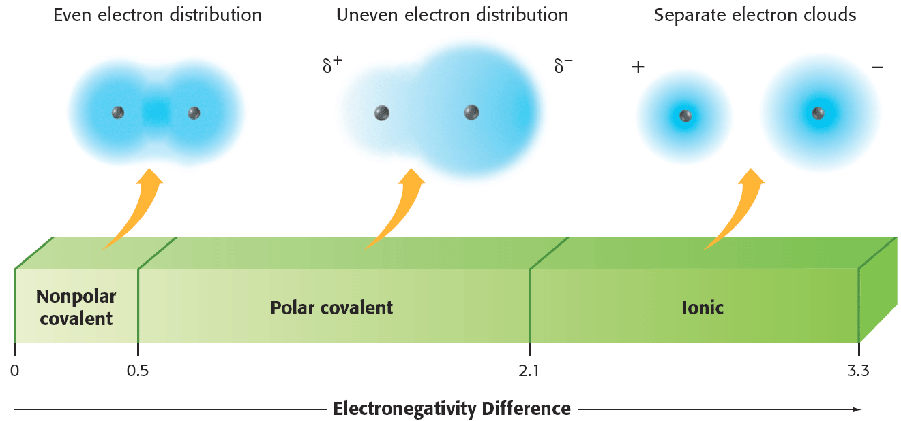

Slide 25
Electronegativity
A molecule in which one end has a partial positive charge and the other end has a partial negative charge is called a dipole.
In a polar covalent bond, the shared pair of electrons is not transferred completely. Instead, it is more likely to be found near the more electronegative atom.

Slide 26
Electronegativity
The symbol δ is used to mean partial.
δ+ is used to show a partial positive charge
δ– is used to show a partial negative charge

Slide 27
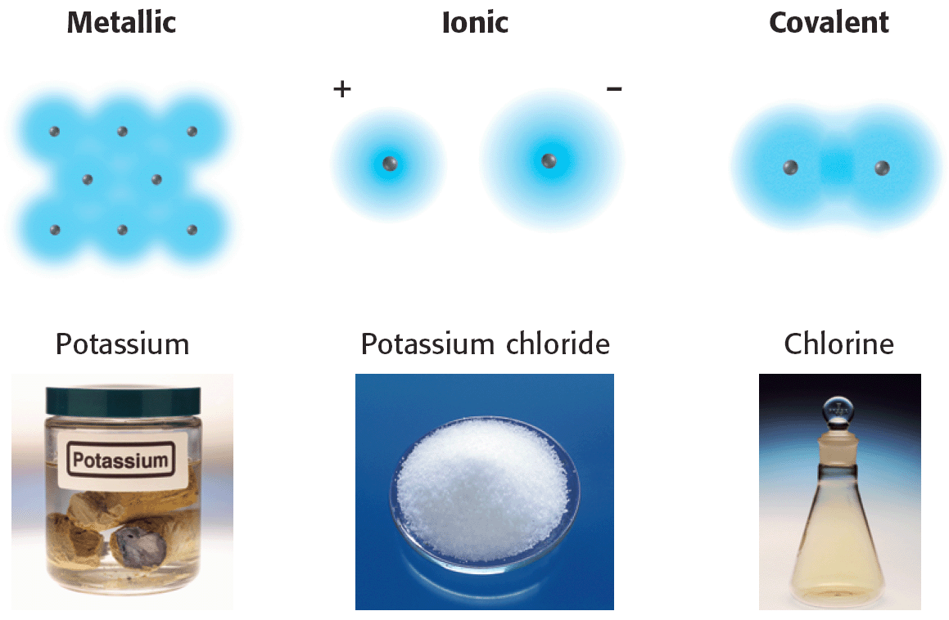

Slide 28
Drawing and Naming Molecules

Slide 29
Lewis Dot Diagrams
Valence electrons are the electrons in the outermost energy level of an atom.
A Lewis structure is a structural formula in which valence electrons are represented by dots.
In Lewis structures, dot pairs or dashes between two atomic symbols represent pairs in covalent bonds.

Slide 30
Lewis Dot Diagrams
An element with an octet of valence electrons has a stable configuration.
The tendency of bonded atoms to have octets of valence electrons is called the octet rule.

Slide 31
Lewis Structures
A single bond is a covalent bond in which two atoms share one pair of electrons
The electrons can pair in any order. However, any unpaired electrons are usually filled in to show how they will form a covalent bond.

Slide 32
Lewis Structure

Slide 33
Lewis Structure Example
CH₃I

Slide 34
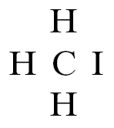
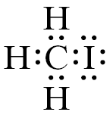
Lewis Structure Example

Slide 35
Lewis Structure (Multiple Bonds)

Slide 36
Naming Covalent Compounds
The first element named is usually the first one written in the formula.
The second element named has the ending -ide.
Unlike the names for ionic compounds, the names for covalent compounds must often distinguish between two different molecules made of the same elements.

Slide 38
Molecular Shape
The valence shell electron pair repulsion (VSEPR) theory is a theory that predicts some molecular shapes based on the idea that pairs of valence electrons surrounding an atom repel each other.

Slide 39
Molecular Shape
According to the VSEPR theory, the shape of a molecule is determined by the valence electrons surrounding the central atom.
Electron pairs are negative, so they repel each other.
Therefore, the shared pairs that form different bonds repel each other and remain as far apart as possible.

