Slide 1
Introduction to
Acids and Bases

Slide 2
Acid
A substance that produces hydrogen ions, H⁺_{(aq)}, when it dissolves in water.
Sour-tasting and good conductors of electricity.
e.g., Hydrochloric acid:
HCl _{(aq)} H⁺ _{(aq)} + Cl⁻ _{(aq)}
e.g., Sulfuric acid:
H₂SO₄ _{(aq)}
2 H⁺ _{(aq)} + SO₄²⁻ _{(aq)}

Slide 3
Base (Alkali)
A substance that produces hydroxide ions, OH⁻_{(aq)}, when it dissolves in water.
Bitter-tasting, slippery-feeling compounds; good conductors of electricity.
e.g., Sodium hydroxide:
NaOH _{(aq)} Na⁺ _{(aq)} + OH⁻ _{(aq)}
e.g., Ammonium hydroxide:
NH₄OH _{(aq)}
NH₄⁺ _{(aq)} + OH⁻ _{(aq)}

Slide 4
WATER
Cl⁻
Cl⁻
H+
Cl⁻
H+
H+
H+
Cl⁻
Acid
Base
Acidic Solution
Basic Solution
Na⁺
Na⁺
OH-
Na⁺
OH-
OH-
Na⁺
OH-

Slide 5
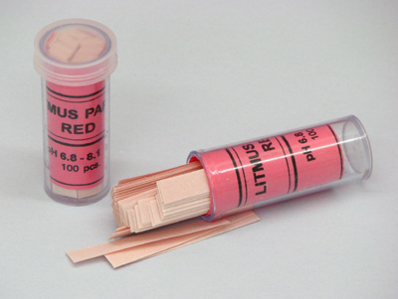
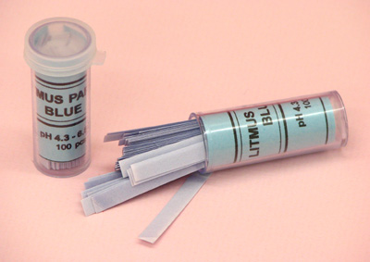
Indicator
A substance used to distinguish between acidic and basic solutions.
These compounds change colour in response to changes in the concentration of hydrogen ions or hydroxide ions.
e.g., Litmus
Red litmus turns blue in basic solutions
Blue litmus turns red in acidic solutions

Slide 6
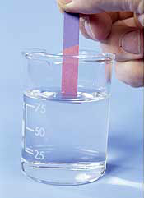
A
C
I
R E D
B A S E
L
U
E
Litmus paper is being used in the picture to the right.
What type of solution is it?
It is an acid.

Slide 7
Indicators
Yellow
Blue
Colourless
Pink/Fuchsia
(a colourless liquid)
Red/Pink
Green
Red/Wet
“Blue”
“Red”
Blue/Wet
Orange-Red
Yellow

Slide 8
The pH Scale
A scale to measure the relative acidity or basicity (alkalinity) of a solution.
The pH of a solution can range between 0 and 14.
pH of 7 is Neutral
Acidic solution: pH < 7 (more hydrogen ions than hydroxide ions)
Basic solution: pH > 7 (more hydroxide ions than hydrogen ions)
pH = -log₁₀[H⁺]

Slide 9
Values on the pH scale go up in powers of 10; therefore, the pH of 1 is 10x more acidic than the pH of 2.
stomach acid
“pure” rainwater
blood
ammonia
drain cleaner
hand soap
battery acid
acid rain
bleach
0 1 2 3 4 5 6 7 8 9 10 11 12 13 14
acids
bases
neutral
strong acid
weak acid
weak base
strong base

Slide 10
Making an Acid
React a non-metal oxide with water
e.g., sulfur trioxide + water → sulfuric acid
SO_{3 (g)} + H₂O _{(l)} → H₂SO_{4 (aq)}
Did you know: this occurs in our atmosphere as the result of industrial smoke emissions and produces acid rain?!

Slide 11
Making a Base
React a metal oxide with water
e.g., calcium oxide + water → calcium hydroxide
CaO _{(s)} + H₂O _{(l)} → Ca(OH)_{2 (aq)}
Did you know: calcium hydroxide is also called “lime” and can be used to neutralize the effects of acid rain in lakes?!
(The problem is, it’s not practical as it is costly and time-consuming).

Slide 12
Neutralization
Acids and bases react together to form water, which is neutral.
The other product of neutralization is a salt (an ionic compound) that forms from the remaining elements.
e.g., hydrochloric acid + magnesium hydroxide:
2 HCl _{(aq)} + Mg(OH)_{2 (aq)} → 2 H₂O _{(l)} + MgCl_{2 (aq)}
acid base water salt
A neutralization reaction is a special kind of double displacement reaction.

Slide 13
WATER
Cl⁻
H
Cl⁻
H⁺
Cl⁻
H
O
H⁺
Cl
H⁺
H⁺
Cl⁻
Na
Acid
Base
Acidic Solution
Basic Solution
Cl
Na
Na⁺
Na⁺
OH⁻
Na⁺
H
O
OH⁻
OH⁻
Na⁺
OH⁻
H
Neutral Solution

