Slide 1
Units of Measurement
SNC2P

Slide 2
Why do we care about units?
Measurements of physical quantities must be given with reference to some standard.

Slide 3
Why do we care about units?
Measurements of physical quantities must be given with reference to some standard.

Slide 4
Why do we care about units?
Measurements of physical quantities must be given with reference to some standard.

Slide 5
Why do we care about units?
Measurements of physical quantities must be given with reference to some standard.

Slide 6
In the SI (Système international) metric system, the base units are:
SI
time
distance
mass
electric current
temperature

Slide 7
In the SI (Système international) metric system, the base units are:
SI
time | second (s)
distance
mass
electric current
temperature

Slide 8
In the SI (Système international) metric system, the base units are:
SI
time | second (s)
distance | metre (m)
mass
electric current
temperature

Slide 9
In the SI (Système international) metric system, the base units are:
SI
time | second (s)
distance | metre (m)
mass | kilogram (kg)
electric current
temperature

Slide 10
In the SI (Système international) metric system, the base units are:
SI
time | second (s)
distance | metre (m)
mass | kilogram (kg)
electric current | Ampere (A)
temperature

Slide 11
In the SI (Système international) metric system, the base units are:
SI
time | second (s)
distance | metre (m)
mass | kilogram (kg)
electric current | Ampere (A)
temperature | Degree Celsius (ºC) or Kelvin (K)

Slide 12
SI
All other physical quantities are measured in units derived from these.
For example, energy is measured in
:

Slide 13
SI
All other physical quantities are measured in units derived from these.
For example, energy is measured in Joules:
kg × m²
1 Joule = 1
_{s}2

Slide 14
Prefixes
Metric prefixes are used to indicate a unit that is some factor of 10 larger or smaller than the base unit:
G
M
k
c
m
μ
n

Slide 15
Prefixes
Metric prefixes are used to indicate a unit that is some factor of 10 larger or smaller than the base unit:
G | giga- | 1 000 000 000
M
k
c
m
μ
n

Slide 16
Prefixes
Metric prefixes are used to indicate a unit that is some factor of 10 larger or smaller than the base unit:
G | giga- | 1 000 000 000
M | mega- | 1 000 000
k
c
m
μ
n

Slide 17
Prefixes
Metric prefixes are used to indicate a unit that is some factor of 10 larger or smaller than the base unit:
G | giga- | 1 000 000 000
M | mega- | 1 000 000
k | kilo- | 1 000
c
m
μ
n

Slide 18
Prefixes
Metric prefixes are used to indicate a unit that is some factor of 10 larger or smaller than the base unit:
G | giga- | 1 000 000 000
M | mega- | 1 000 000
k | kilo- | 1 000
c | centi- | 0.01
m
μ
n

Slide 19
Prefixes
Metric prefixes are used to indicate a unit that is some factor of 10 larger or smaller than the base unit:
G | giga- | 1 000 000 000
M | mega- | 1 000 000
k | kilo- | 1 000
c | centi- | 0.01
m | milli- | 0.001
μ
n

Slide 20
Prefixes
Metric prefixes are used to indicate a unit that is some factor of 10 larger or smaller than the base unit:
G | giga- | 1 000 000 000
M | mega- | 1 000 000
k | kilo- | 1 000
c | centi- | 0.01
m | milli- | 0.001
μ | micro- | 0.000 001
n

Slide 21
Prefixes
Metric prefixes are used to indicate a unit that is some factor of 10 larger or smaller than the base unit:
G | giga- | 1 000 000 000
M | mega- | 1 000 000
k | kilo- | 1 000
c | centi- | 0.01
m | milli- | 0.001
μ | micro- | 0.000 001
n | nano- | 0.000 000 001

Slide 22
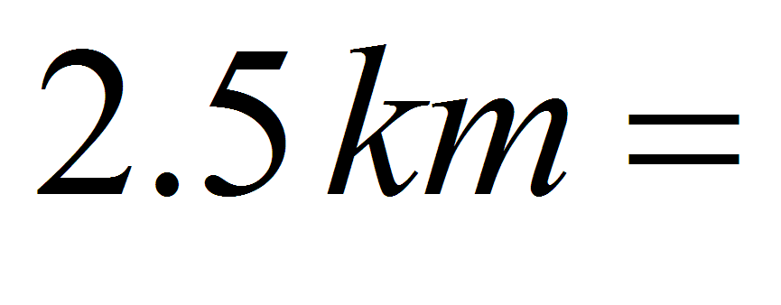
Conversions
To convert from a prefixed unit to the base unit, multiply by this factor.
For example, converting km to m:

Slide 23
Conversions
To convert from a prefixed unit to the base unit, multiply by this factor.
For example, converting km to m:
2.5 km = 2.5× 1000 m
2.5 km = 2500 m

Slide 24
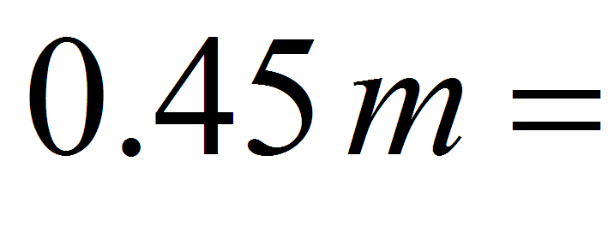
Conversions
To convert from the base unit to the prefixed unit, divide by this factor.
For example, converting m to mm:

Slide 25
Conversions
To convert from the base unit to the prefixed unit, divide by this factor.
For example, converting m to mm:
0.45 m = 0.45 ÷ 0.001mm
0.45 m = 450 mm

Slide 26
Conversion Factors
To convert between Imperial and metric units, we multiply by conversion factors.

Slide 27
Conversion Factors
To convert between Imperial and metric units, we multiply by conversion factors.
Remember:
The unit you want to get goes on top of the factor. The unit you want to cancel out goes on the bottom.
Multiply everything on the top, divide by everything on the bottom.

Slide 28
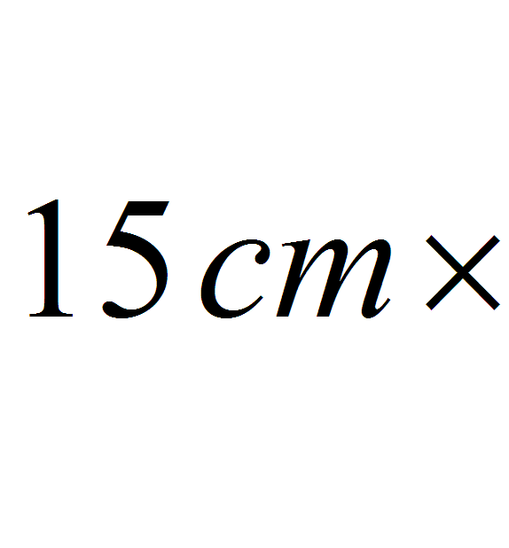
Conversion Factors: Example
Convert 15 cm to inches, given that 1 inch = 2.54 cm.

Slide 29
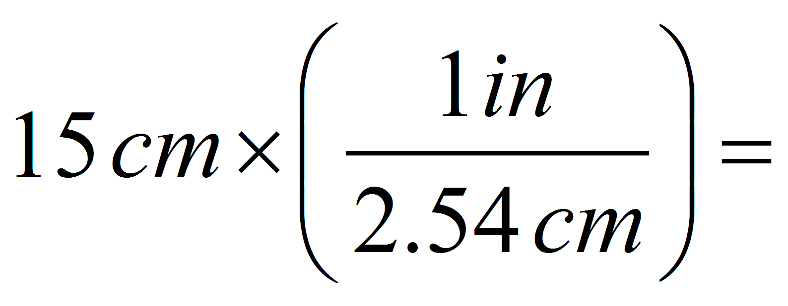
Conversion Factors: Example
Convert 15 cm to inches, given that 1 inch = 2.54 cm.

Slide 30
Conversion Factors: Example
Convert 15 cm to inches, given that 1 inch = 2.54 cm.

Slide 31
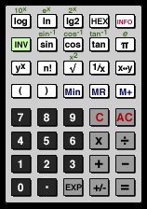
Conversion Factors: Example
Convert 15 cm to inches, given that 1 inch = 2.54 cm.
Enter this on your calculator as:

Slide 32
Conversion Factors: Example
Convert 15 cm to inches, given that 1 inch = 2.54 cm.
⎛ ⎞
1in
15 cm × ⎜⎜ ⎟⎟ = 5.9 in
⎝ 2.54 cm ⎠
Enter this on your calculator as:

Slide 33
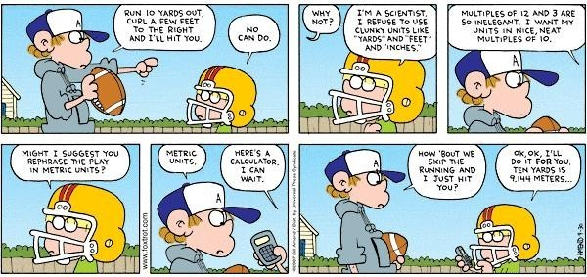
More Practice
Units of Measurement Activity
Units of Measurement More Practice

