Slide 1
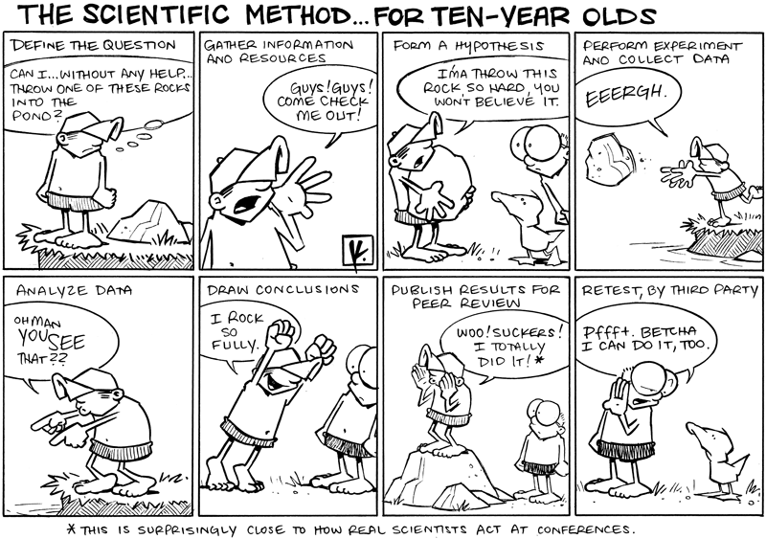
The Scientific Method
SNC2P

Slide 2
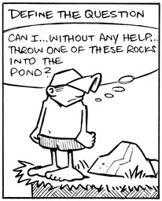
Step 1
Define the Question

Slide 3
Scientific Questions
A scientific question is any question that can be answered using the scientific method (by experiment or observation).

Slide 4
Scientific Questions
A scientific question is any question that can be answered using the scientific method (by experiment or observation).
“What is the meaning of life” is not a scientific question.

Slide 5
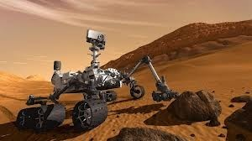
Scientific Questions
A scientific question is any question that can be answered using the scientific method (by experiment or observation).
“Is there life on Mars?” is a scientific question. It can be answered by experiment or observation.

Slide 6
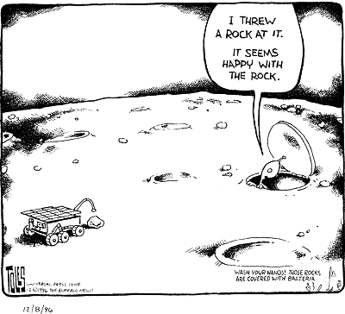
“Is there life on Mars?”
To design an experiment, however, we would need to come up with a more specific question.
We would need to think about how we would test for life.

Slide 7
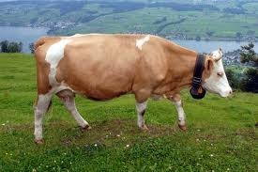
“Is there methane on Mars?”
For example, methane is an unstable gas that is produced by biological processes. Significant levels of methane in the Martian atmosphere would be evidence that there may be life.

Slide 8
Step 2
Gather Information and Resources
(Has anyone else worked on the question before? What did they discover?)

Slide 9
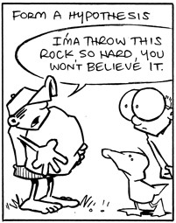
Step 3
Form a Hypothesis
A hypothesis is a prediction.

Slide 10
Step 3
A hypothesis is not just a guess.
It is based on the information gathered.

Slide 11
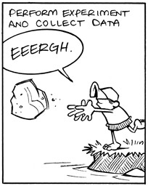
Step 4
Perform Experiment and Collect Data

Slide 12
Variables
A variable is anything in an experiment that may be changed.

Slide 13
Variables
Most experiments change only two:
the manipulated variable
(also called the independent variable)
is the variable changed by the experimenter.

Slide 14
Variables
Most experiments change only two:
the responding variable
(also called the dependent variable)
is the variable measured by the experimenter.

Slide 15
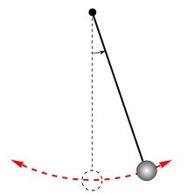
Variables: Example
For the Question,
“How does changing the length of a pendulum affect the time it takes to swing?”
The manipulated variable is the
.
The responding variable is the
.

Slide 16
Variables: Example
For the Question,
“How does changing the length of a pendulum affect the time it takes to swing?”
The manipulated variable is the length.
The responding variable is the
.

Slide 17
Variables: Example
For the Question,
“How does changing the length of a pendulum affect the time it takes to swing?”
The manipulated variable is the length. The responding variable is the time.

Slide 18
Variables
All other variables that are kept the same are called controlled variables.

Slide 19
Variables
All other variables that are kept the same are called controlled variables.
In the pendulum experiment, what would you have to control?

Slide 20
Variables
All other variables that are kept the same are called controlled variables.
In the pendulum experiment, what would you have to control?
the angle from which the pendulum is dropped, the mass of the pendulum, etc.

Slide 21
Experimental Error
Because you can never control everything completely (what if there’s a wobble in the pendulum?), you should perform multiple trials and average the results.
This reduces the effect of experimental error
(error beyond the experimenter’s control).

Slide 22
Paper Helicopters
Today’s Question is,
“How does the length of the rotor blades affect the flight time of your paper helicopter?”
The manipulated variable is the
.
The responding variable is the
.

Slide 23
Paper Helicopters
Today’s Question is,
“How does the length of the rotor blades affect the flight time of your paper helicopter?”
The manipulated variable is the blade length.
The responding variable is the
.

Slide 24
Paper Helicopters
Today’s Question is,
“How does the length of the rotor blades affect the flight time of your paper helicopter?”
The manipulated variable is the blade length. The responding variable is the flight time.

Slide 25
Paper Helicopters
Today’s Question is,
“How does the length of the rotor blades affect the flight time of your paper helicopter?”
What variables would you have to control?

Slide 26
Paper Helicopters
Today’s Question is,
“How does the length of the rotor blades affect the flight time of your paper helicopter?”
What variables would you have to control?
design, drop height, etc.

Slide 27
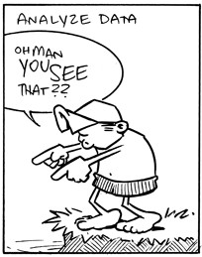
Step 5
Analyze Data
(often using graphs)

Slide 28
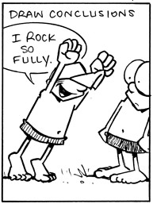
Step 6
Draw Conclusions
(Your conclusion should answer the Question.)

