Slide 1
An Introduction to SNC 2P1

Slide 2
Assessment & Evaluation:
Term work: 70%
Culminating Activities: 15% At the end of each unit
Final Exam: 15%

Slide 3
Term Work: 70% of final mark
Unit Tests:
Labs & Assignments:
Quizzes Daily Work
Labs and Assignments may have an in-class independent quiz component.

Slide 4
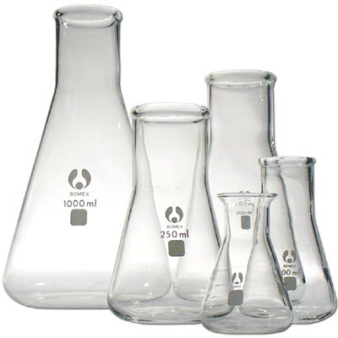
Strand A: Scientific Investigation Skills
Students will demonstrate skills related to planning and performing investigations, recording and analysing data, and communicating results.

Slide 5
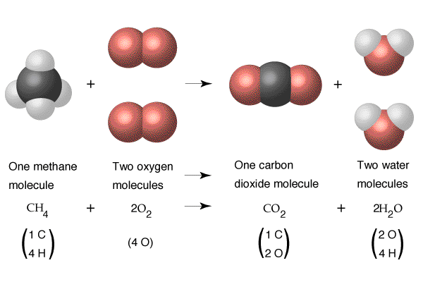
Strand C: Chemical Reactions
Students will demonstrate, through investigation, an understanding of the characteristics and practical applications of chemical reactions.

Slide 6
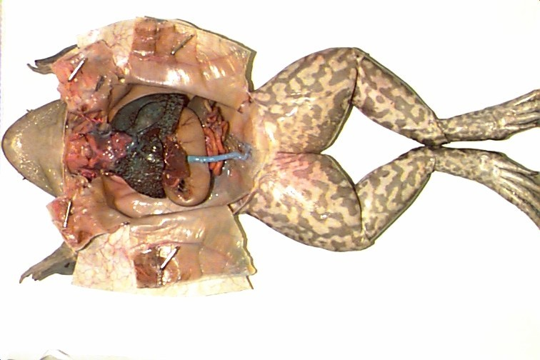
Strand B: Tissues, Organs, and Systems
Students will demonstrate, by investigation, an understanding of cells, the organization of systems in animals, and technologies that can impact health.

Slide 7
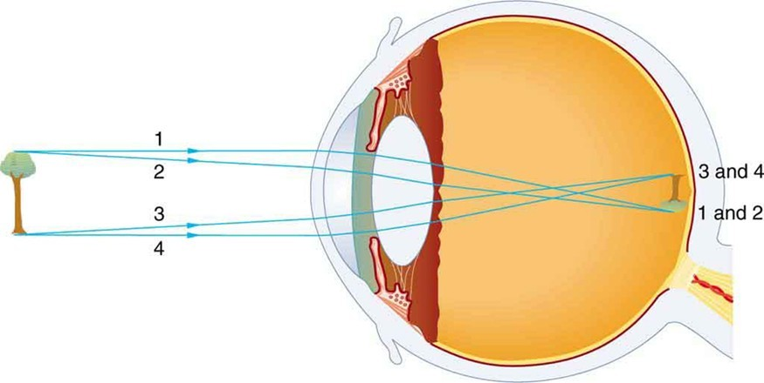
Strand E: Light and Optics
Students will demonstrate, by investigation, an understanding of the properties of light and the application of these properties in various technologies.

Slide 8
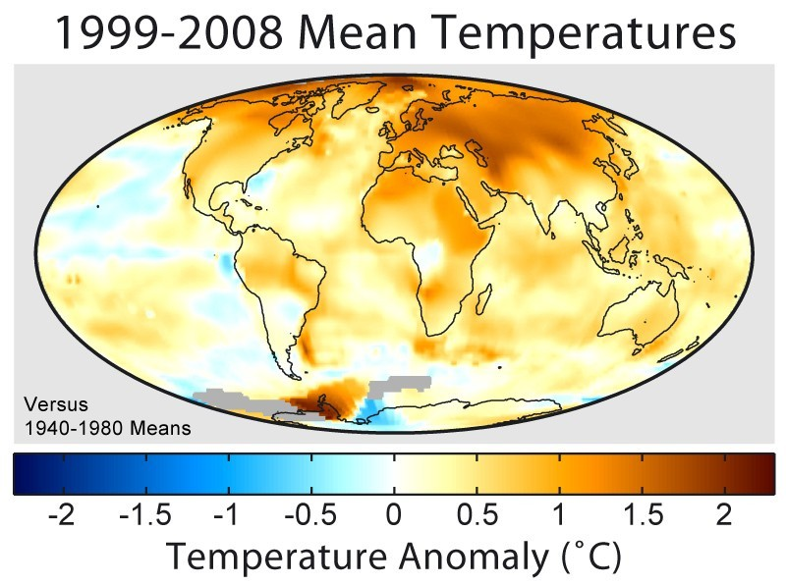
Strand D: Earth’s Dynamic Climate
Students will demonstrate, by investigation, an understanding of the properties of light and the application of these properties in various technologies.

Slide 9
SAFETY PRACTICES FOR SCIENCE CLASSES
Food and drinks may not be brought into the lab.
Coats & bags may not be brought into the lab.

Slide 10
SAFETY PRACTICES FOR SCIENCE CLASSES
Food and drinks may not be brought into the lab.
Coats & bags may not be brought into the lab.
Safety glasses must be worn when using Bunsen burners or hazardous chemicals.
Students must stand up during lab work.
Accidents must be reported to the teacher.
Long hair must be tied back.
Wash hands after contact with chemicals.
Keep lab bench clutter to a minimum to prevent accidents.
Students may not enter the science office.
Never leave a lit Bunsen burner unattended.

Slide 11
Absences: Tests
An absence on the day of a test must be fully accountable (through a dated, written note from a parent or guardian). An unexplained absence during a test will result in a mark of zero.

Slide 12
Absences: Laboratory Activities
The expectations in science courses call for an active, experimental approach to learning, with all students participating regularly in laboratory activities. Laboratory activities can reinforce the learning of scientific concepts and promote the development of the skills of scientific investigations and communication. At the discretion of the teacher, students may be required to make up any missed lab work.

Slide 13
Safety Sheets
Students will not be allowed to participate in laboratory activities until they have completed the safety quiz and returned a safety sheet signed by a parent or guardian to indicate that the student understands and agrees to abide by the departmental safety rules. Lab activities that a student misses are expected to be made up independently by the student.

Slide 14
Work Completion
All assignments & labs are to be handed in by the date assigned. Late assignments will receive a 10% mark deduction. No assignments will be accepted after the marked assignments have been handed back to the rest of the class.

Slide 15
What to bring to class:
C R E P P

Slide 16
What to bring to class:
Calculator (scientific) R
E P P

Slide 17
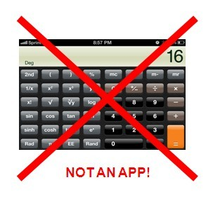
What to bring to class:
Calculator (scientific) R
E P P

Slide 18
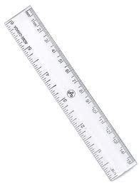
What to bring to class:
Calculator
Ruler 12" see through is most useful E
P P

Slide 19
What to bring to class:
Calculator Ruler Eraser
P P

Slide 20
What to bring to class:
Calculator Ruler Eraser Pencil
P

Slide 21
What to bring to class:
Calculator Ruler Eraser Pencil
Paper
3 holes to fit in a binder

