Slide 1
SBI4U BIOCHEMISTRY
Atoms, Bonding &
Molecular Polarity

Slide 2
6 types of atoms make up 99% of all living organisms
Naturally Occurring Elements in the Human Body
Element | Symbol | Atomic # | % of human body weight
Oxygen | O | 8 | 65.0
Carbon | C | 6 | 18.5
Hydrogen | H | 1 | 9.5
Nitrogen | N | 7 | 3.3
Calcium | Ca | 20 | 1.5
Phosphorus | P | 15 | 1.0
Potassium | K | 19 | 0.4
Sulfur | S | 16 | 0.3
Sodium | Na | 11 | 0.2
Chlorine | Cl | 17 | 0.2
Magnesium | Mg | 12 | 0.1

Slide 3
Atoms and Elements
Matter is any substance in the universe that has mass and occupies space
All matter is composed of extremely small particles called atoms, which is the smallest unit of any given element.
Every atom has the same basic structure:
Subatomic Particles
Core nucleus of protons and neutrons
Orbiting cloud of electrons

Slide 4
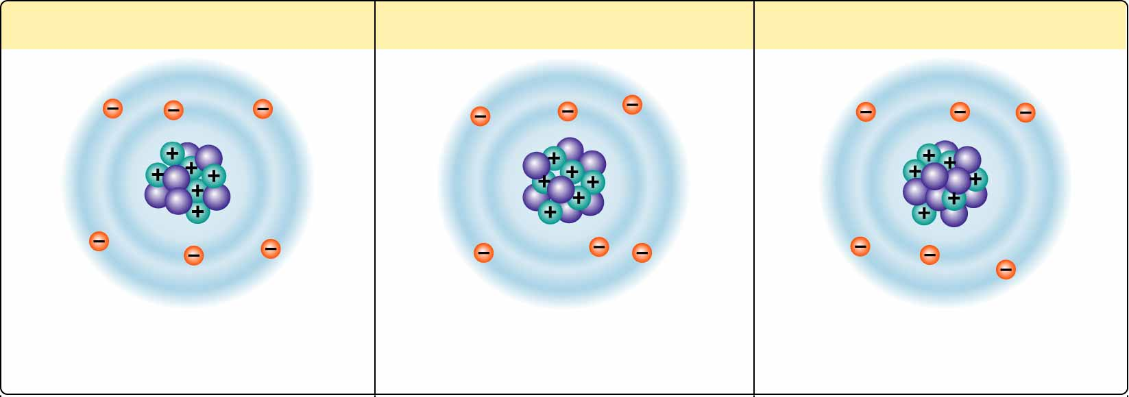
Isotopes are atoms of the same element that vary in the number of neutrons.
Nonradioactive carbon-12
Nonradioactive carbon-13
Radioactive carbon-14
6 electrons
6 protons
6 neutrons
6 electrons
6 protons
7 neutrons
6 electrons
6 protons
8 neutrons
Because they have the same number of electrons, all isotopes of an element have the same chemical properties.

Slide 5
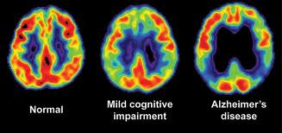
Radioisotopes
Unstable isotopes are radioactive and are called radioisotopes
Using radioisotope tracing doctors can trace the movement of radioactive material through the body
metabolism of radioactive glucose in a PET scan (left), indicated in yellow and red. The levels of glucose metabolism in the brain are decreased in patients with mild cognitive impairment (middle) and with Alzheimer's disease (right). (Cindee Madison and Susan Landau/UC Berkeley)

Slide 6
Why are electrons so important?
The chemical behavior of an atom is determined by its electron configuration – that is, the distribution of electrons in the atom’s electron shells.
The chemical behaviour of an atom depends mostly on the number of electrons in its outermost shell. (= valence electron/shell)
All atoms with incomplete valence shells are chemically reactive.

Slide 7
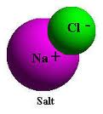
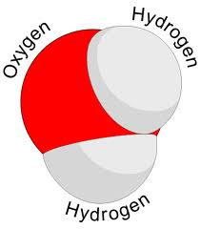
Atoms bond to form compounds
Compounds are made up of at least 2 different kinds of atoms (e.g., H₂O)
Bonds are formed by the sharing or transfer of electrons
Ionic Bonds
2 Types of
Chemical Bonds
Covalent
bonds

Slide 8
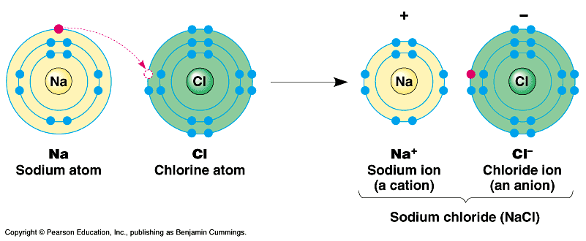
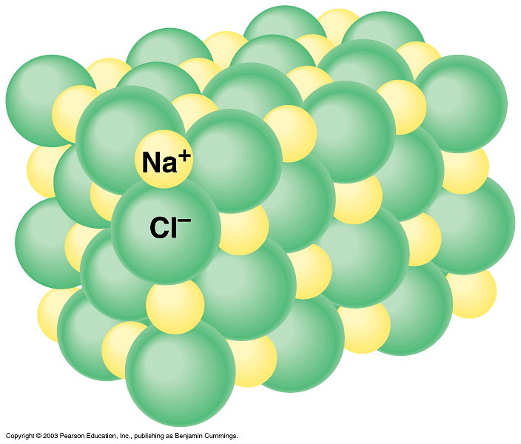
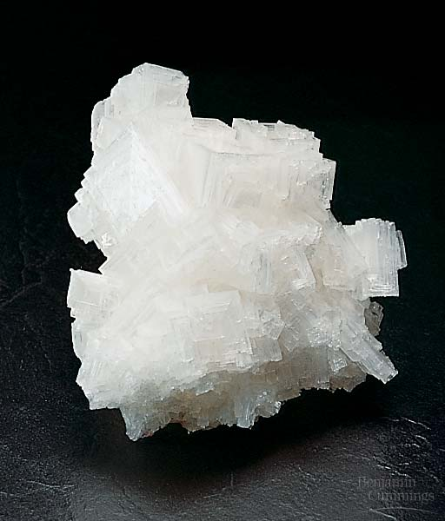
Ionic Bonds – occur when one atom donates or gives up one or more electrons
Opposite charges attract to form ionic bonds
Salt crystals
Ionic Compound ( Na⁺Cl⁻)

Slide 9
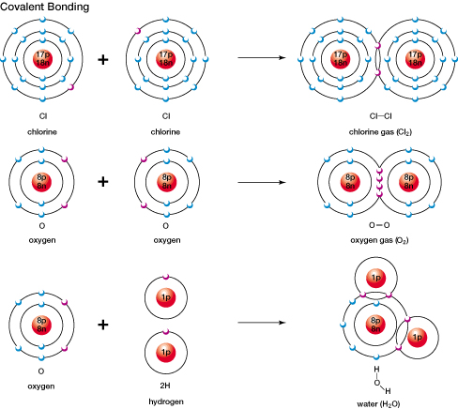
Covalent Bonds – involve a sharing of a pair of valence electrons between atoms.
Figure. 1.5, p.10

Slide 10
2 Types of Covalent Bonds
Polar Covalent
Non-polar covalent
Unequal sharing
of electrons
Equal sharing
of electrons
E.g., H₂O
E.g., H₂
O₂
Determined by the atoms
ELECTRONEGATIVITY

Slide 11
Electronegativity
the measure of the relative abilities of bonding atoms to attract electrons
In a non-polar covalent bond, there is no electronegative difference. Electrons are shared equally. E.g., O₂ oxygen atoms have the same elecronegativity
In a polar covalent bond, there is an electronegative difference. Electrons are shared unequally. E.g., H₂O oxygen atom is more electronegative than the hydrogen atoms
Electronegativity = Stronger pull of shared electrons

Slide 12
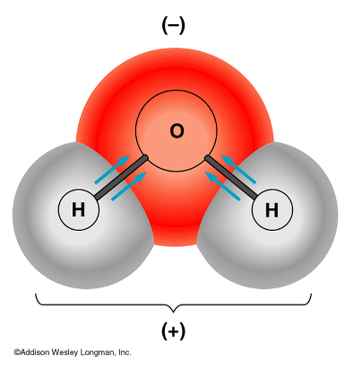
Shared electrons spend more time near the the oxygen nucleus
As a result, the oxygen atom gains a slightly negative charge and the hydrogen atoms become slightly positive
Water is a polar molecule because oxygen is more electronegative than hydrogen, and therefore electrons are pulled closer to oxygen.

Slide 13
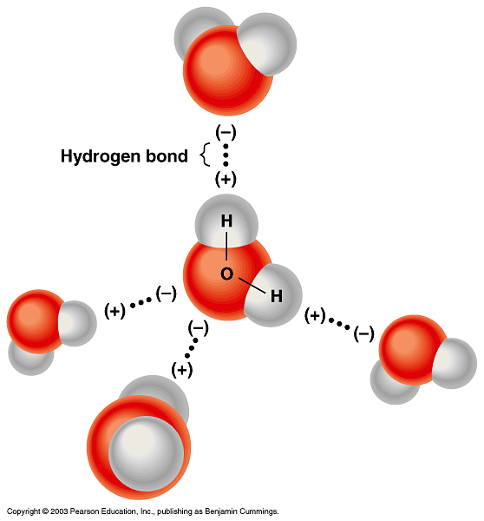
Polar Molecules (like water) have an unequal distribution of charge.
Since water is polar,
it can attract other
water molecules.
The attraction between
water molecules are
called hydrogen bonds.
Hydrogen bonds are weak forces between molecules

Slide 14
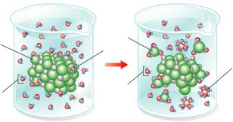
Solubility of Substances in Water
Due to water’s polarity, it is a great solvent. A solvent is a substance in which a solute dissolves. A solute is what is being dissolved.
What is happening in the example below?
Cl⁻
Cl⁻
Na⁺
Na⁺
Water
Water
Water is great at dissolving both ionic (+,-) compounds and polar (partial
positively, partial negatively charged molecules) molecules.

Slide 15
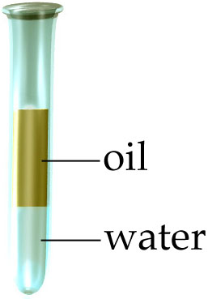
Solubility of Substances in Water
Hydrophilic (means water-loving) compounds interact with water by dissolving in it.
E.g., Anions (chloride ions) in salt attracted to + poles of water
Hydrophobic (means water-hating) compounds do not interact with water because they cannot form hydrogen bonds
E.g., Non-polar compounds are insoluble in water
Oil – non-polar compound of carbon and hydrogen
http://www.sumanasinc.com/webcontent/animations/content/propertiesofwater/water.html

