Slide 1
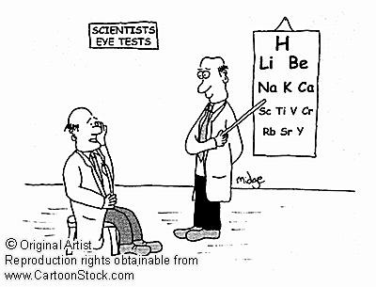
Periodic Table

Slide 2
Important facts
Arrangement of elements in order of increasing atomic number such that the elements show related chemical properties
The periodic table arranges elements by:
  into vertical columns called groups – group number tells the number of electrons in the outermost shell ie the number of valence electrons. There are 18 groups
  horizontal rows called periods – period tells the number of shells or energy level. There are 7 periods

Slide 3
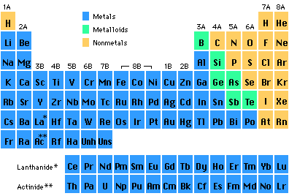
Groups in the Periodic Table
Elements in groups react in similar ways!

Slide 4
Periods in the Periodic Table

Slide 5
Important facts cont’d
Groups are numbered from 1 to 18.
Elements within groups share similar properties and chemical behaviour
Elements in the upper right area of the table are non-metals
Elements to the left and middle are metals
Elements that appear along a “staircase line” running from the top of group 13 to the bottom of group 16 are metalloids—elements that share characteristics of metals and non-metals

Slide 6
Family of Elements
Alkali Metals - Group 1
  Lithium - Li
  Sodium - Na
  Potassium - K
  Rubidium - Rb
  Cesium - Cs
  Francium - Fr

Slide 7
Group 1 – Alkali Metals
Very reactive metals that do not occur freely in nature.
Have only one electron in their outer shell.
Ready to lose that one electron in ionic bonding with other elements. Follows the octet rule.
Have a valency of +1
malleable, ductile, and are good conductors of heat and electricity.
The alkali metals are softer than most other metals.
Cesium and francium are the most reactive elements in this group. Alkali metals can explode if they are exposed to water

Slide 8
Alkaline Earth Metals -Group 2
- Beryllium - Be
Magnesium -Mg
Calcium - Ca
Strontium - Sr
Barium - Ba
Radium - Ra

Slide 9
Group 2 cont’d
All alkaline earth elements have an valency of +2s
Have two electrons in their outer shell.
Ready to lose those two electron in ionic bonding with other elements.
malleable, ductile, and are good conductors of heat and electricity.
Very reactive. Because of their reactivity, the alkaline metals are not found free in nature

Slide 10
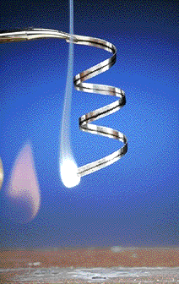
Magnesium
Magnesium oxide

Slide 11
Group 3-12 Transition metals
Sc →3,
Ti →3,4
V→2, 3, 4, 5
Cr→2, 3, 4, 6
Mn→ 2, 3,4, 6, 7
Fe →2, 3
Co → 2, 3
Ni →2
Cu →1, 2
Zn →2
Form coloured ions
Form complexes
Have variable valency
Show catalytic activity

Slide 12
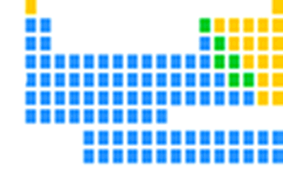
Transition Elements
Lanthanides and actinides
Iron in air gives iron(III) oxide

Slide 13
Metalloids
Boron B
Silicon Si
Germanium Ge
Arsenic As
Antimony Sb
Tellurium Te
Polonium Po

Slide 14
Metalloids
Metalloids have properties of both metals and non-metals.
Some of the metalloids, such as silicon and germanium, are semi-conductors. This means that they can carry an electrical charge under special conditions.
This property makes metalloids useful in computers and calculators

Slide 15
Group 13 - Boron Family
Boron – B
Aluminium – Al
Gallium – Ga
Indium – In
Thalium - Tl
have three valence electrons, they have a valency of 3+
are metallic (except boron, which is a solid metalloid)
- are soft and have low melting points (except boron, which is hard and has a high melting point)
- are chemically reactive at moderate temperatures (except boron)

Slide 16
Group 14 - Carbon Family
Carbon – C (non-metal)
Silicon – Si (metalloid)
Germanium – Ge (metalloid)
Tin – Sn (metal)
Lead – Pb (metal)
Have four electrons in their outermost energy level.
are relatively unreactive
Valency of (± 4)
tend to form covalent compounds (tin and lead also form ionic compounds)

Slide 17
Group 15 – Nitrogen Family
Nitrogen – N (nonmetals)
Phosphorous – P (nonmetals)
Arsenic – As (Metalloids )
Antimony – Sb (Metalloids)
Bismuth – Bi – Metals
have five valence electrons, need 3 more electrons
to satisfy the octet rule → have a valency of (3-)
Form covalent compounds
solids at room temperature, except nitrogen

Slide 18
Group 16 – Oxygen Family
Oxygen (O)
Sulfur (S)
Selenium (Se)
metalloid tellurium (Te) and one metal polonium (Po)
have six valence electrons, need two more electrons
to satisfy the octet rule → have a (2-) valency
tend to form covalent compounds with other elements
Non-Metals

Slide 19
Group 17 – Halogens/Halides
nonmetals and occur as diatomic in nature
Occur mainly as metal halides
Fluorine – F₂, gas
Chlorine – Cl₂, gas
Bromine - Br₂, Liquid
Iodine – I₂, solid
Astatine – At₂ , solid
seven valence electrons, needs only one more have
electron for the octet → valency of -1
tend to gain one electron to form a halide, X- ion, but also share electrons
are reactive, with fluorine being the most reactive of all nonmetals

Slide 20
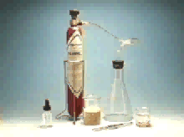

Slide 21

Group 18 – Noble gas / Inert gases
Helium –He
Neon –Ne
Argon – Ar
Krypton – Kr
Xenon – Xe
Radon – Rn
not reactive
have a full outer energy level
are all gases
are all nonmetals

Slide 22
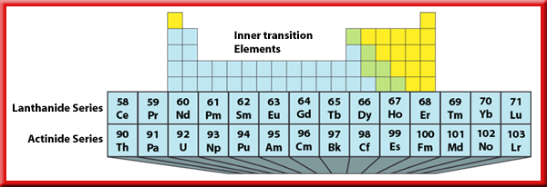
Inner Transition Elements
There are two series of inner transition elements.
The first series of elements, from cerium to lutetium, is called the lanthanides.
The second series of elements, from thorium to lawrencium, is called the actinides.

Slide 23
The Lanthanides
The lanthanides are soft metals that can be cut with a knife.
The elements are so similar that they are hard to separate when they occur in the same ore, which they often do.
The Actinides
All the actinides are radioactive.
The nuclei of atoms of radioactive elements are unstable and decay to form other elements.

Slide 24
Periodic Trends
Atomic radius
Ionic radius
Ionization energy
Electron affinity
Electronegativity
Metallic and nonmetallic character

Slide 25
Atomic radius
Atomic radius – size of an atom
Increases down a group – more shells, electrons added further from nucleus, more shielding effect
Decreases across a period – same # of shells, same # of protons and electrons are added, electrons feel a greater pull.
What about the shielding effect?

Slide 26
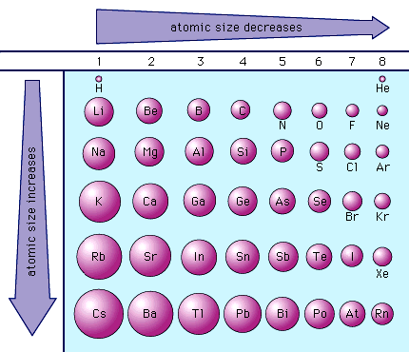

Slide 27

Ionic radius – page 52
Increases down a group
Decreases across a period
Cations (positively-charged ions)
Cations are smaller than their parent atom because the same number of protons in the nucleus pulls on less electrons.
Metals commonly become cations.
Anions (negative ions)
Anions are larger than their parent atom because the same number of protons in the nucleus pulls on more electrons.
Nonmetals commonly become anions.

Slide 28
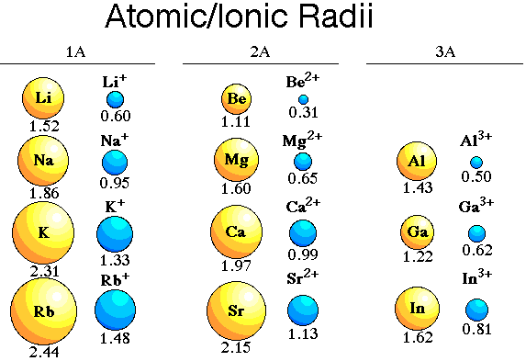

Slide 29
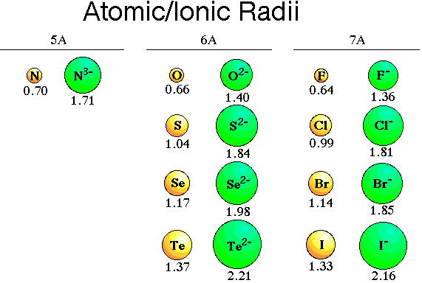

Slide 30
Ionization energy
Ionization energy (IE) is the amount of energy required to remove the outmost electron
IE decreases down a group -the size of the atom increases, shielding increases.
IE increases across a period. More protons in the nucleus create greater nuclear pull where shielding remains the same.
The energy needed to remove a second electron from an atom is always greater than that to remove the first. After the first is removed, the protons have greater pull on each of the remaining electrons. Also, there is always a jump in the IE when removing an inner shell electron--the greatest nuclear pull exists in the inner shell.

Slide 31
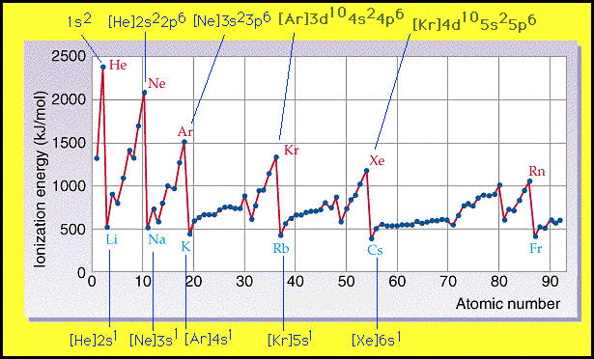

Slide 32
Electronegativity
Electronegativity (EN) is the attraction of an atom in a compound for an electron.
The scale for this characteristic was developed by Linus Pauling. The scale shows that fluorine is the most electronegative element at 4.0. The scale can be used to determine the type of bond that will form between two atoms.
Decreases down a group
Increases across a period.
Group 18 is again an exception.

Slide 33
Electron affinity
The energy change that occurs when an atom gains an electron
Decreases down a group
Increases across a period.
Exceptions to this rule is group 18. Group 18, the noble gases, have essentially no electron affinity.

Slide 34
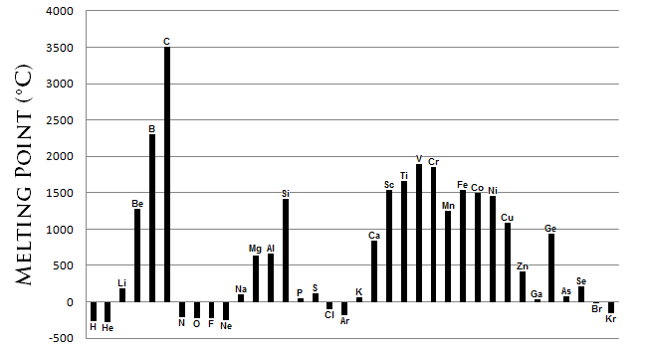
Melting point
Metals - the melting point for metals generally decreases as you go down a group.
Non-metals - the melting point for non-metals generally increases as you go down a group.

Slide 35
Reactivity
Metals
Period - reactivity decreases as you go from left to right across a period.
Group - reactivity increases as you go down a group
Why? The farther to the left and down the periodic chart you go, the easier it is for electrons to be given or taken away, resulting in higher reactivity.
Non-metals
Period - reactivity increases as you go from the left to the right across a period.
Group - reactivity decreases as you go down the group.
Why? The farther right and up you go on the periodic table, the higher the electronegativity, resulting in a more vigorous exchange of electron.

Slide 36
Oxides of metals
The oxides of metals are basic , basicity increases down a group
The oxides of non- metals are acidic, acidity decreases down a group

Slide 37
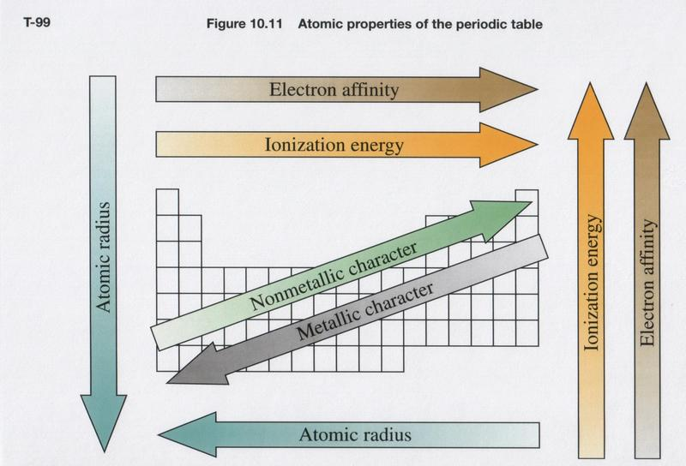

Slide 38
Other trends
For other trends please see the following links on the “myclass” web site
  – periodic trends on the site - http://www.geocities.com/CapeCanaveral/Lab/4097/chem/chap4/periodictrends.html
  Questions - http://www.sciencegeek.net/Chemistry/taters/Unit2PeriodicTrends.htm
  Trends notes-http://www.mwiseman.com/courses/common/notes/atom/PeriodicTable1.pdf
  Periodic table and trends questions – http://www.unit5.org/christjs/periodtablequest.doc
Please complete worksheet – “Periodic table Exercises” in your groups

